Slide 1
seaLandings Daily Trip Report Logbook
January 2024

Slide 2
Agenda
01.
eLandings staff and the eLandings Program
seaLandings 2024 Training
eLandings Interagency electronic reporting system for commercial fishing in Alaska
02.
Installing seaLandings
03.
Where to get help
04.
Navigating the Logbook
05.
Important Updates and Future Development
06.
IFQ and CDQ Reporting
Notes:
Agenda items for today
First we will cover eLandings staff and program introductions to the dedicated eLandings staff and an overview of the seaLandings program
Second we will discuss Installing seaLandings this will include step by step guide on installing seaLandings, ensuring a seamless integration for your operation
3 Where to get help We will review resources and support channels for any queries or challenges encountered while navigating the seaLandings logbook
4 New and Noteworthy items We will explore the latest features and updates in seaLandings
5 IFQ and CDQ Reporting In-depth coverage of IFQ and CDQ reporting processes, ensuring compliance and accuracy

Slide 3
Program Management and Support
Your eLandings
Support Staff
Sara Villafuerte
Amy Hadfield
eLandings Program Manager
Lifelong Fisheries Experience
Claire Minelga

Slide 4
Program Management and Support
Your eLandings
Support Staff
Amy Hadfield
Claire Minelga
eLandings Support
Contractor, 12 years experience in fisheries
Sara Villafuerte

Slide 5
Program Management and Support
Your eLandings
Support Staff
Claire Minelga
Sara Villafuerte
eLandings Support
Contractor, 20+ Years experience
Amy Hadfield
Notes:
Hello, I am Sara Villafuerte, a contractor associated with Wostmann and Associates. I have had the privilege of supporting NMFS and contributing to the dynamic landscape of ALaska fisheries Today I am excited to share insights and expertise gained over these 20 plus years as we navigate through the intricacies of seaLandings and electronic reporting.

Slide 6
How do I get the new seaLandings release for 2024?
Download from the eLandings Wiki page - lots of bandwidth required
Pick up a thumbdrive from NMFS in Dutch Harbor
Request a thumbdrive mailed to you directly - Contact us at eLandings@alaska.gov
Notes:
Sara - Let's discuss the ways you can obtain access to the 2024 sealandings release.
The first option is to access the new sealandings release by downloading it from the eLandings wiki page. This method requires a substantial amount of bandwidth for a smooth download.
Secondly, you can conveniently get the sealandings 2024 release by picking up a thumbdrive from the NMFS office in Dutch Harbor. Krista ensures that these are accessible by taping them to the door in case you visit during her absence
Lastly if you prefer a mailed option you can email eLandings staff and request a thumb drive be sent directly to you.

Slide 7
Installation
Notes:
Today we will review the installation process for seaLandings, we will first show you the step by step process of installing seaLandings from the thumbdrive, then we will demo a live installation of seaLandings from the wiki link. Let’s dive right into the step by step process and make your seaLandings installation a breeze

Slide 8
Reminder: seaLandings Installation Requirements
Admin Rights are required to install seaLandings.
You must have a 64 bit machine to run seaLandings software.
You need the seaLandings user ID and password to install.
Notes:
Sara -Let’s start with some universal reminders: To install seaLandings ensure you have administrator rights on your computer. In the absence of administrator rights, contact your IT department for assistance.
If your IT manager is installing sealandings remotely, please provide them with your user ID and password in order to complete the full installation. If you are unsure of your password, you can try logging into eLandings online at elandings.alaska.gov and using your known credentials to log in.
Sealandings requires a 64 bit computer for installation and optimal performance. Ensure your system meets this requirement before proceeding.

Slide 9
SeaLandings Installation and Setup for the new year
If you want eLandings staff to help you with installation, please feel free to reach out to us for one on one assistance.
Email: eLandings@alaska.gov to set up an appointment
-OR-
Call Sara: 907-227-2147
Call Claire: 907-953-9695
Business hours: Monday - Friday 0800-1630
Notes:
For assistance with seaLandings installation or support questions throughout the year don't hesitate to reach out to us directly. We're here to help and ensure a smooth experience.

Slide 10
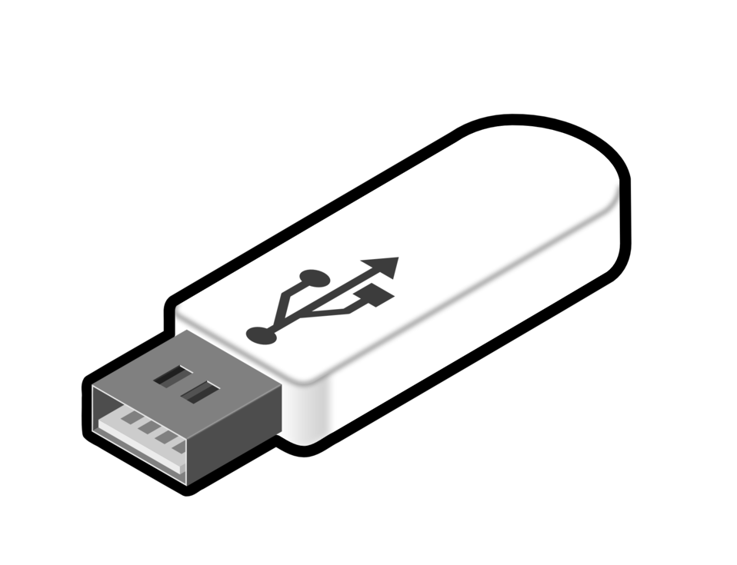
Preparing for Installation
Full demonstration of an installation using a thumb drive with a computer running 2023 seaLandings
The installation process looks the same for everyone! Old and new Users!
Notes:
Ok, let’s get into the actual installation now. Before beginning the installation process ensure that the sealandings program is closed.
Next insert your thumb drive into the USB port of your computer

Slide 11
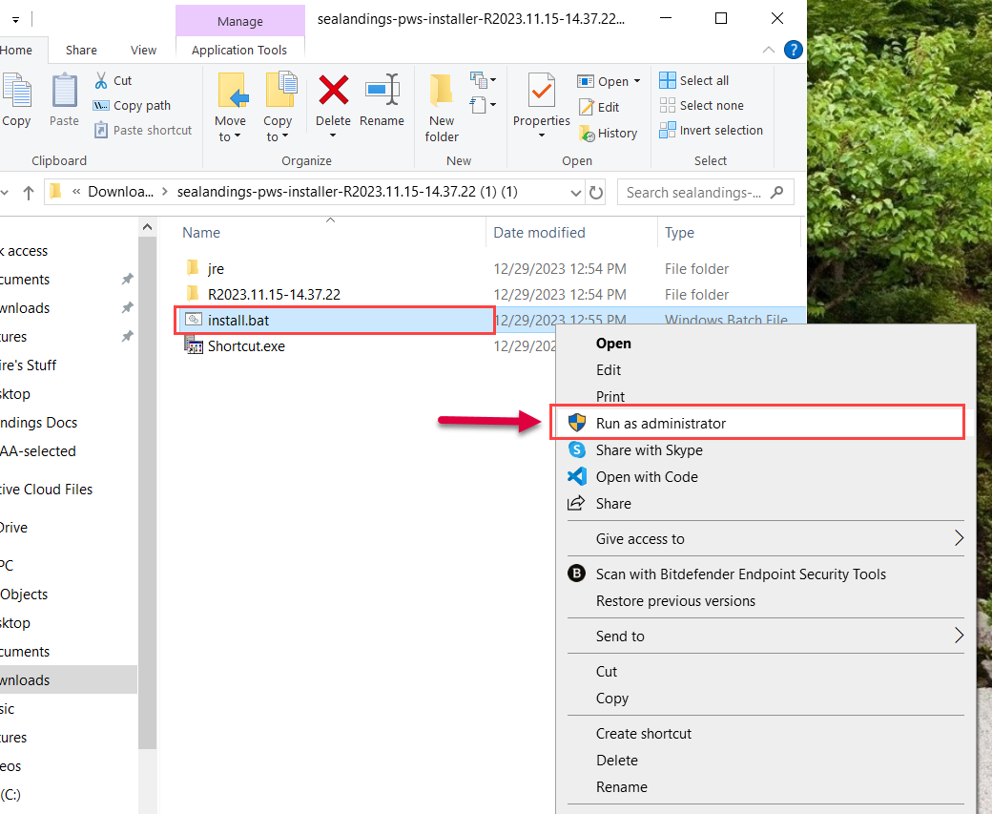
Installation Process
Notes:
After inserting the thumb drive, a window will open
Navigate to the seaLandings folder within the window and double click to open
Find the install.bat file in the seaLandings folder
Right click on the install.bat file, then select Run as Administrator from the drop down menu
A window will open asking if you want to allow sealandings to make changes to your computer. Select Yes to proceed

Slide 12
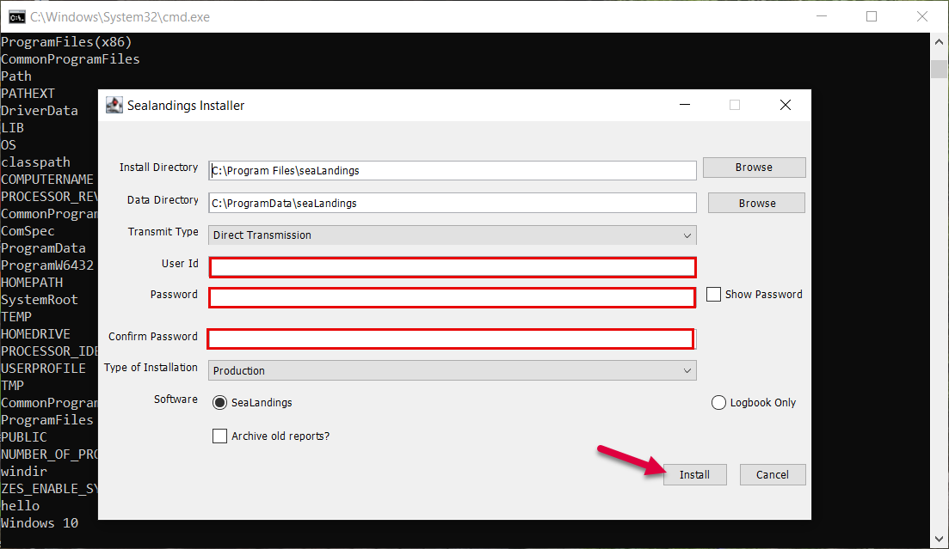
Installation Process
Notes:
After running as an Administrator, a black dialogue window will open, initiating the installation process.
When prompted enter your user name and password. Confirm the password when requested.
Ensure the default transmit method is set to “Direct.” If you cannot transmit over a direct connection select the File Transmit Method
Be aware that the File Transmit method will be retiring in the future
Next click on the install button to commence the installation process.
Be patient during the installation The installation usually takes a few minutes. Please refrain from closing any open windows during this period.

Slide 13
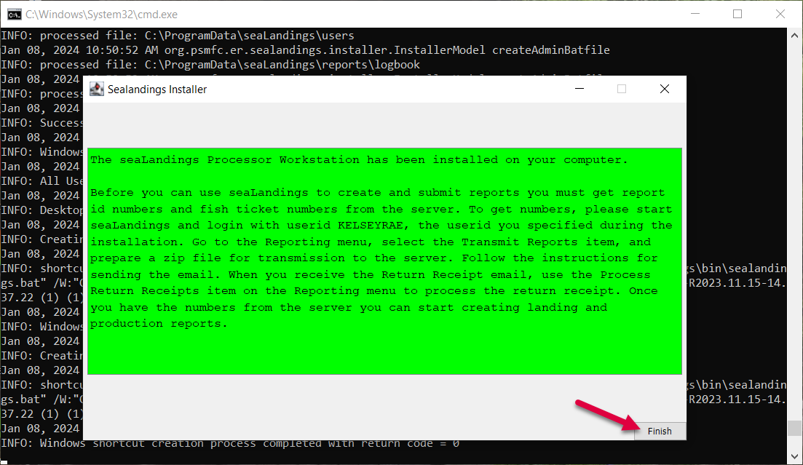
Installation Process
Notes:
Upon successful installation, you should see a green screen. This indicates that the installation is complete, and you are good to go.
If you encounter a red screen it’s a signal to stop. Contact us immediately and we’ll troubleshoot and resolve the issue with you.
After successful installation you can close any remaining windows that might be open from the installation process.
Your successful installation is our priority. In case of any issues, reach out to us for prompt assistance.
DEMO Installation

Slide 14
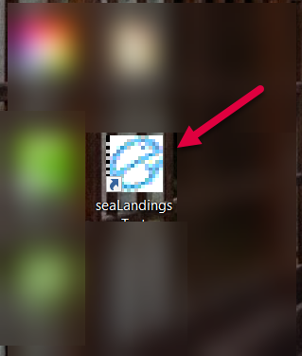
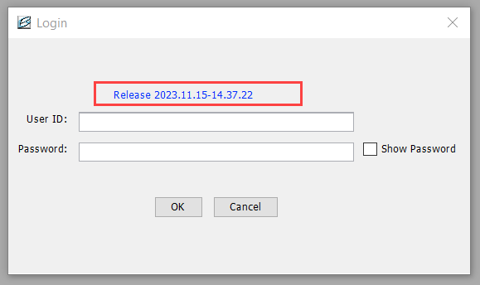
Installation Process
Notes:
Now that you’ve finished installing the software, let’s go through opening seaLandings right after installation and the steps to beginning your logbook for the year. Go ahead and find the seaLandings icon on your desktop, and double click to open. The login screen displays the software release details. Ensure that the release year displayed corresponds to 2023. This confirms a successful installation. Enter your user ID and password to log into the application. Once logged in you are ready to explore sealandings with the latest updates.

Slide 15
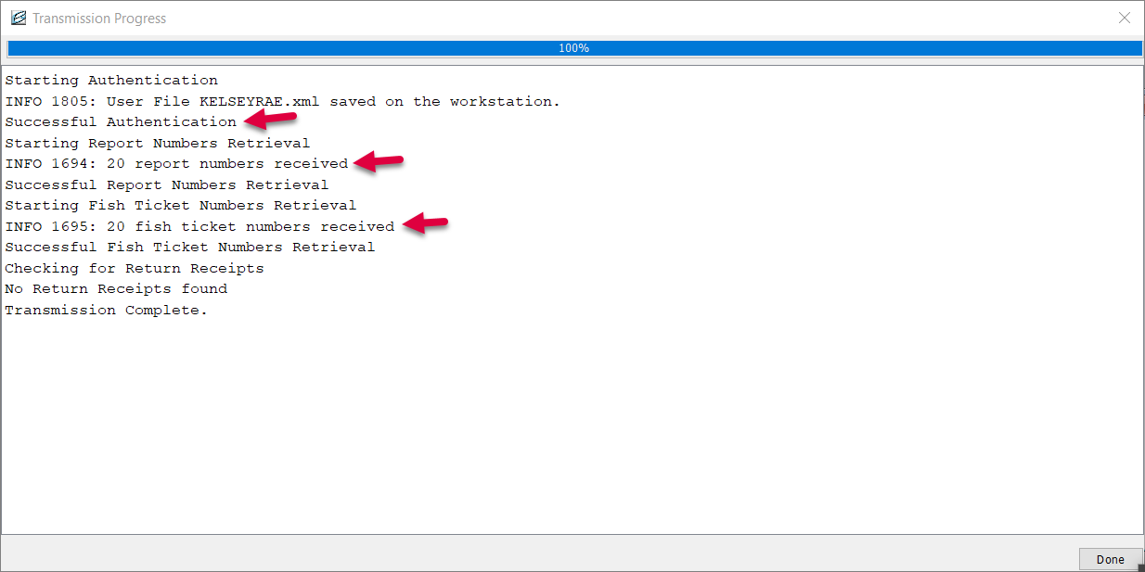
Notes:
When you sign in to seaLandings, a transmission window will open immediately. This window initiates a user authentication transmission. A progress bar at the top will indicate the status of the process. Once the transmission completes, carefully read the details in the user authentication transmission to confirm a successful authentication.
If authentication fails, a common problem is entering the password incorrectly during the sealandings installation.
In case of failure, follow the previous steps to reinstall seaLandings with the correct password ensuring a successful user authentication.
This picture here is an example the user authentication was successful, and report numbers have been received.
With a confirmed authentication process proceed to the next step by clicking Done.

Slide 16
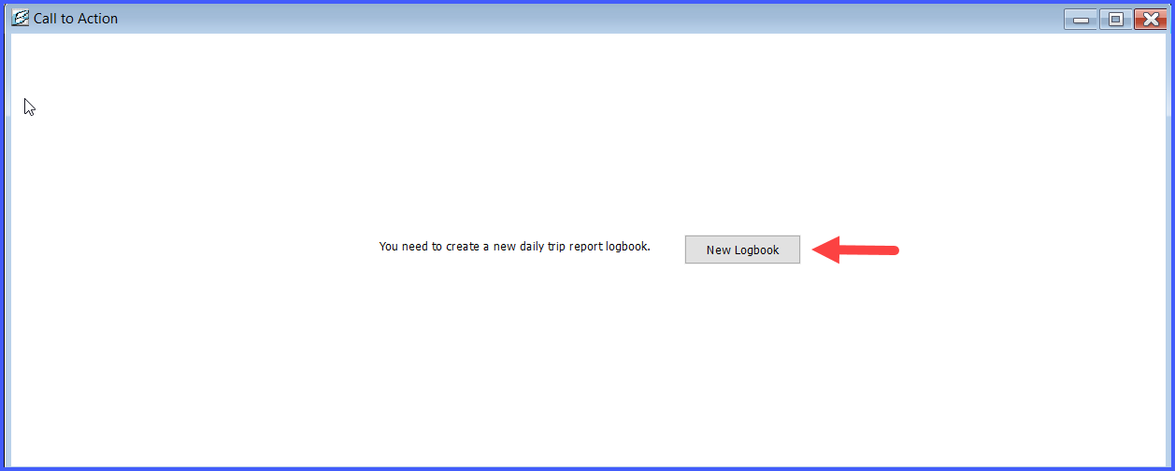
Register a Logbook Profile for a New DTR Logbook
The Logbook Wizard will prompt you to register for the 2023 year
If you have already been using a Daily Trip Report Logbook, you won’t need to register a new logbook. Close this window!
Notes:
If you’ve never used the Daily Trip Report Logbook before, you’ll be prompted to register a new logbook
The logbook wizard will guide you through creating a new Daily Trip Report Logbook. Follow the steps for a seamless set up.
If you are a veteran seaLandings user and see this Call to Action window, close the window.
Go to Reporting, Transmit Reports, uncheck any reports in the transmission window, then click Transmit.
This sends a request to the server, and your existing logbook profile should be sent to you.
If these steps don’t grant you access to your logbook, please contact us directly for further assistance

Slide 17
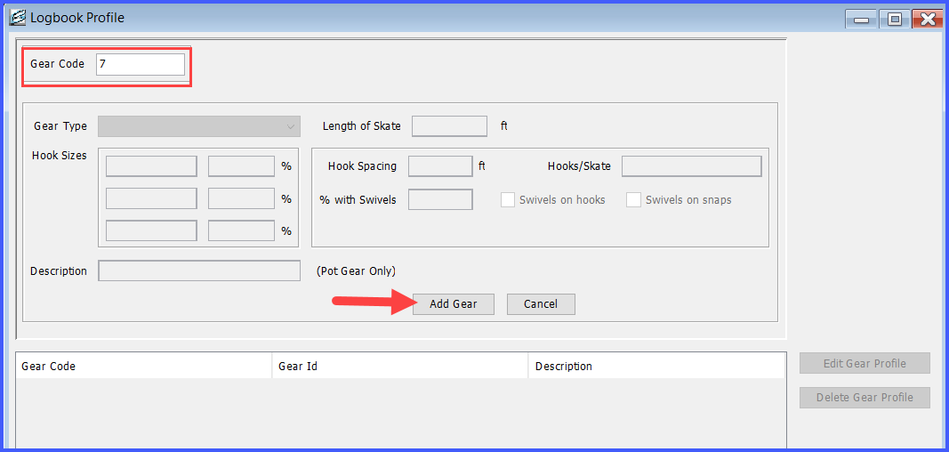
Add your first gear profile!
You can always add more profiles later.
Established Users do not need to add a gear profile each year. Gear Profiles roll over between years
Logbook Profile Gear Information
Notes:
For a new seaLandings user, the next thing you will be asked to do is to create a logbook profile and add a gear profile.
If you are not installing SeaLandings for the first time and have historical data in the Daily Trip Report you don’t need to enter new gear code information.
Gear codes entered in previous years do not expire. You’ll find that historically entered gear codes remain available to you from year to year, ensuring continuity in your logging process.

Slide 18
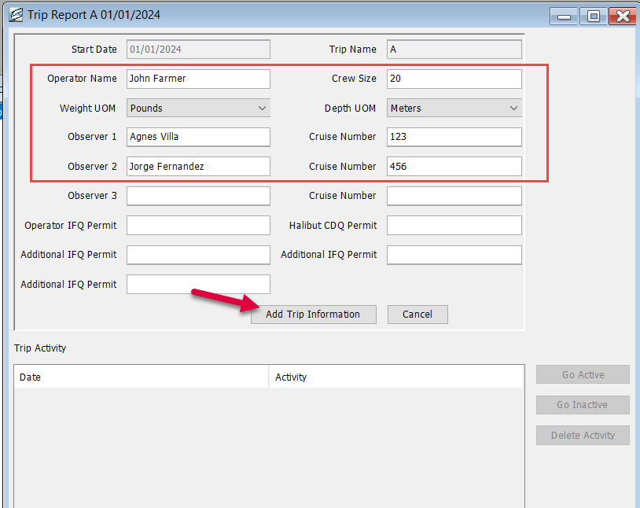
Trip A
Notes:
For both new and old users the first thing you will need to do in your logbook is start a new trip for the year. Everyone’s start date for their first trip of the year will always be January 1st. Enter the following Information
vessel operators name
crew size
weights unit of measure
depth unit of measure
Observers Names and crew numbers.
Include any IFQ or CDQ permits associated with the trip
After entering all relevant details, click the Add Trip Information button to complete the creation of your new Trip report.

Slide 19
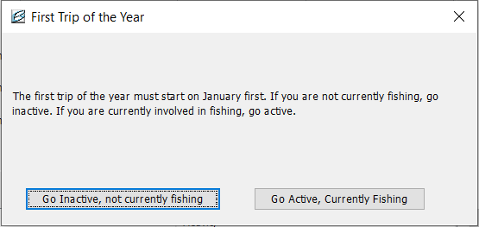
Inactive or Active?
Notes:
You will need to indicate whether you are Active or Inactive. If you are currently inactive, you have the flexibility to go active and update the status later. Simply navigate and edit your Trip Report to designate yourself as active on a certain date.

Slide 20
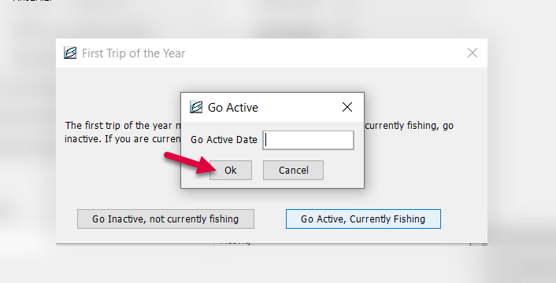
Go Active
Notes:
When transitioning to an active status, the system will prompt you to specify the date on which you went active
Enter the relevant date to accurately reflect when you resumed or started your fishing activities within the system.
Definition of activity

Slide 21
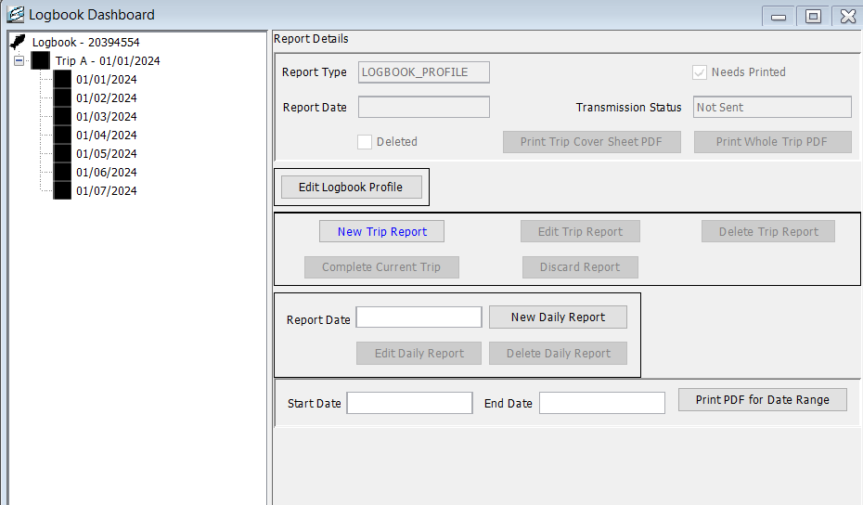
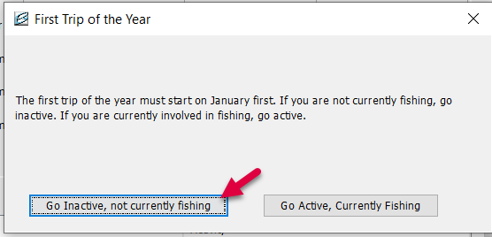
Go Inactive
Notes:
If you initially selected an inactive status when creating your first trip for the year and indicated that you are not currently fishing an important visual cue will be displayed
From January 1st to the current date black boxes with be reflected in the date tree. These black boxes signify that there was no fishing or processing activity recorded on those specific days during the indicated inactive period. When your fishing activity begins you can either start a new trip or edit the trip report to reflect the date you went into active fishing activity.

Slide 22
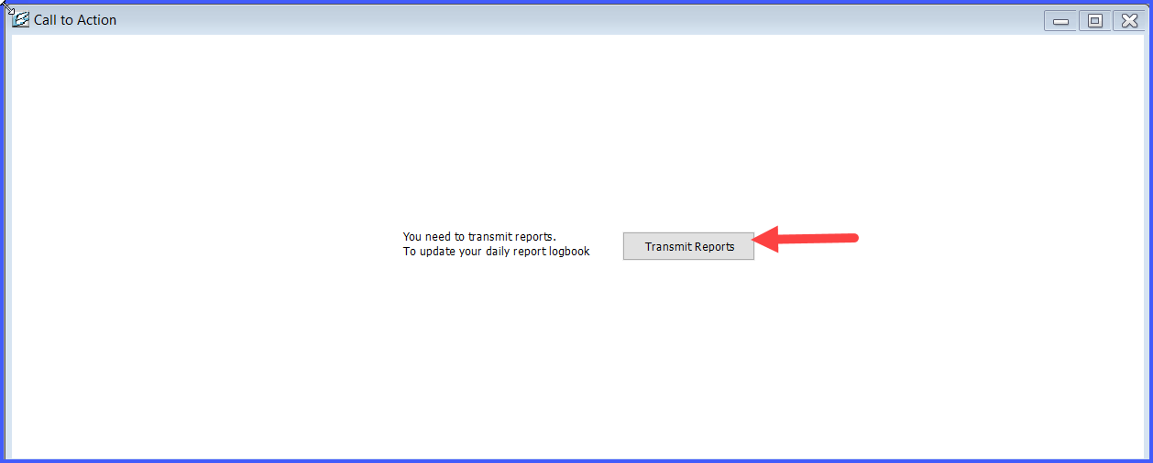
Transmit Reports
Notes:
The concluding action involves transmitting your logbook reports. You will be prompted to transmit your logbook reports to ensure that your recorded data is submitted to the server. This step ensures the comprehensive completion of your report entries and contributes to accurate record-keeping.

Slide 23
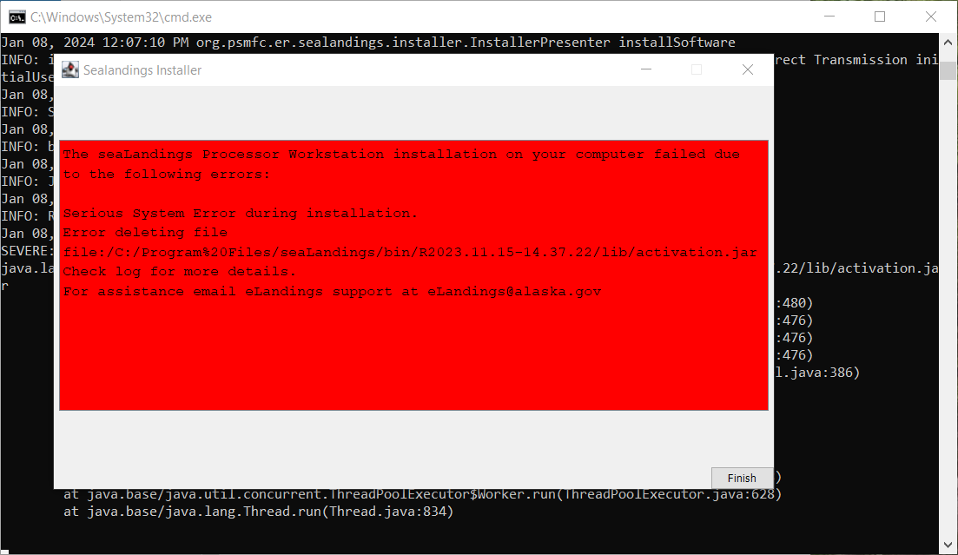
Common Installation Problems
Notes:
Claire - Before we move on from the topic of installation, we wanted to bring up a couple of common installation problems. The first regularly encountered installation problem is that you receive a “Serious system error” during installation. This could be due to the seaLandings application running in the background. Confirm all sealandings windows are closed and then click Finish to attempt the installation again.

Slide 24
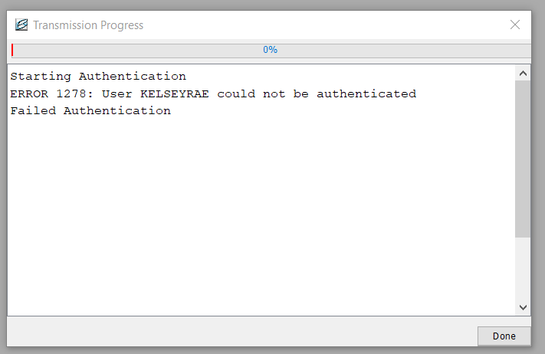
Wrong Password/ Authentication Error
Notes:
Claire - Another common installation problem is if you got all the way up to sending that first transmission and then you encounter an error stating User could not be authentication Error 1278 during transmission. This signals a potential authentication failure. Possible causes are incorrect installation with the wrong user ID or password. A frequent issue arises when your IT administrator resets your password during installation, but the change doesn’t synchronize with the server. Or there was a password change initiated without updating on the server.
Confirm the accuracy of your credentials by visiting elandings.alaska.gov and attempt to log in with your user ID and password to validate the information.

Slide 25
Register a Logbook Profile Prompt
Notes:
Claire -This third and final error happens for existing users only. If you have been using the Daily Trip Report Logbook and the system prompts you to create a new logbook profile, don’t do it! Logbook profiles transfer from year to year. Instead of following the prompts to create a new logbook, close the window and navigate to Reporting. Choose the Transmit Reports menu option to request logbook data from the server. After transmitting reports, go the Logbook and open your current year logbook. Your existing logbook profile should be accessible. If you still encounter issues please contact eLandings support and we can assist in sending you the necessary logbook data.

Slide 26
Where to Get Help
Email: eLandings@alaska.gov to set up an appointment
-OR-
Call Sara: 907-227-2147
Call Claire: 907-953-9695
Business hours: Monday - Friday 0800-1630
Notes:
We want to reiterate that whether you just want some one on one support during installation or if you enter the issues we’ve just discuss or something else entirely, we are here to help you.
Email us at eLandings@alaska.gov to schedule a personalized support or training session
You can also call us during regular business hours for prompt assistance.
Feel free to take down our numbers for any additional questions or concerns. We look forward to assisting you.

Slide 27
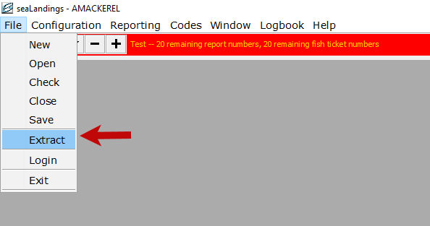
Logbook Data Extract Process
To extract your logbook data, navigate to File > Extract.
A new window will open and allow you to pick your date range you wish to extract.
Notes:
To extract logbook data, navigate to File and select Extract.
A new window will open, enabling you to choose your desired date range.
Use the drop down menu for quick options like “this week” or “today” to automatically populating the dates.
After selecting the date range, click ok
A copy of the extracted data will be saved in your sealandings Reports folder on your C drive.

Slide 28
Important Updates and Future Developments
End of file transmit proposed for 2025
NMFS is no longer accepting Ocean Logic logbooks
Deckhand Logbook is approved for use this year.
Pacific Cod Trawl (PCTC) Program Opens Jan 20.
ELandings Online changes
Notes:
We wanted to take a minute to discuss some of updates that might be important for you to know.
As mentioned earlier, the File email Transmit method approaching its end.
NMFS is longer supporting the Ocean Logic Logbook application. Users have been contacted to migrate to seaLandings as a supported platform.
A third party, Deckhand, now provides a logbook application endorsed by NMFS. Data entered into the Deckhand logbook will eventually integrate into the NMFS system.
Effective January 1 of this year the PCTC, or Pacific Cod Trawl Cooperative program, is available to users employing trawl gear and you will see this management program available to you.
We are actively developing a web version of the Daily Trip Report Logbook for our web based users. If you’re interested in being a beta tester and providing feedback on the look and feel of the logbook, please let us know. You can stay informed and be part of shaping the future of our logbook. Your input is valuable.

Slide 29
PCTC - Pacific Cod Trawl Cooperative Program
Those using PCTC and acting as a mothership will need to fill out the Delivery Haul Number when taking deliveries. For everyone else this is an optional field.
Notes:
For those of you who are participating in the PCTC program the biggest change you will see is that there is a new field on the deliveries tab of the daily trip report.
If you are a mothership receiving deliveries from vessels involved in the PCTC program, there are specific steps to follow. Select the appropriate management program and enter the management program ID on the delivery to ensure accurate record keeping. There is a new field, the Delivery Haul number. This information must be provided by the fishing vessel. The system validations prevent the same vessel and haul number combination to be used more than once per year to maintain data accuracy. This information is crucial for the observer program and reconciliation for any errors is expected to be undertaken by the Observer Program.

Slide 30
Common Problems
Notes:
Sara - We are going to address common challenges frequently encountered in reporting for the at sea fleet
Understanding and resolving these issues is crucial for maintaining accurate and efficient reporting practices

Slide 31
Addressing Duplicate Reports
Notes:
A common challenge we’ve identified is the occurrence of presumed duplicate reports within the At Sea Fleet. The state has flagged these reports and Claire and I are actively reconciling them. We will reach out to you to determine the accuracy of the reports and whether voiding one the reports is necessary.
We strongly caution against deleting reports from your sealandings folder without explicit instruction from us.
When you transmit a report to the NMFS server Deleting it from the sealandings application does not remove it from the server potentially leading to double debiting.
Before taking any action contact us to verify if a report needs voiding. Deleting without proper guidance may have many negative downstream effects.
Stay vigilant and communicate with us to ensure accurate and secure reporting practices.

Slide 32
Permitting
Processor Code Renewal
Federal Fisheries Permit Renewal cycle is this year.
Online Renewal Process
Notes:
Please ensure that your processor codes through the Dept of Revenue with the State are being renewed.
You will also want to note that it’s a renewal cycle year for the federal fisheries permit. Please confirm that your federal fisheries permit is renewed for year 2024. You can complete the renewal process conveniently through your online eFISH account.
Let’s do our best to stay compliant and updated by renewing both your state and federal permits for the year 2024

Slide 33
Registered Buyer Number
Verify Your Registered Buyer Number
Multiple Captain, Multiple Numbers
Update the Information on your operation
Notes:
Please verify and confirm the registered buyer number associated with your operation is accurate.
In cases where there are multiple captains there might be various registered buyer numbers. Ensure the one linked to the current vessel operation is the correct one on the profile.
If there is a need for updating or if you believe the associated number is incorrect, kindly email us with the correct information.
Ensuring accuracy in your permitting is crucial for a seamless landings.

Slide 34
Ensuring Accuracy in Production Reports
Incorrect Production Reports
Importance of accuracy
Reporting Essentials
Transmission before consolidated landing
Impact of errors
Notes:
A recurring problem we observe in electronic reporting is the submission of incorrect production reports. Accuracy is imperative for reliable landing data and precise catch accounting and management of the fisheries. Please ensure correctness in the management program, any modifiers, weights and statistical areas. If mistakes are made, instead of deleting the report or creating a new report, you can edit the existing report and retransmit to correct the report on the NMFS Server. Any edits or changes must be transmitted before generating your consolidated report. Help maintain data integrity by reporting production details accurately and transmitting changes promptly. Your diligence contributes to a robust reporting system

Slide 35
IFQ & CDQ Reporting
Notes:
As we near the conclusion of our presentation, we’ll now dive deeper into IFQ and CDQ reporting. We acknowledge that these aspects may not be applicable to everyone, as some of you might not be involved with either IFQ or CDQ management programs. For those not participating, we welcome any final questions from the group. However, if you are part of the IFQ or CDQ programs, we kindly ask you to stay on the line for this crucial segment of the training. Your active participation is valued as we navigate through this specific information.

Slide 36
CDQ Weekly Reporting
6 AAC 93.080. Reporting of CDQ program fishery harvest
A buyer of fish that, under AS 16.05.690 and 5 AAC 39.130, is required to record and report a purchase of fish shall also record and report the buyer's purchases of fishery resources that are harvested through a CDQ program. This shall be done in the manner required by AS 16.05.690 and 5 AAC 39.130 and other regulations adopted under that statute.
Notes:
Claire -If you are fishing CDQ sablefish the state requires that you submit a weekly report of your CDQ catch. You can complete this report using the consolidated report tool in seaLandings. The seven day period begins and ends on Sunday.
We will do a brief overview of the consolidated report tool just give an example.
6 AAC 93.080. Reporting of CDQ program fishery harvest
A buyer of fish that, under AS 16.05.690 and 5 AAC 39.130, is required to record and report a purchase of fish shall also record and report the buyer's purchases of fishery resources that are harvested through a CDQ program. This shall be done in the manner required by AS 16.05.690 and 5 AAC 39.130 and other regulations adopted under that statute.
https://www.touchngo.com/lglcntr/akstats/aac/title06/chapter093/section080.htm

Slide 37
IFQ & CDQ Reporting
CDQ Sablefish quota is debited from production reports
IFQ sablefish is debited by the IFQ report.
Notes:
it is important to understand that CDQ sablefish quota is debited from production reports, while IFQ sablefish is debited by the IFQ report.
When creating a consolidated report, make sure that your production reports reflect the correct weight and management programs, or your landing report will be incorrect.
Have your IFQ permit information and the permit holder’s personal NMFS ID ready to make the landing report. Company NMFS IDs will not work and often on Hired Skipper Permits the company’s NMFS ID is what will be printed on the permit.
Let’s walk through a consolidated IFQ/CDQ landing report together —--
Max out pounds

Slide 38
Consolidated Reports
Verify Production Reports are all submitted and reflect accurate data.
Have your IFQ permit information and the permit holder’s personal NMFS ID
Make sure you have the CFEC permits that coincide with the Management programs used on this trip.
Notes:
Just to reiterate, it's important when creating a consolidated report to make sure that your production reports reflect the correct weight, or your landing report will be incorrect. If you need to correct production report weights, make sure to edit and transmit them before generating your consolidated report

Slide 39
Questions?
elandings@alaska.gov
Notes:
We are opening the floor to questions. We have covered a lot of ground today. Do any of you have any final questions or concerns?

