Slide 1
seaLandings
Daily Trip Report Logbook
December 2019
Trawl Fleet

Slide 2
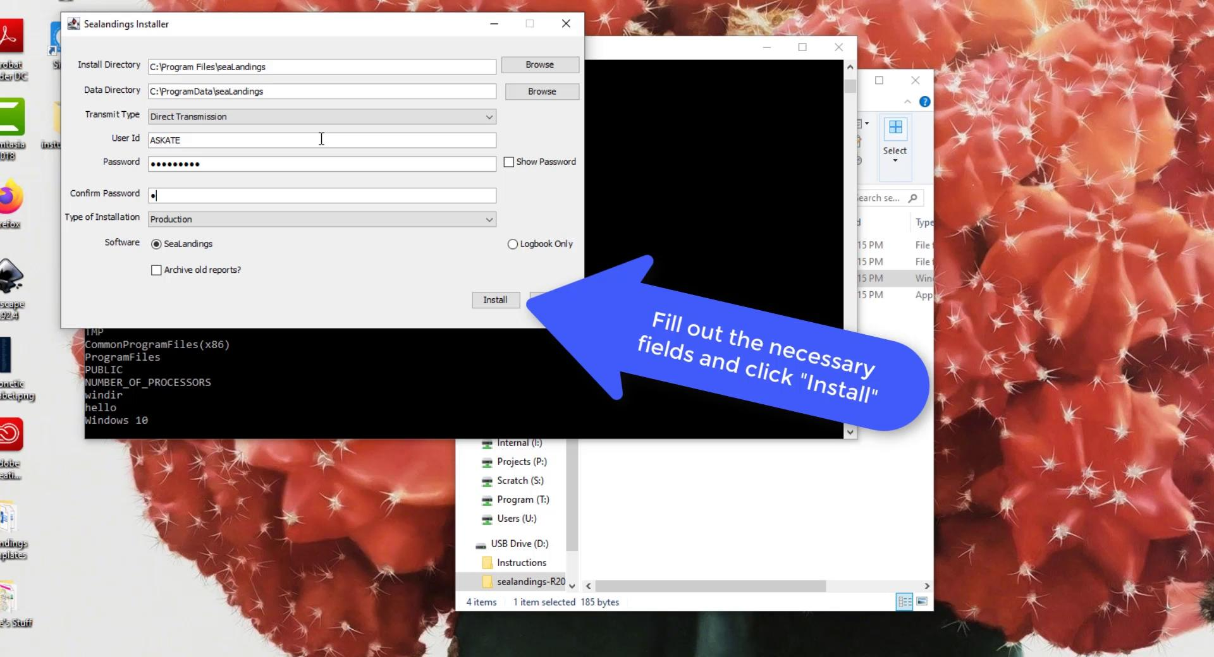
Installation from thumb drive

Slide 3
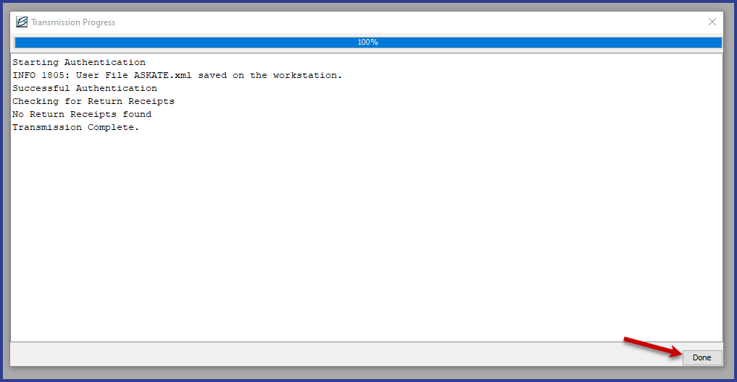
Register logbook profile for new DTR
Changes in registering a Daily Trip Report:
seaLandings will default to Direct Transmit Method
You will not be able to register a new Legacy Logbook
User authentication process will be automatic

Slide 4
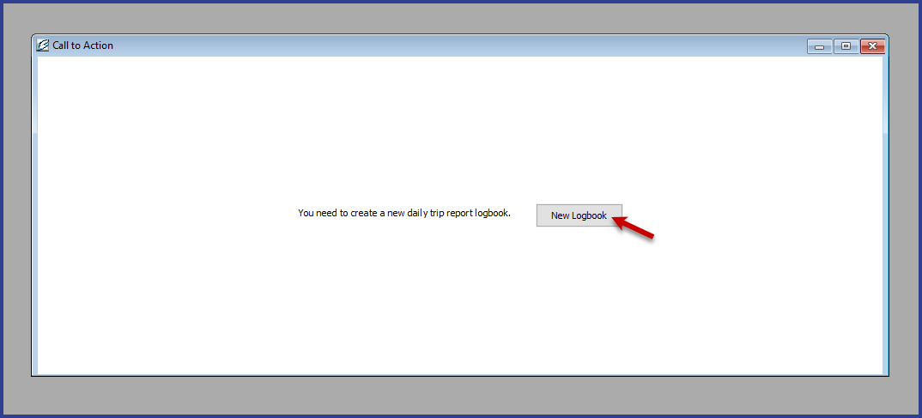
Register logbook profile for new DTR
The Logbook Wizard will prompt you to register for the 2020 year
If you have already been using a Daily Trip Report Logbook, you won’t need to register a new logbook

Slide 5
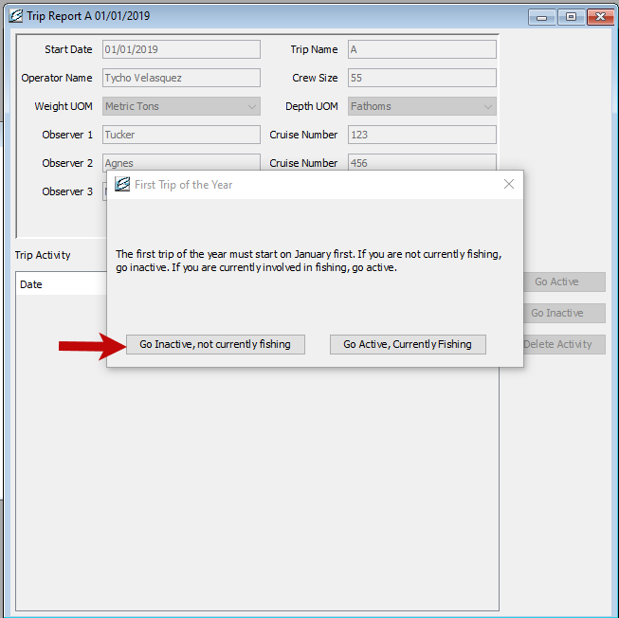
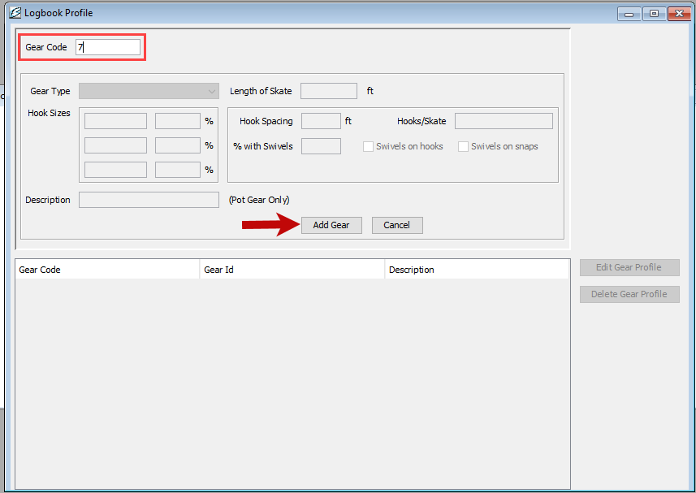
Logbook Profile and your first trip report
Add your gear profile!
You can always add more profiles later.
Your first trip of the year will always start on 01/01
You will be able to choose to go active or inactive

Slide 6
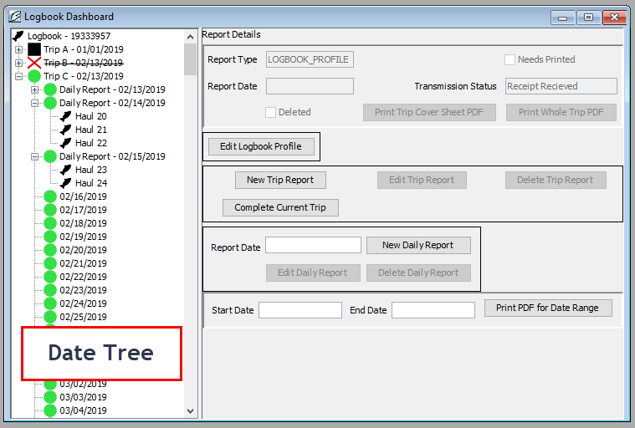
Logbook
Dashboard
The logbook dashboard is your main control center for the Daily Trip Report logbook. From here you can create a new trip, navigate through your logbook date tree, edit gear types, end a trip and more.

Slide 7
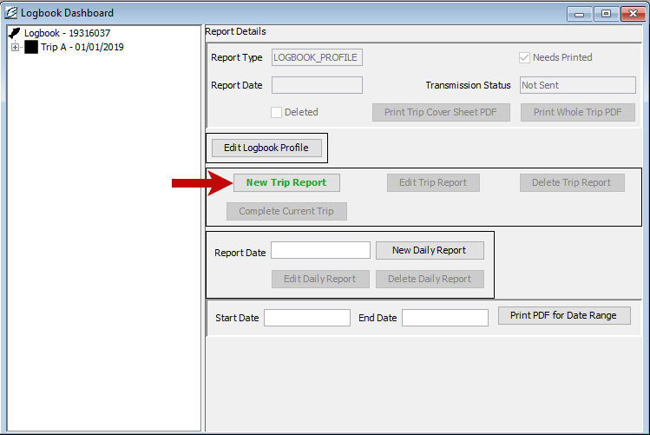
New Trip
To create a new trip, click on the “New Trip Report” on the logbook dashboard.
The new trip registration window will open and allow you to enter your trip details.
If you are inactive, you will be able to go active at this time.

Slide 8
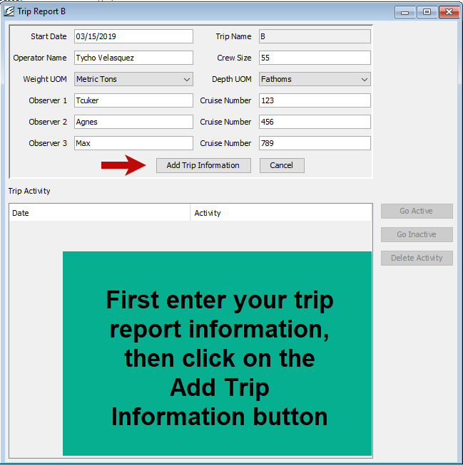
Go Active
When you click “Add Trip Information” a dialog box will open and ask you to confirm your go active date. Your go active date can be after your trip start date.

Slide 9
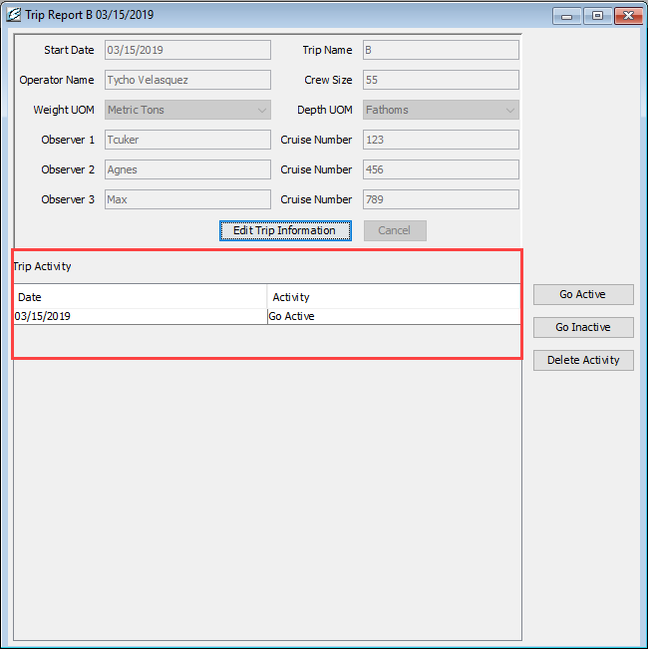
Trip Activity
Now you have created your new trip report B and you can see date you went active in the trip activity section.

Slide 10
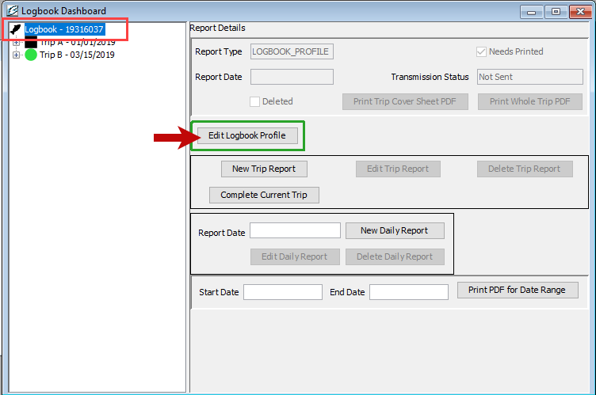
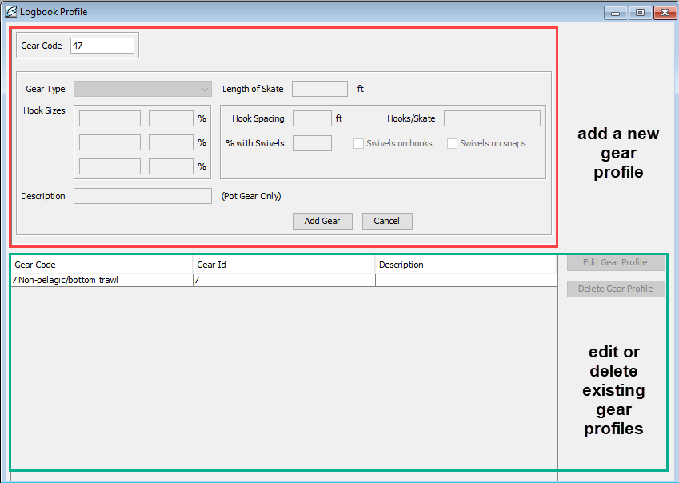
Gear Profile
You have the ability to add, edit, and delete gear profiles.

Slide 11
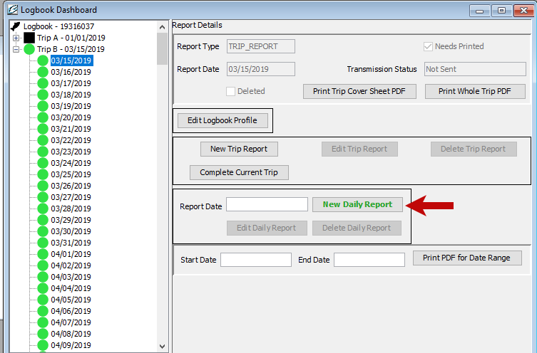
Flow Scale Test
To create a flow scale test you can create a new daily report or edit an existing daily report.

Slide 12
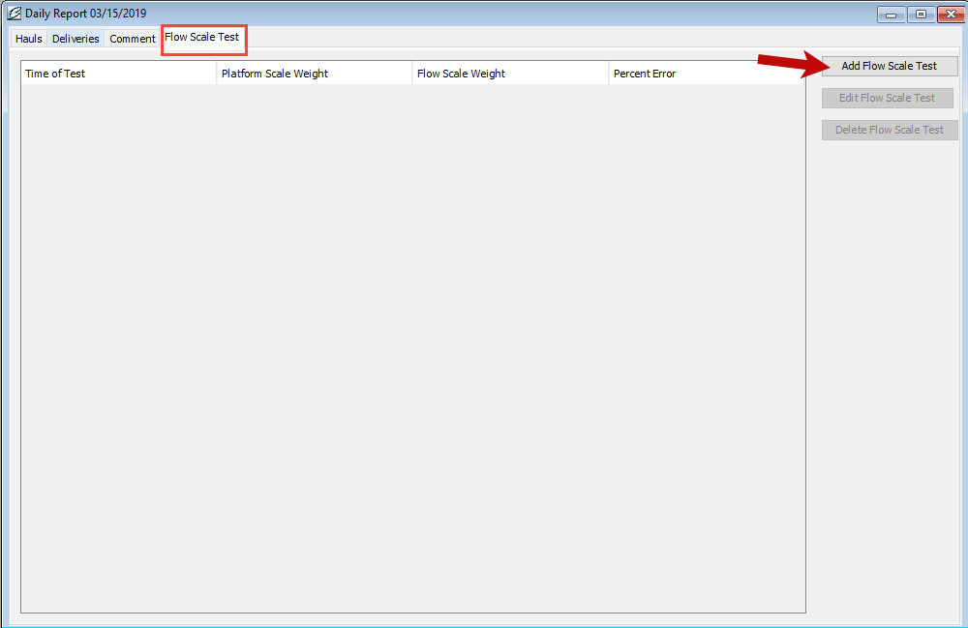
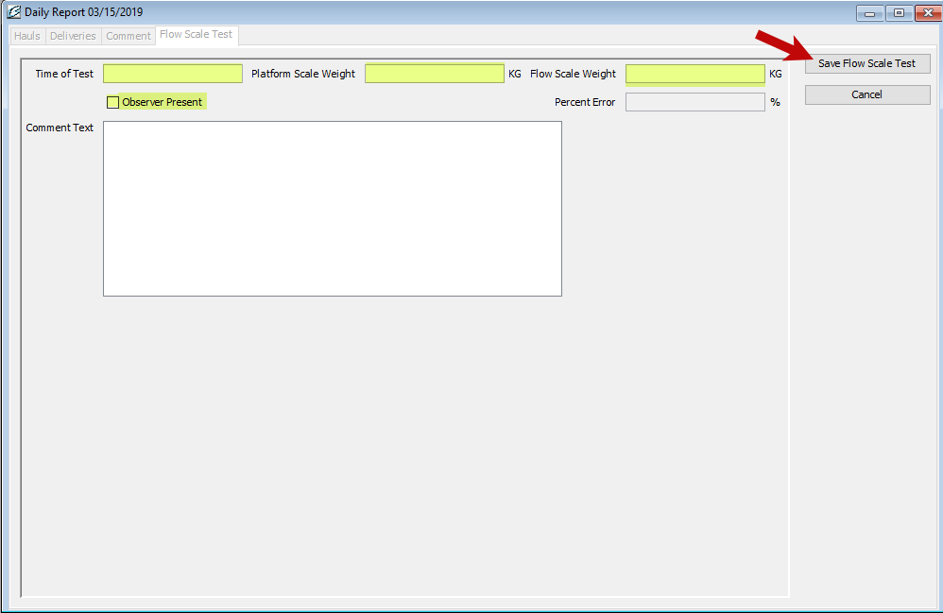
Add, Edit, Delete Flow Scale Test Entries
NOTE: All Pcod must go over the scale no matter how small the amount.
Select the Flow Scale Test tab and click on the Add Flow Scale Test button. After you enter your flow scale information click on the Save Flow Scale test button.

Slide 13
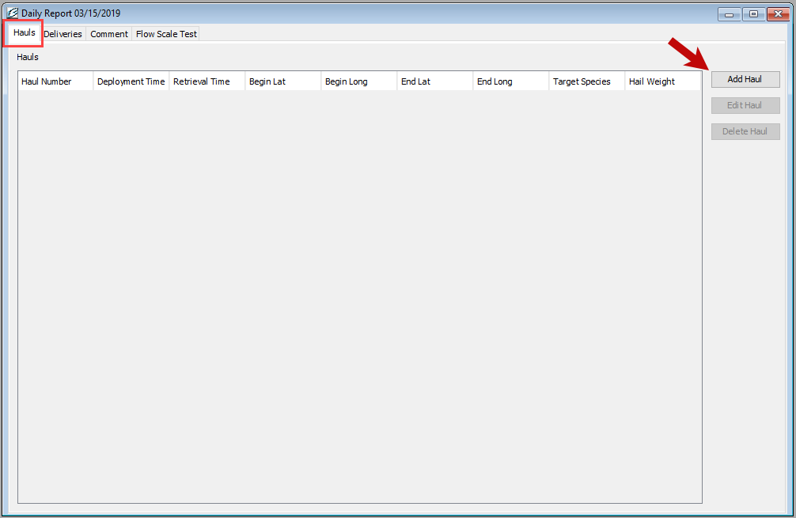
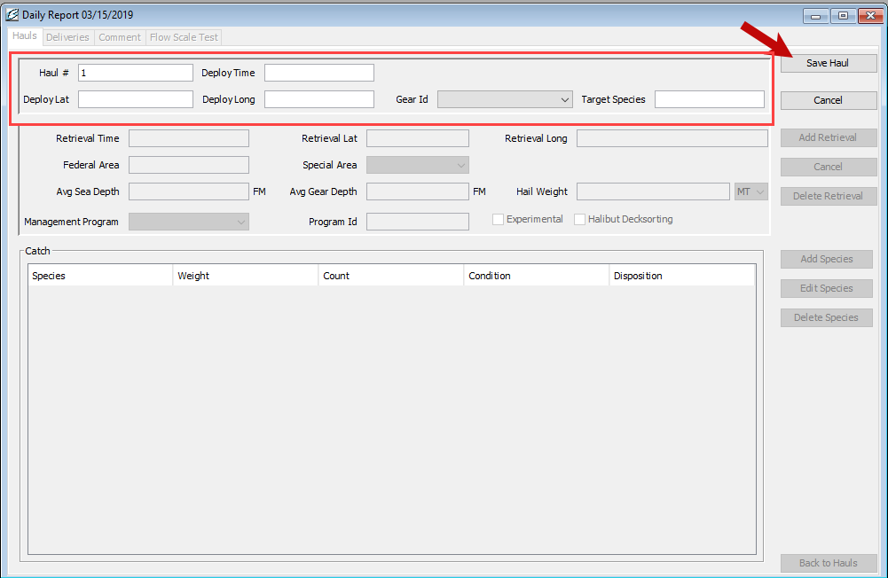
Adding Hauls
You now have the ability to easily add, edit and delete sets/hauls and catch entries.

Slide 14
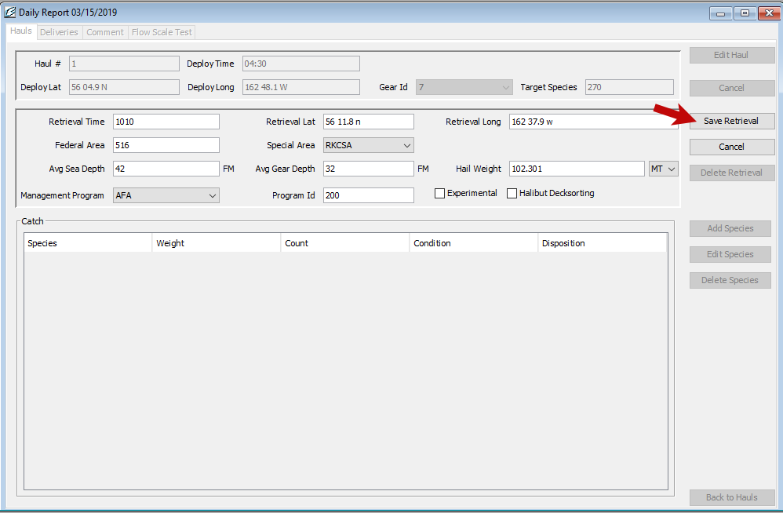
Retrievals
Retrieval information can be added, edited and deleted.
You will notice that some fields are filled in based on your previous retrieval entry, so it is important to review the data fields for any necessary updates.

Slide 15
Management Programs
Management program is a required field when entering report data. A detailed list of management programs and their accompanying IDs can be found within the seaLandings program if you click on the Codes link in the header.

Slide 16
AFA: Any AFA vessel that targets pollock and uses pelagic trawl gear in the Bering Sea should mark AFA as the management program.
Management program ID is required for AFA vessels: list 200 for CPs.
A80: Vessels that participate in the Amendment 80 limited access or Amendment 80 cooperative fisheries should select A80 as management program. If an Amendment 80 vessel is fishing their Sideboards in the Gulf of Alaska, they should select OA as the management program.
CDQ: Vessels fishing CDQ quotas should always select CDQ as their management program. A Management Program ID is also a required entry as each CDQ program has a different ID number.
OA: When a vessel is fishing open access or in the parallel fishery, even if they are in state waters while participating in parallel fisheries. Parallel fishing is inside 3 miles under a Federal opening.
RPP: Vessels that fish off the Rockfish Program quota should select RP as management program.
If fishing outside of areas 620 & 630 select OA as the management program.
When catch is not coming off a Rockfish Program quota, i.e. fishing their Sideboards, select OA or another applicable management program.
SMPC: If a vessel fishes for cod in state waters, the crew should choose SMPC as management program.
One exception is when their catch is coming off their CDQ quota, in which case they should mark CDQ as management program.
SMPC should not be marked when a vessel is participating in the parallel fishery, even if that vessel is in state waters.
SMPC should only be marked when Federal fisheries are closed. One example is when a vessel is fishing for state cod in the Aleutian Islands or Gulf of Alaska.
You should report AISWW as Special Area when your vessel is fishing in the Aleutian Islands state waters for cod when the Federal fishery is closed.
AISWW should not be marked when fishing in parallel waters.

Slide 17
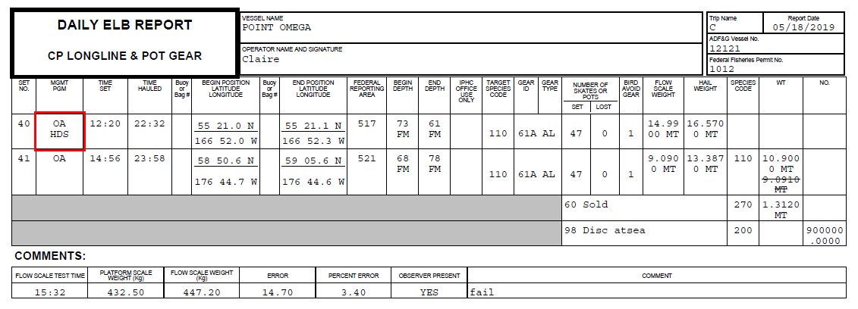
Halibut Deck Sorting

Slide 18
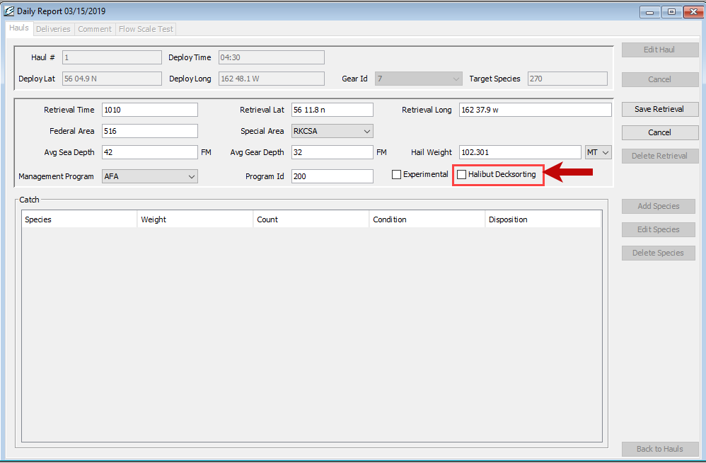
Halibut Deck Sorting
1. The operator of a catcher/processor or mothership must record the following information in the electronic logbook (eLogbook):
a. In the "Management Program" section of the logbook, record the appropriate management program code (e.g. CDQ, A80, OA, RPP, etc).
b. Use the "Halibut Decksorting" check-box to indicate that halibut were sorted on a particular haul.
2. If you are operating as a mothership, in "Management Program" section of the mothership landing report, record the appropriate management program code (e.g. CDQ, A80, OA, RPP, etc).

Slide 19
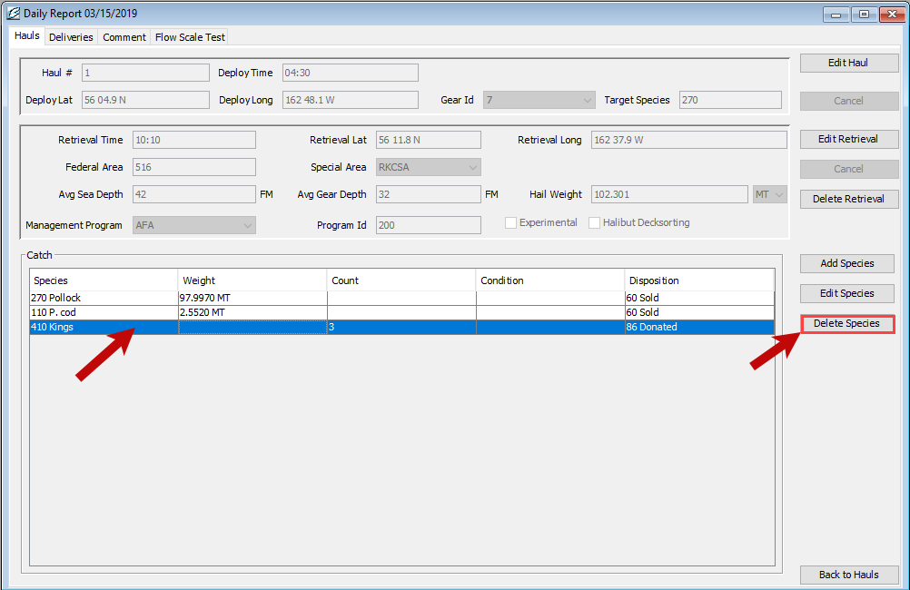
Catch Entries
Catch entries can easily be added or edited.
A new and helpful feature is the ability to delete rows of catch. Simply highlight the row you want to remove and click the Delete Species button.

Slide 20
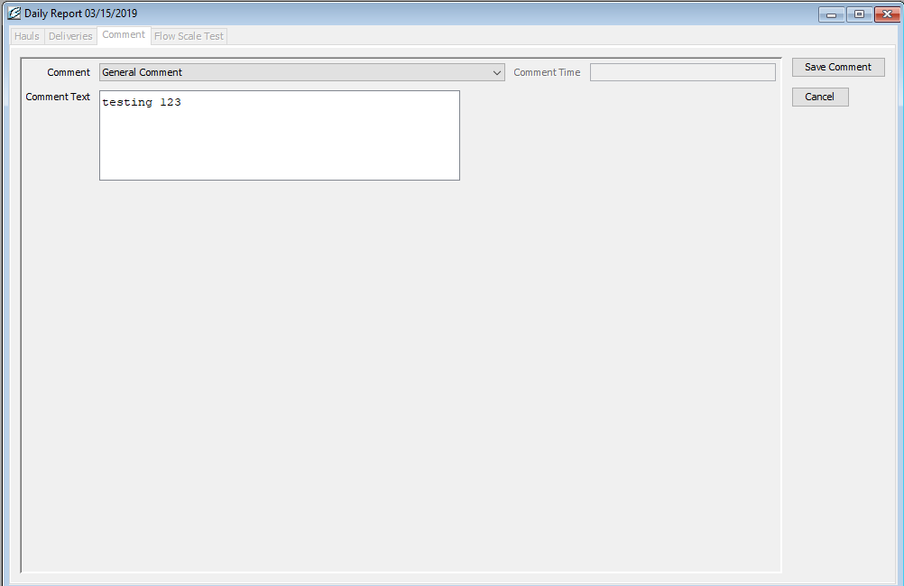
Comments
There are two types of comments, a general comment, or the “Moved to Avoid Salmon” comment.
If you choose the “Moved to Avoid Salmon” comment, the program will take note of the time and date as the full comment.
To add notes or text, choose the “General Comment” option.
Character space is limited to 140 characters, so long comments may result in needing to make several comments.

Slide 21
Sending Transmissions
We have improved the logbook so it's a much smaller transmission. Using direct is faster, uses less bandwidth, and has fewer security risks associated with it compared to the file/email transmit method.
NMFS is moving towards retiring the file transmit method, so let us know if you run into any issues with Direct Transmit. We want to address any potential issues quickly!
If you can’t report/transmit please email Elandings support staff at elandings@alaska.gov
If you can’t report in three days you must return to port to remedy the issue.

Slide 22
Edits
The Daily Trip Report Logbook provides the user with the ability to easily edit and delete entries.
There are only two features that existed in the legacy logbook that are not available in the Daily Trip Report Logbook, these are the drag and drop option and undo last unsubmitted entry feature. With the ability to edit and delete we have not noticed users are missing those two legacy features.
Another benefit of the Daily Trip Report Logbook is that the application automatically saves and you no longer have to manually save as you data enter into your elogbook.

Slide 23
Deleting Reports
When making a delete of a daily report or trip report it is always best to transmit after the delete before entering new data. This also applies to deleting Go Active/Go Inactive entries.
Deleting a trip report will delete any hauls/sets and Daily Reports that are associated with that particular trip.

Slide 24
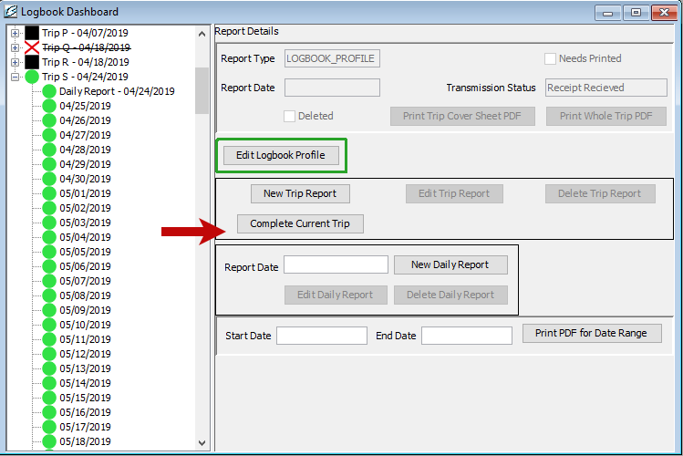
Ending Your Trip Report
There are multiple ways to end a trip.
The first method would be to use the Complete Current Trip button.

Slide 25
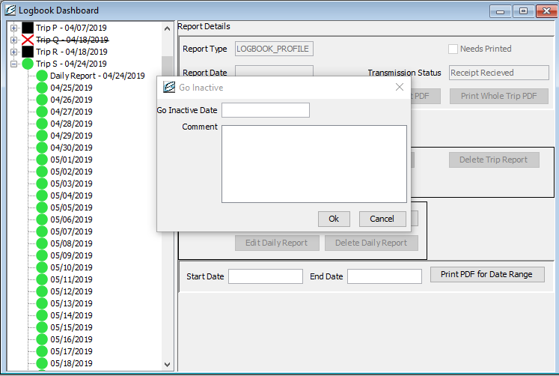
Complete Current Trip
This method should be used when you are going inactive between trips.
Remember that you do not want to go inactive unless it is at least a 24 hour period of inactivity.

Slide 26
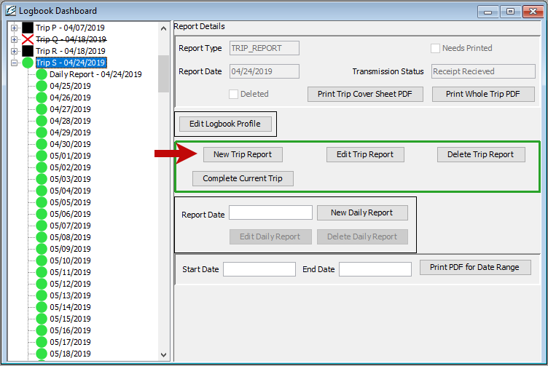
Ending a Trip
The second way to complete a trip is to create a New Trip Report.
This method is best when you are not going inactive between trips.

Slide 27
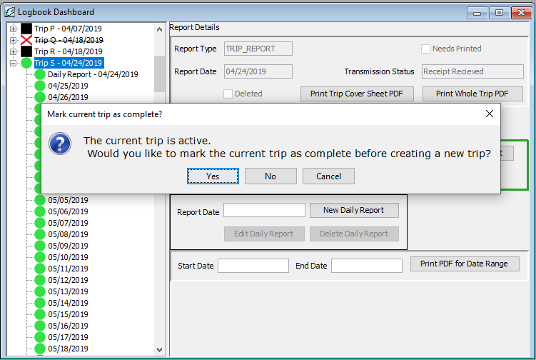
This method enables you to go inactive on the current trip or to stay active through this trip and then you start creating the next trip report profile.

Slide 28
What constitutes a new trip?
New Trips are triggered by a change in any of the following:
New vessel operator
Change in Observers
Loss or addition of crew members

Slide 29
When Should I go Inactive?
If you are not engaged in fishing activity (gear in the water) or processing activity, you should Go Inactive (ex. steaming to port for offload).
However, if you are offloading in port and plan on turning around the same day and going back out to the fishing grounds, DO NOT GO INACTIVE
To Go Inactive during a Trip you can either click on the Complete Current Trip button on the logbook dashboard, which will end the trip.
NOTE - Inactive periods in the logbook are 24 hour increments so you cannot have more than one Go Active and one Go Inactive entry in a 24 hour period

Slide 30
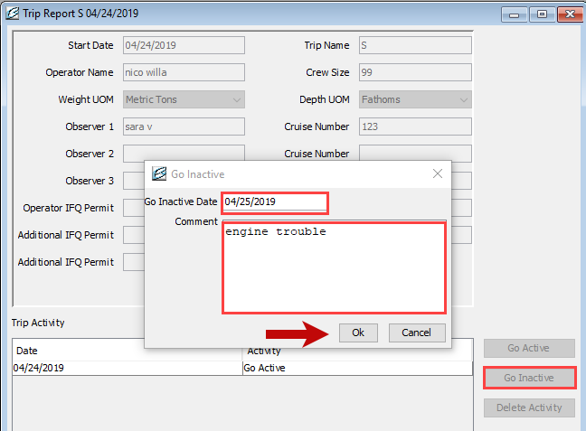
In order to go inactive but not end the trip click on the Trip in the left hand navigation pane, and then click the Edit Trip Report button and select the Go Inactive button and enter the date you went inactive.
Go Inactive

Slide 31
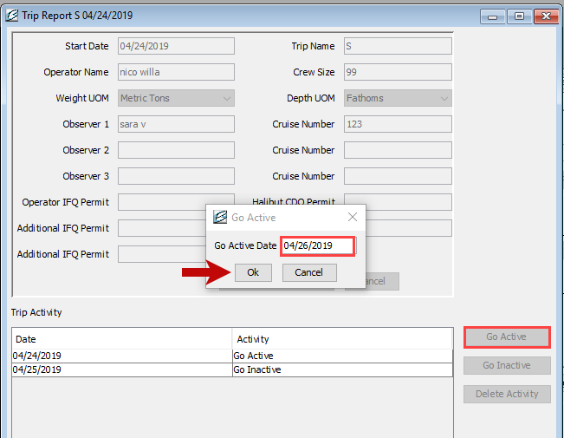
In order to go active on the same trip just click on the Trip in the left hand navigation pane, and then click the Edit Trip Report button and select the Go Active button and enter the date you want to go active.
Go Active

Slide 32
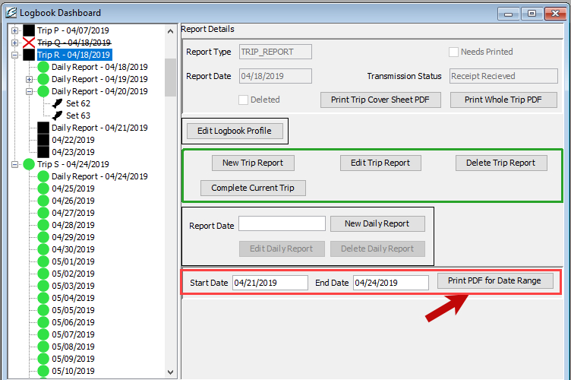
Print Logbook PDF’s
Select your desired date range and click Print PDF’s for Date Range button.
A copy will automatically be saved in your seaLandings pdf folder.

Slide 33
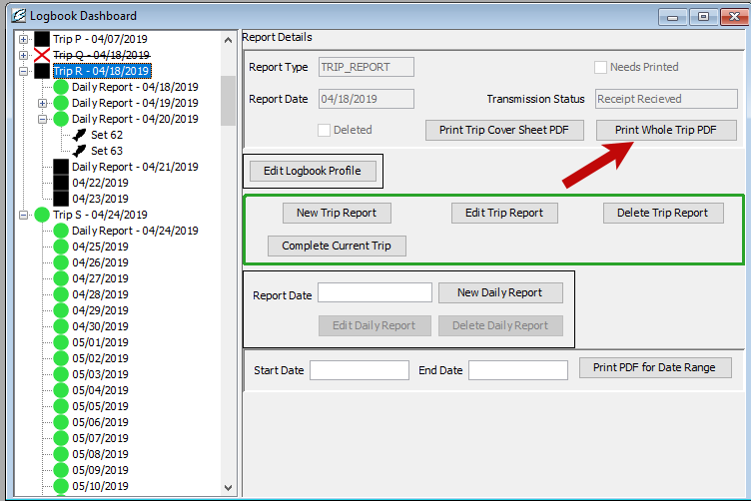
Print Whole Trip Report
Select the trip you want to print from the Logbook Date tree.
Use the “Print Whole Trip PDF” button to generate a PDF for an entire trip.

Slide 34
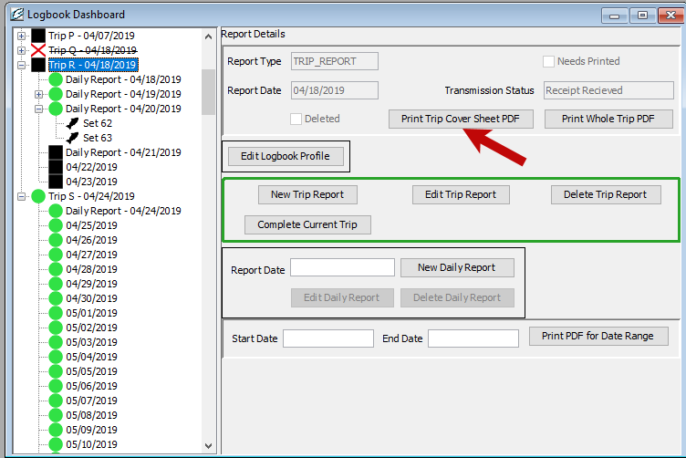
Print Trip Report Cover Sheet
Once you have completed a trip you can reprint the trip cover sheet to reflect the most current version.
You will need to provide a signed PDF copy of your logbook entries for each day to the Observer assigned to your vessel. If you have made edits to your logbook entries you will need to provide the Observer with those edited PDFs.

Slide 35
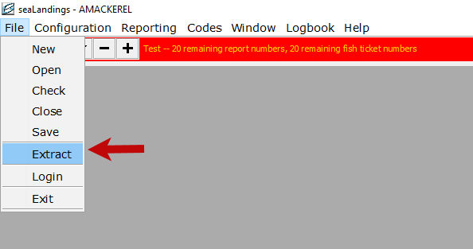
Logbook Data Extract
To extract your logbook data, navigate to File > Extract.
A new window will open and allow you to pick your date range you wish to extract.

Slide 36
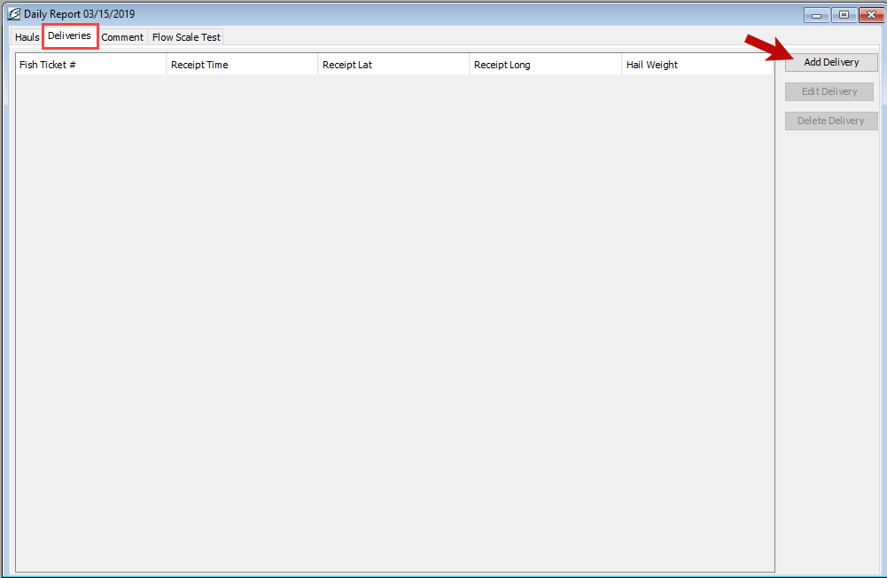
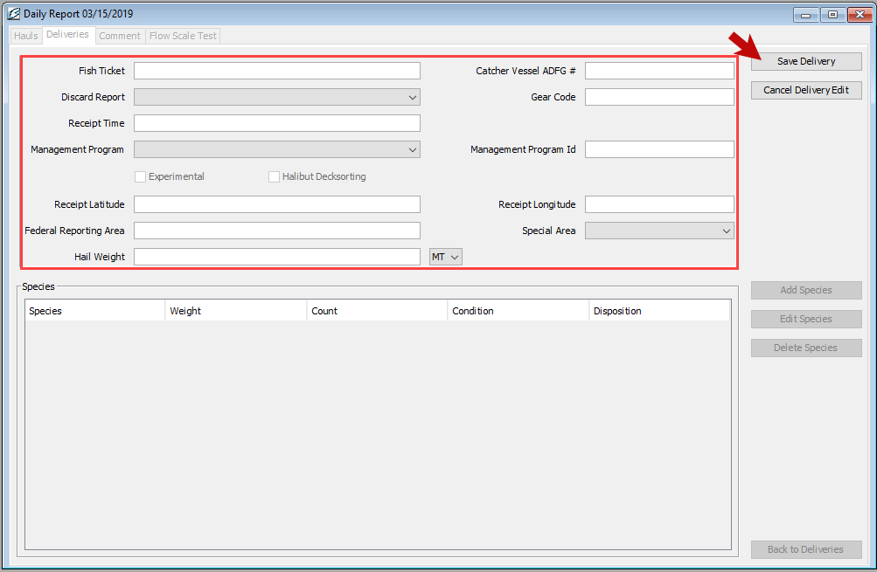
Mothership Deliveries
Enter the delivery information and then click the Save Delivery.
Then you will be able to enter any catch information.

Slide 37
Changing your password
If you need to change your password in seaLandings, please follow the steps below:
Sign into eLandings.alaska.gov, and change your password online
Sign into seaLandings using your old password, then transmit. Your new user authentication will contain your new password.
Close the seaLandings program
Re-open seaLandings and sign in using your new password.
You have now reset your password fully!

Slide 38
Questions?

