Slide 1
Daily Trip Reporting
2018 Electronic Logbook Design

Slide 2
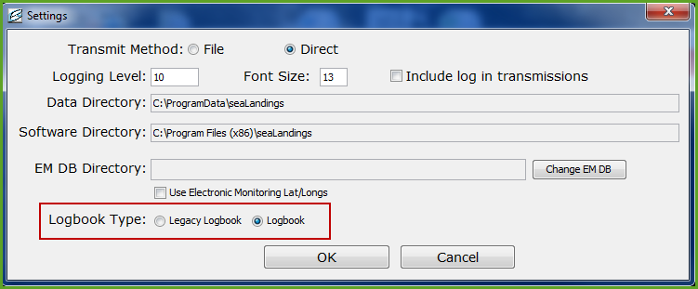
How to Choose Your ELB
seaLandings users that do not fish into the new year can select the Daily Trip ELB when running the software installer in January
seaLandings users that fish through the new year can close out their Legacy logbook and choose the new Daily Trip ELB
Go to Configuration > Settings and click on the circle in front of Logbook

Slide 3
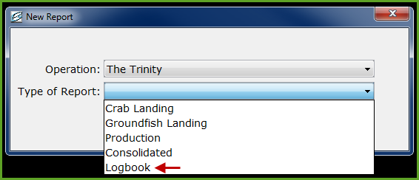
Accessing your logbook
The new ELB is presented like a production or groundfish landing report which means it is much smaller in size. We believe that this will make it easier to use Direct transmit
There will not be a need to “register” a logbook with the new format changes

Slide 4
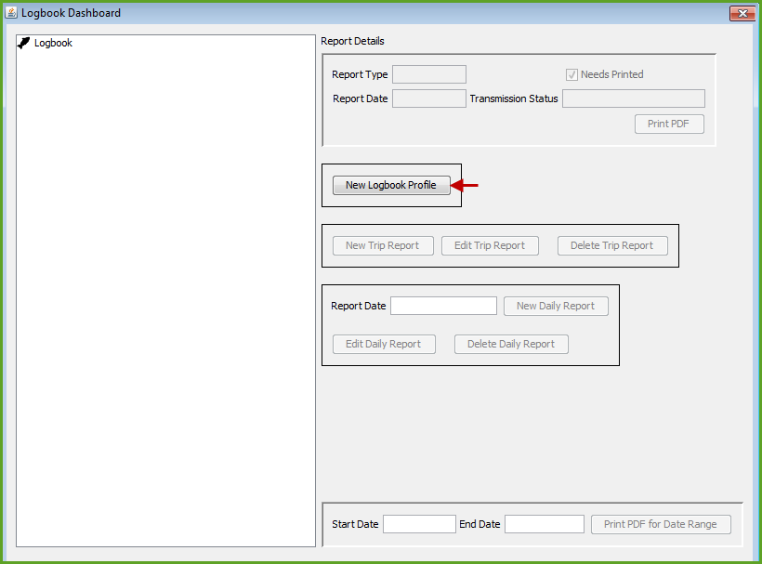
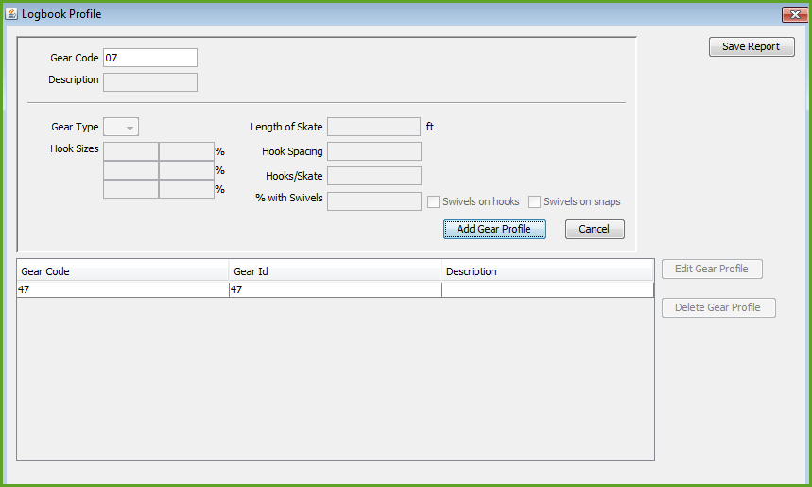
Logbook Dashboard
The first step in this process is to create a New Logbook Profile
The logbook profile captures the vessel gear information

Slide 5
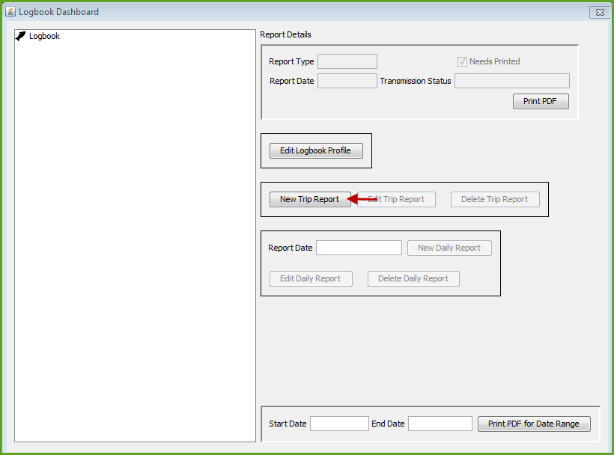
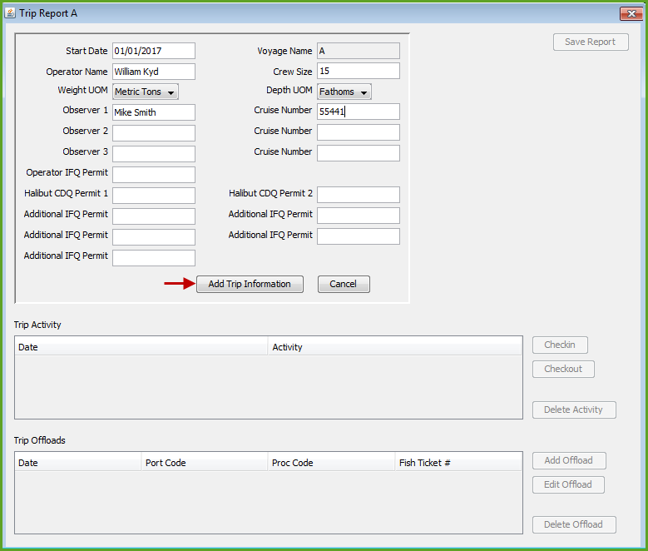
Trip Report aka New Voyage
Once you’ve completed adding your gear profiles, the next step is to create a New Trip Report
The Trip Report captures your basic Voyage information in addition to your Go Active/Go Inactive dates

Slide 6
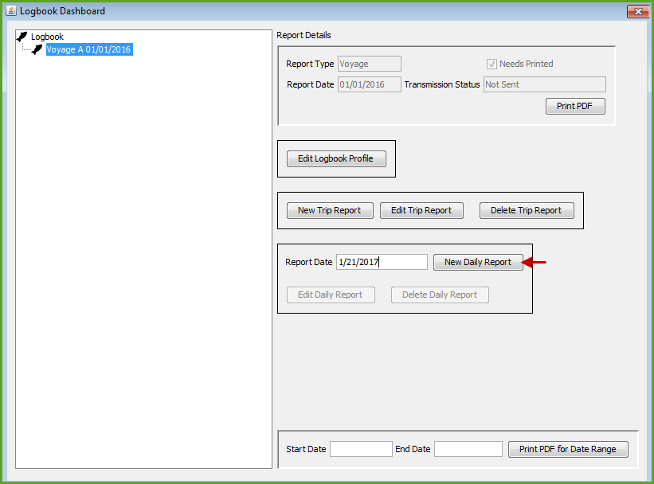
New Daily Report
The Daily Report captures set/haul information that occurs on days that fall within a Voyage
Once you have saved a New Voyage, you can then begin entering your logbook information

Slide 7
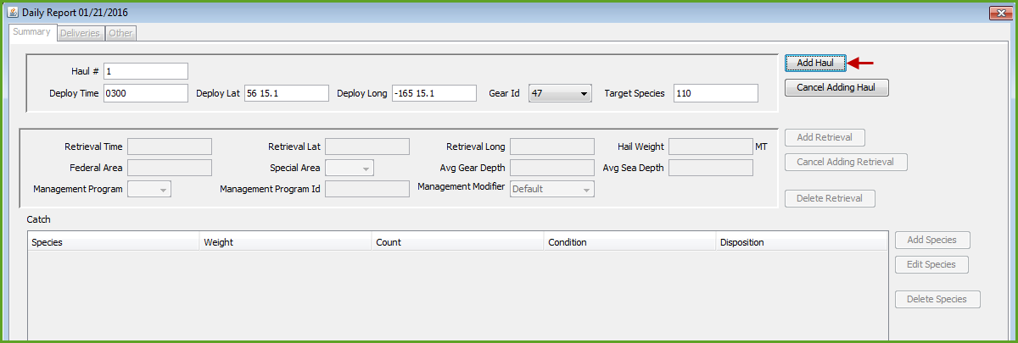
Haul Entry

Slide 8
Haul Summary Data
Users can view and access their haul or set information in the Daily Report dialog box under the Summary tab

Slide 9
Deliveries and Other tab
The Daily Report dialog box has a Delivery tab to capture catcher vessel deliveries made to Motherships
The Other tab captures Daily Flow Scale tests and Comments, free form or canned

Slide 10
Logbook Dashboard
When you’re ready to print your logbook PDF pages, access the dashboard and select the dates you want to print out

Slide 11
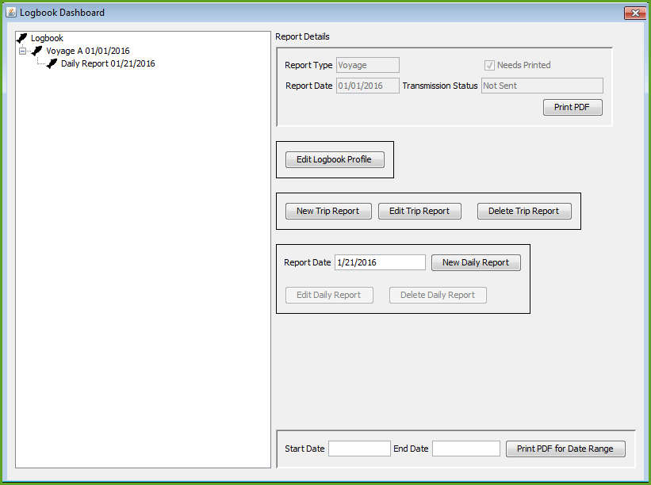
Logbook Navigation
Primary logbook navigation occurs through the Logbook Dashboard dialog box.
Logbook profiles, Trip reports, and Daily reports are initiated through the dashboard

