Slide 1
COAR Reporting
Commercial Operator’s Annual Report
Licensed processors
Buying activity
Processing activity
Final price per pound & value of each

Slide 2
COAR Reporting
Generate COAR buying
By COAR area
Add Final Price
Add Production
And Value
Submit electronically

Slide 3
eLandings Generated COAR
Summarizes all landing report fish tickets within the eLandings database
Summarizes all custom processing that occurs with YOUR processor code – when you are the owner
Provides a spreadsheet to record your production information
Immediate data validation and upload to ADF&G
Can be used by both seafood processors and by at sea fleet

Slide 4
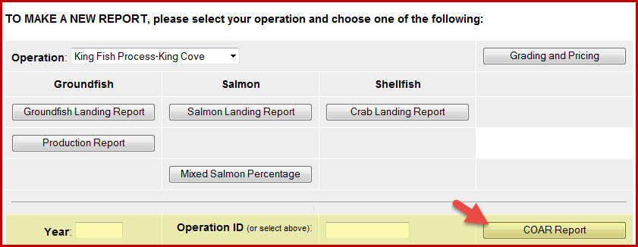
COAR Reporting

Slide 5
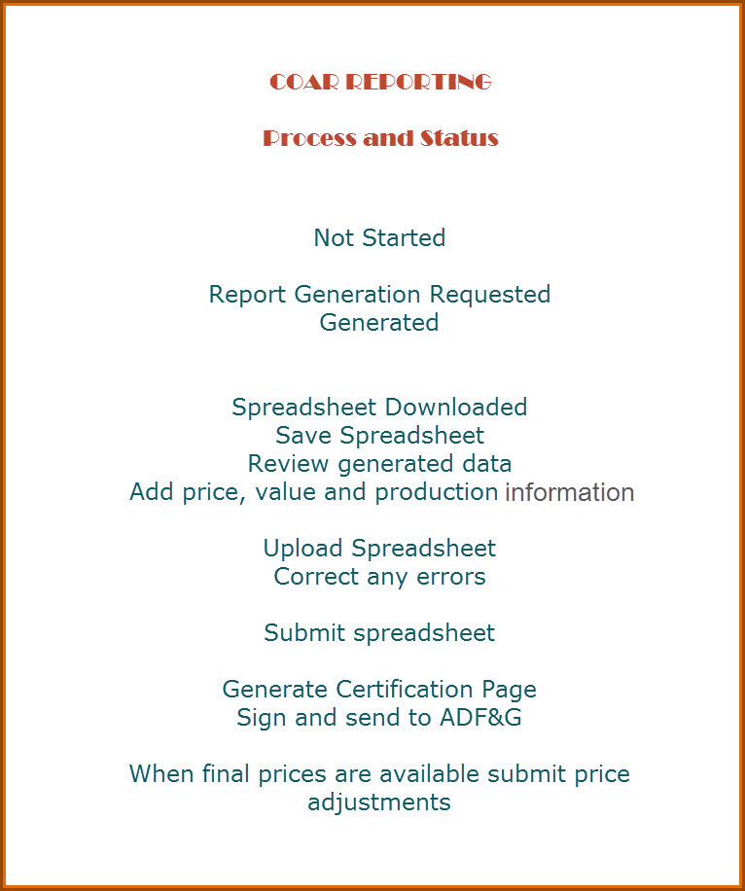

Slide 7
Missing Values
ADF&G Vessel Number
99995
Boat Not Required or Used (Beach, Dive, Herring Pound, Clam Digging, Ice Fishing, Hatchery
99996
Setnet Site

Slide 8
PERSONAL USE REPORTING
PLEASE REMEMBER TO ASK ALL FISHERS ABOUT THE RETENTION OF FISH FOR PERSONAL USE
Crab
Chinook Salmon
Steelhead
Record in eLandings, tLandings or on the paper ticket
Help us all understand the extent of harvest from our shared public resource.

