Slide 1

tLandings ~
2017
for
Salmon and Groundfish

Slide 2




Interagency Electronic Reporting Program Components
eLandings
Web-based reporting of landings & production
seaLandings and eLogbook Desktop reporting on vessels submitted via email
System Interface
Third-party software & web services interface with elandings directly
Agency Desktop
Agency staff review & edit submitted data
tLandings
Reporting from tender vessels via USB drive
eLandings Repository Database

Slide 3
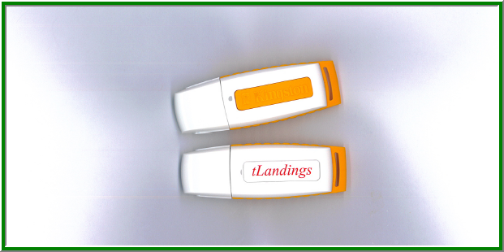
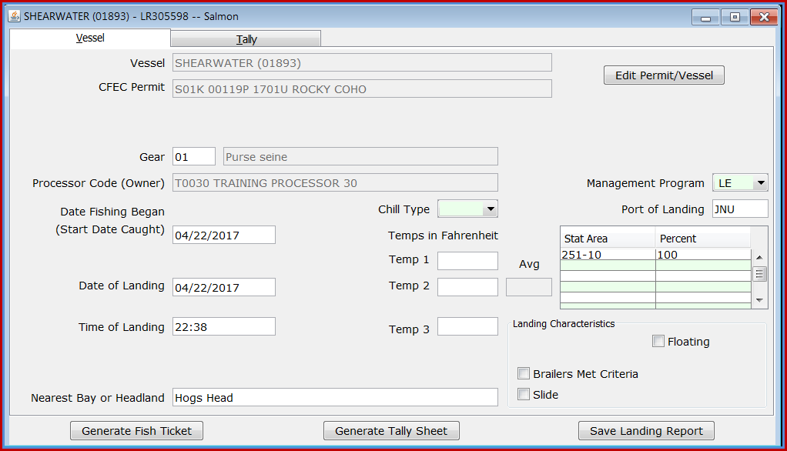
tLandings
Can be used with tenders, buying stations and with custom processing buying.
tLandings application is loaded onto the thumb drive.
Used by tender vessels.
During tender offload at plant, the USB data is uploaded to elandings server using the Processor Tender Interface.

Slide 4
PTI and tLandings Management and Data Flow
Operation Tender Operations
Processor Tender Interface (PTI) Configure Thumb Drives
Distribute Thumb Drives
tLandings Report tender-based Landings for groundfish and salmon
PTI Upload reports to eLandings Database
Data Extract Tool
Extract Landings Data
Web Service Uploads

Slide 5
tLandings Procedures and Data Flow
Seafood office ~
Establish operation and user accounts in eLandings.
Download Processor Tender Interface.
Establish Configuration Defaults and Settings, Tenders and Species Defaults.
Configure thumb drives for each tender, label and distribute.
On-Board Tender ~
Record landings within tLandings application.
Obtain signatures for each landing.
When the tender trip is completed, return the used thumbdrive and signed fish tickets to the Seafood office.
Seafood office ~
Make certain all signed fish tickets are present.
Upload fish tickets using the PTI.
Extract data to your own business application.

Slide 6
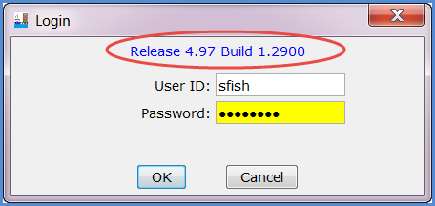
2017 PTI and tLandings
Each year we make modifications to the PTI and tLandings. These updates are ONLY available if you download the 2017 version – Release 4.97 and Build 1.2900.
Fish tickets created in prior versions of the PTI are NOT compatible with the 2017 version.
You will not be able to upload tickets created with prior versions of the PTI,

Slide 7
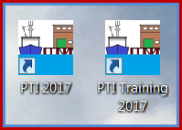
2017 PTI and tLandings
When you download the PTI, a new icon is created, labeled PTI 2017. If you have already downloaded the PTI 2017 in the winter to use with groundfish, the application will be refreshed.
Always check the PTI login documentation to verify you are using the current version.

Slide 8
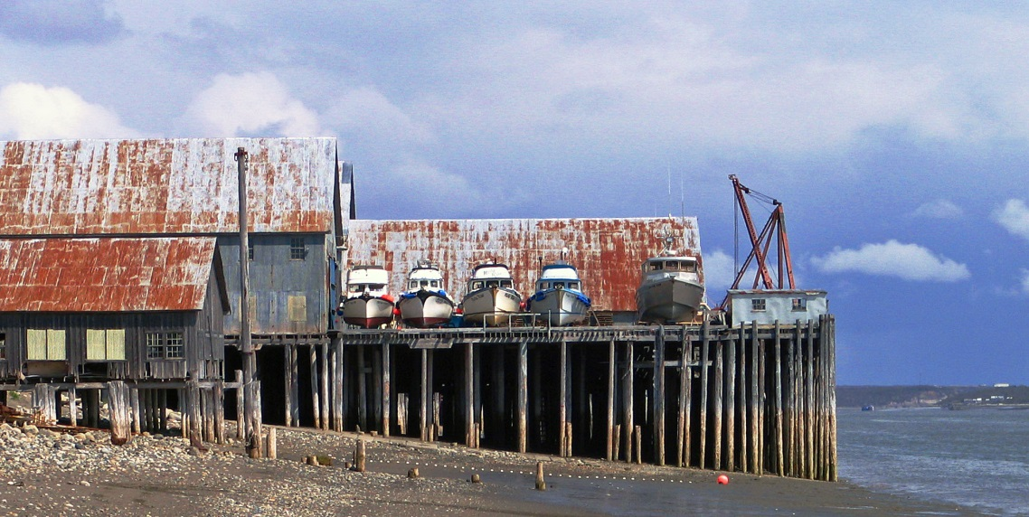
What is new for 2017 tLandings
  CFEC Permit and Vessel Data Capture
  Vessel Lists and Vessel Pick Lists
  Settings and Customized Display
  Tender Operations Management
  Additional Groundfish Data Elements

Slide 9
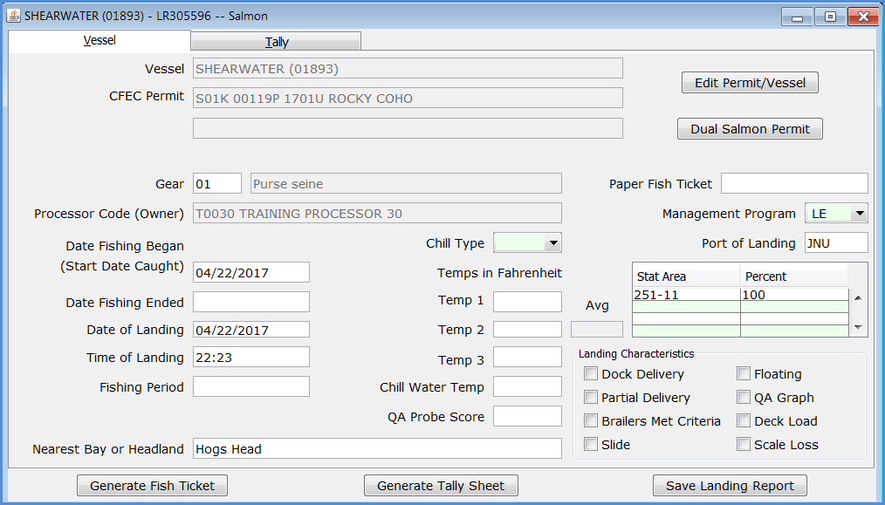
tLandings Vessel Page Defaults

Slide 10
Customized tLandings Vessel Page Defaults

Slide 11
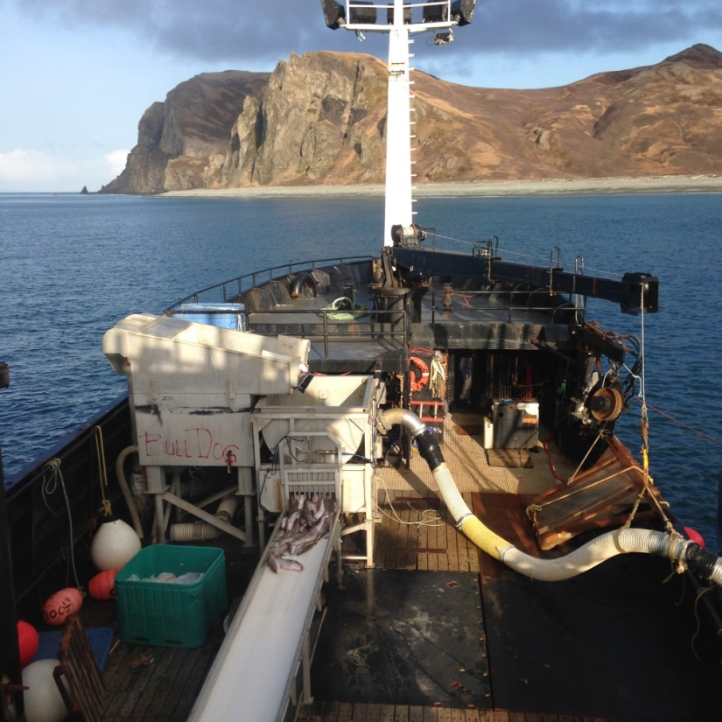
Demonstration ~ tLandings

Slide 12

Questions?

