Slide 1

eLandings for Salmon
2018
Gail Smith, ADF&G
Jennifer Shriver, ADF&G
Notes:
Gail

Slide 2

Welcome
Housekeeping
Breaks and snacks
Agenda review
We plan to present this information quickly and provide time after the formal workshop to review again
Questions – ask if you do not understand!
Handouts
Notes:
Gail

Slide 3

eLandings
Quick Overview
eLandings =
Interagency Electronic Reporting System (IERS)
tLandings =
Electronic reporting application for tenders and buying stations without internet service
Notes:
Gail

Slide 4



eLandings for Salmon Components
Processor-Tender Interface
Web-based application to configure thumb drives and upload landing reports
eLandings
Web-based reporting of landings
tLandings
Reporting from tender vessels via USB drive
eLandings Repository Database
Notes:
Gail

Slide 5
eLandings System
eLandings Database stores:
    Your Operation licenses and permits
    Your User Accounts
    Species and pricing
    Configuration profiles
    Your landing reports (fish ticket records)
Notes:
Gail

Slide 6
eLandings System
tLandings Thumb drive stores:
    The tLandings application
    Your Operation licenses
    The Tender Vessel information
    Your user accounts to access the thumb drive
    Your species list
    Unique landing report and fish ticket numbers
    and landing reports
Notes:
Gail

Slide 7

eLandings System
Processor – Tender Interface (PTI)
  Web-based application
    Loads data on thumb drive – license/permits, user accounts, vessel and species information and unique numbers
    Allows you to view & correct reports
    Allows you to assign a tender batch ID
    Allows you to modify the processor (buyer) and port
    After the tender trip – uploads report
Notes:
Gail

Slide 8
eLandings System
tLandings application
    Loaded on the thumb drive
    Used by tenders, buying stations and even office locations to report salmon and groundfish landings
    Each configured thumb drive is unique to tender
    Generates tender reports:
        Species summary
        Species/statarea summary
        Tender trip log report
        Personal User Report
    Does not require the internet
Notes:
Gail

Slide 9
What’s New for 2018?
Custom Displays
  Hidden fields – if you don’t need it, you don’t see it
  Vessel page
  Tally page
  Autofill default values
Configuration Profiles
  Includes species lists
  Selectable upon configuration of thumb drive
eTablet
Notes:
Gail

Slide 10
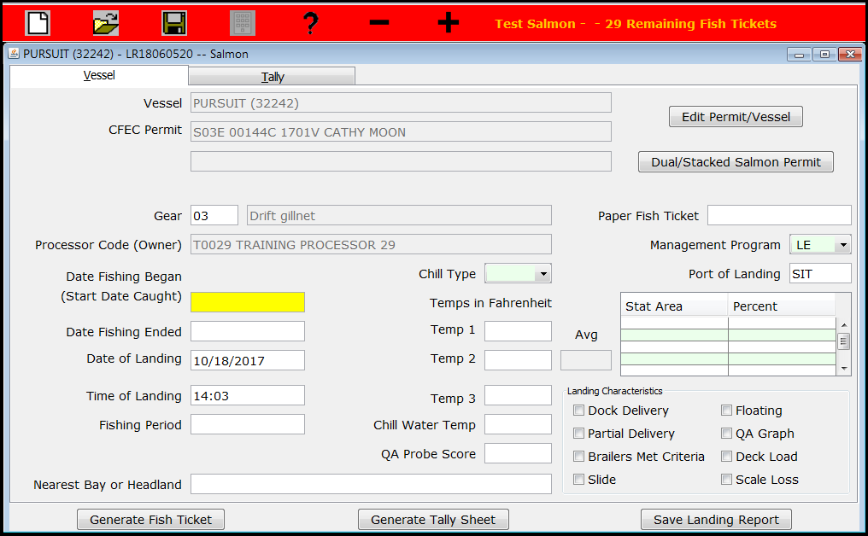
Customized Display
Standard Default

Slide 11
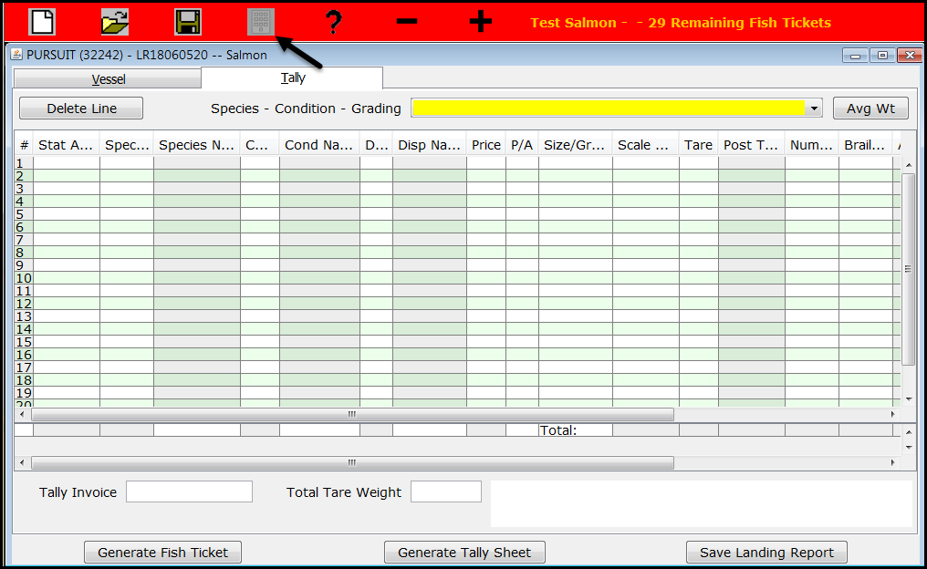
Custom Display
Standard Default

Slide 12
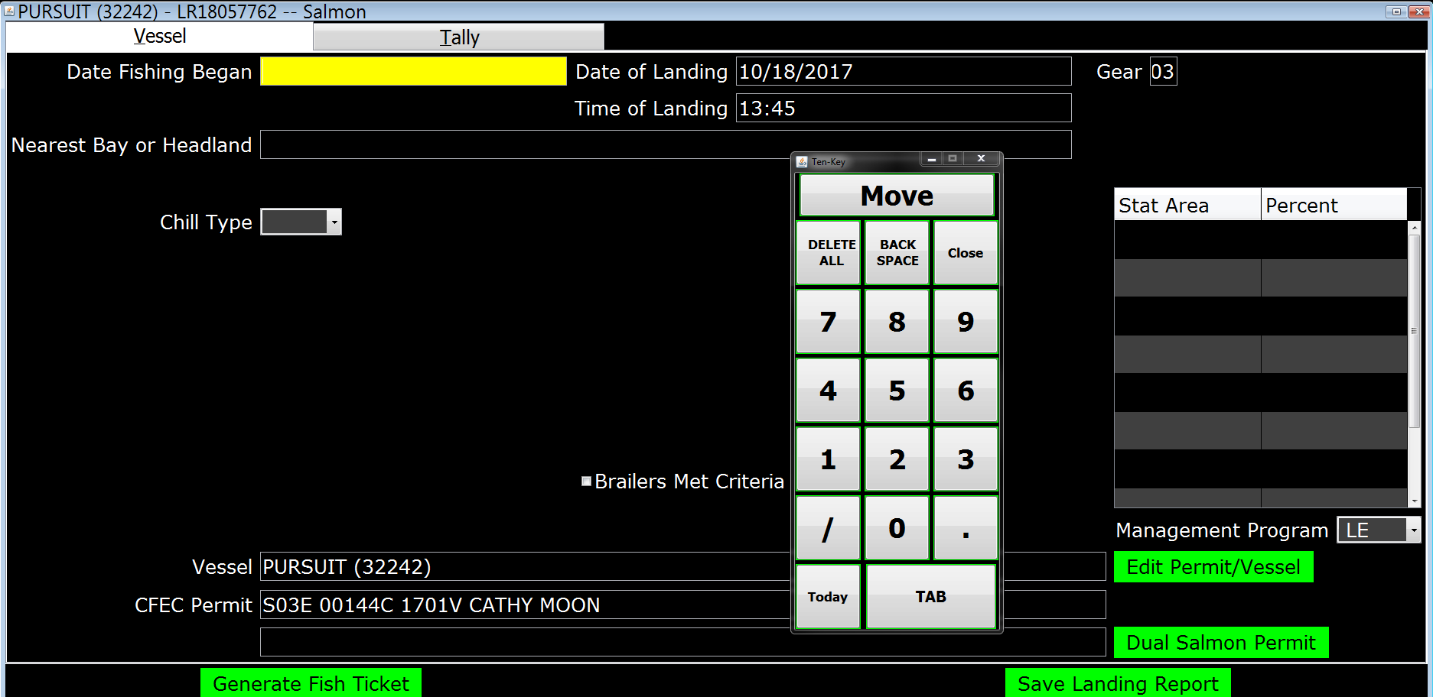
eTablet Display
Vessel page

Slide 13
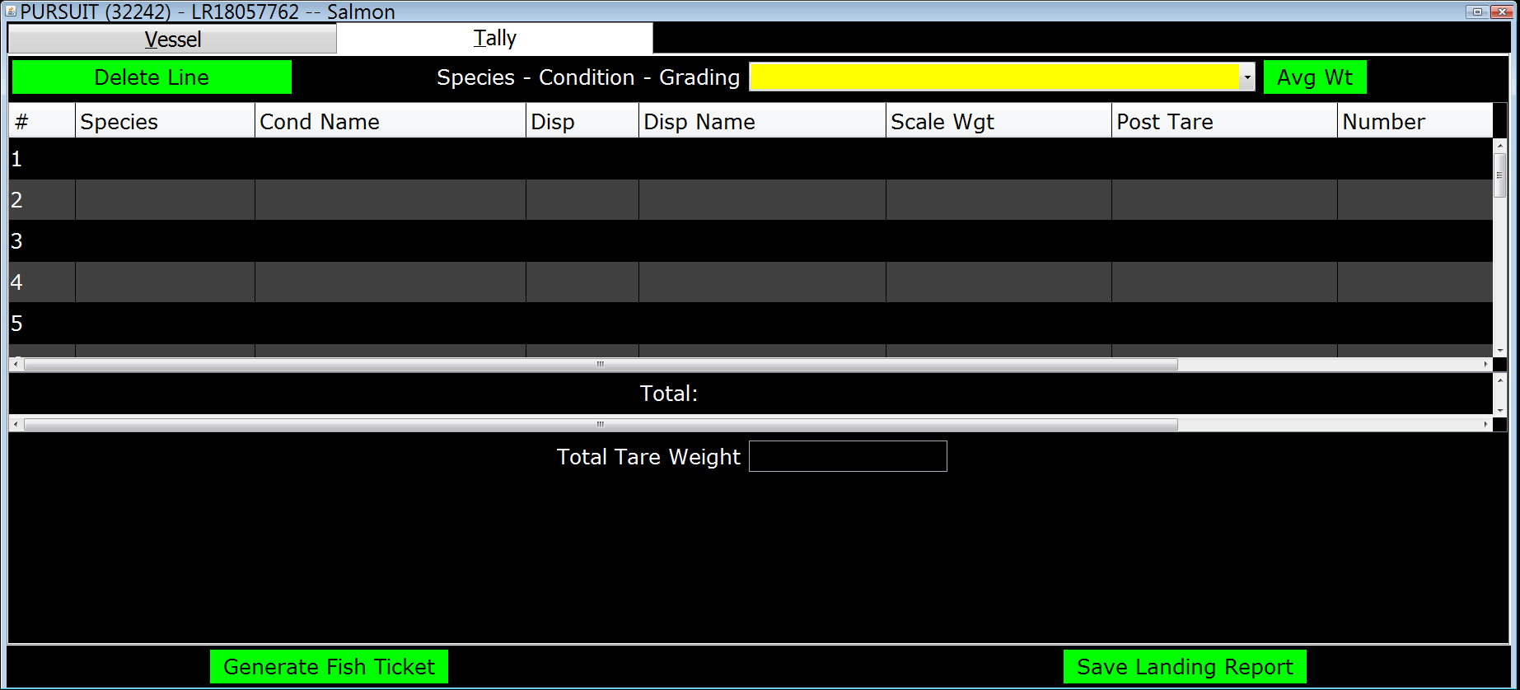
eTablet Display
Tally page

Slide 14
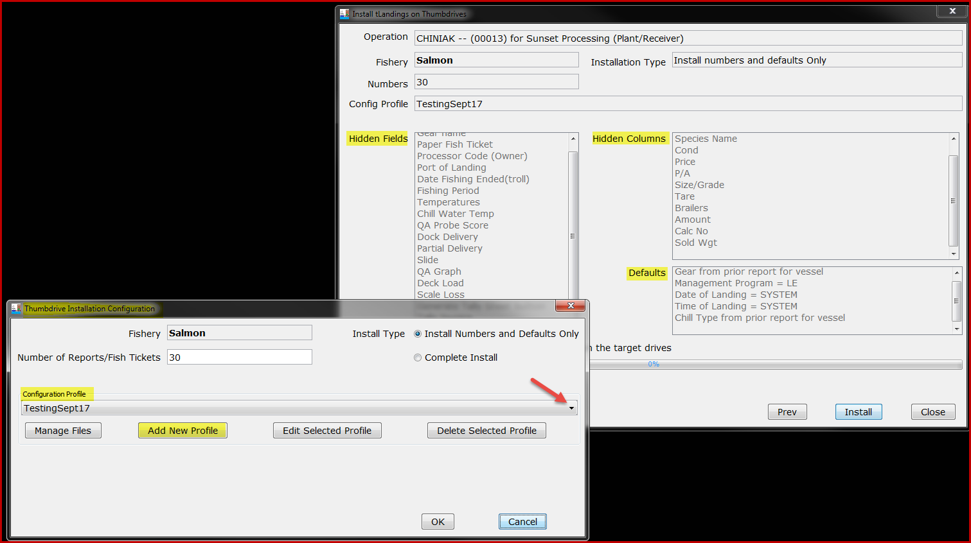
Configuration Profiles
Stored and Selectable

Slide 15
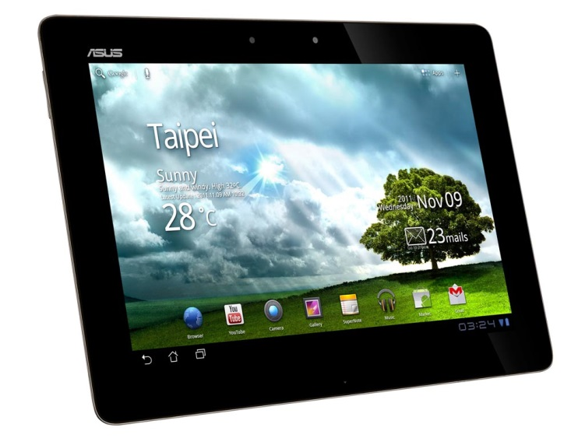
eTablet
Designed to facilitate electronic reporting for beach-based deliveries ~ set net sites
Successful proof of concept field trials summer 2017
Notes:
Gail

Slide 16
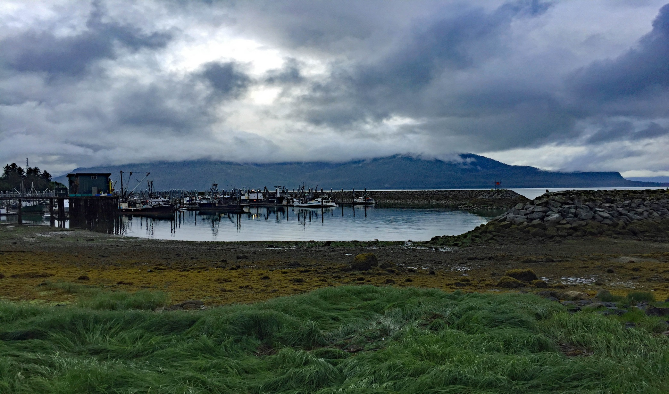
ADF&G Reporting Requirements and Expectations
Notes:
Jen

Slide 17
ADF&G Reporting Requirements
Commercial Fisheries reporting requirements are located in each regulatory book:
General Provisions - 5 AAC 39.130
Fishers and processing staff must be familiar with this regulation, including seasonal staff, to assure compliance.
Each delivery must be recorded on a fish ticket.
Each fish ticket must be signed by the fisher or fishers if dual fishery.
Signed copies of each completed fish ticket must be submitted to ADF&G within 7 days.
Bristol Bay processors must update mixed salmon species to unique species prior to the submission of the Bristol Bay Weekly Report.
Notes:
Jen

Slide 18
Additional Requirements from Area Management Biologists (AMB)
Check with your local area office they will have specific reporting requirements for that area
BRISTOL BAY
Both permit holder signatures on fish tickets for dual drift operations.
All kings either sold or personal use shall be reported on a fish ticket.
Apply chum percentages prior to uploading to tLandings on the Eastside.
Coho to must be reported on fish tickets as well and chum percentages should be applied for the Westside
Use correct stat areas (we provide maps).
Fish tickets shall be submitted within 7 days.
Include the copy of the B ticket if they are entered into tLandings.

Slide 19
Upper Cook Inlet
For those e-tickets that were created from a yellow paper ticket, especially when the paper ticket has the fisherman’s signature, please remember to attach the paper ticket with the e-ticket when submitting these to the ADF&G office.
It also would be very helpful for processors to attach a copy of the tender log (lists all tickets) to tickets being submitted to ADF&G.
Make sure you are buying fish from the permit card holder and it is the permit card holder signing the fish ticket.

Slide 20
Commercial Operator’s Annual Report (COAR) Reporting
Due April 1, 2018
Very important data collection that is used for evaluating the total exvessel and wholesale value of Alaska Seafood.
Electronic submission is available.
Operations will receive an email in April.
No longer sending paper report out.

Slide 21
eLandings COAR
Call Shellene or Jen
We will set up authorized users and provide step by step instructions
Download report in excel format
Fill in and upload!
We have grant money for improvements to the system, so if you have feedback, let us know!

Slide 22
Average Weight of Salmon
By salmon species
By location
By time
The average weight of salmon species vary significantly by location and time.
ADF&G manage salmon fisheries by number of fish – not pounds
Accurate documentation of average weight is crucial to good fisheries management

Slide 23
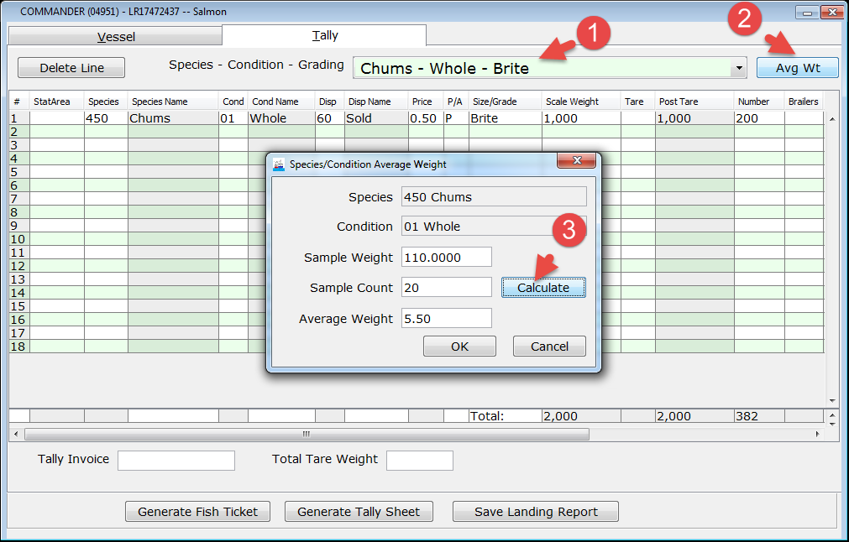
Automatic calculation of number of fish

Slide 24
Average Weights
Please contact your Area ADFG office for their scheduled procedure to calculate average weight. Ask them:
  When to calculate average weight?
  How to calculate average weight?
Notes:
Ammon

Slide 25
eLandings System
Reporting Process
Establish Operation and user accounts
Download PTI and establish configuration profile(s)
Configure thumb drives and distribute to tenders, buying stations, trucks
Notes:
Gail

Slide 26
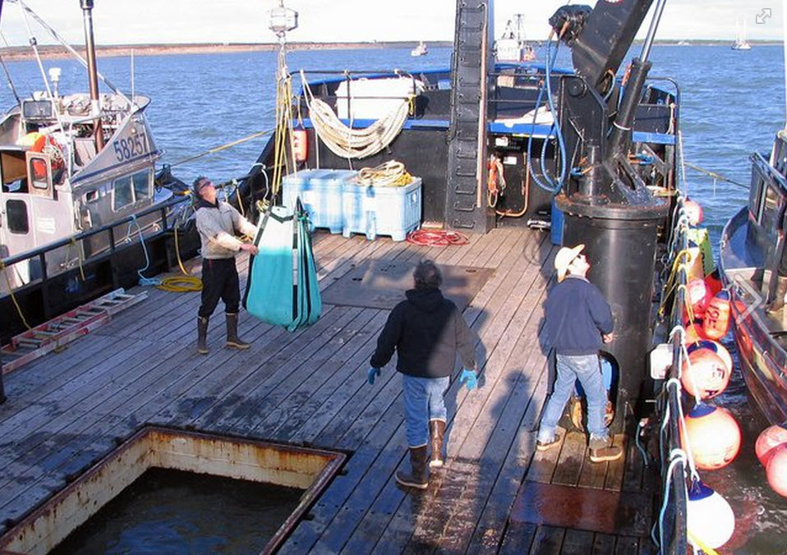
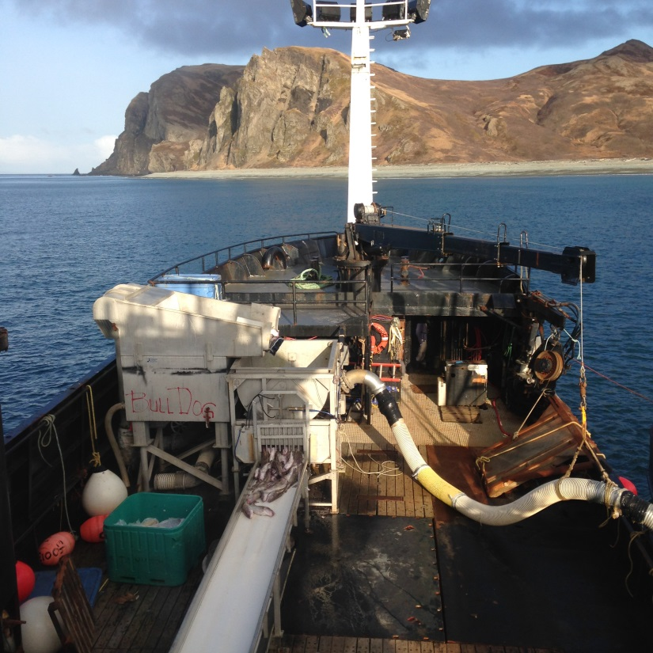
eLandings System
Record landings – salmon or groundfish in tLandings
Notes:
Gail

Slide 27
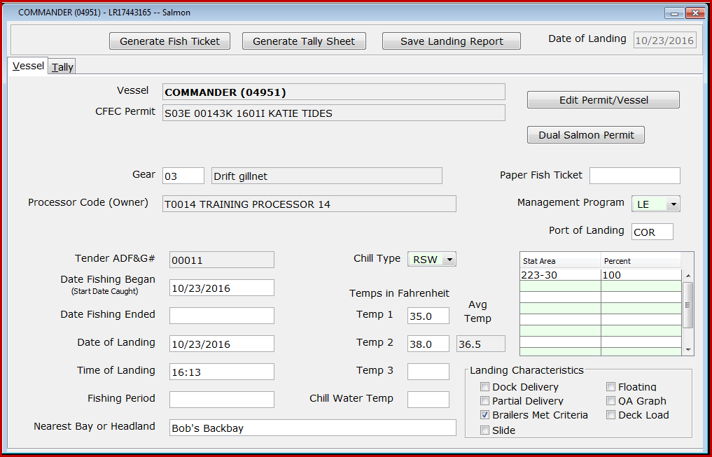
tLandings
Notes:
Gail

Slide 28
eLandings System
Tender Operator generates Tender Trip Log Report
Returns signed copies of fish tickets and thumb drive to seafood office
Office staff review landings in PTI and upload data to eLandings Database
Notes:
Gail

Slide 29
eLandings System
Re-configure thumb drives
Distribute to tenders
Create landing reports in tLandings
Provide fish ticket copies and thumb drive to office
Upload landing reports into eLandings database
Notes:
Gail

Slide 30

Operations and User Accounts
INTERNET BASED REPORTING
Obligates both agencies staff and industry users to be sensitive to the confidential nature of the information.
Allows authorized users to enter landing reports documenting your company’s licenses and permits.
The operation structure allows us properly display your company’s data to authorized users.

Slide 31
Operations
An operation is defined by:
  Processor Code
  Fed Proc Code
  Registered Buyer Number
  Registered Crab Receiver Number
  Port of Landing
eLandings now stores an operation_id on every landing report
User authorization is tied to opertion_id’s
Notes:
Ammon

Slide 32
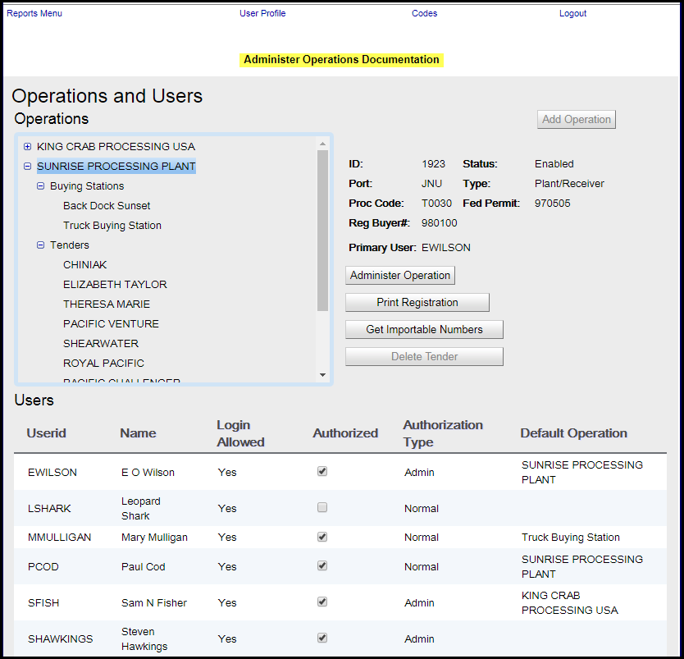
Notes:
Ammon

Slide 33
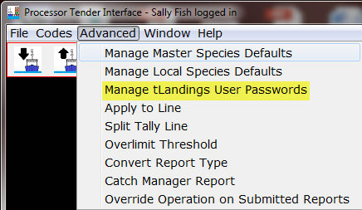
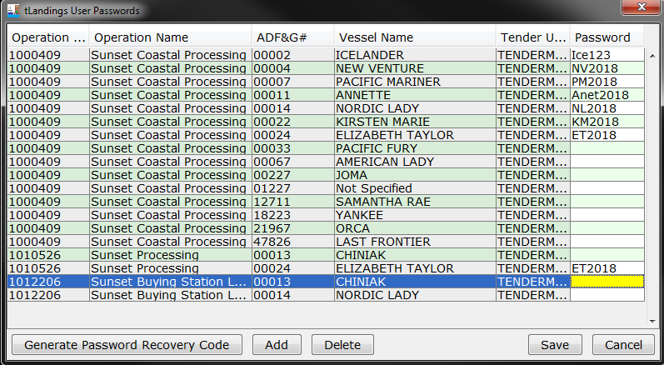
Tender and Buying Station Accounts

Slide 34
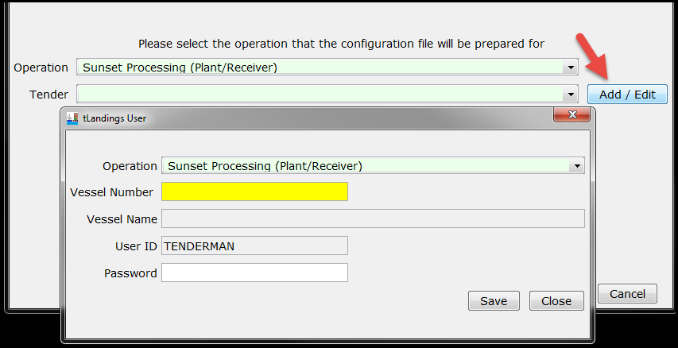
Tender Operations
Notes:
Ammon’s slides

Slide 35

Tender Operations
Who can see/edit tender operations and passwords?
  Normal and Admin users
Who can run reports in the elandings web?
  Normal and Admin users
Who can correct or modify, and even void a landing report while still on a thumb drive?
  The tender operator and authorized users to access the thumb drive.
Who can correct or modify a landing report uploaded to the eLandings database?
  Normal and Admin users.
  You can request to have a landing report voided by contacting elandings.alaska.gov (include explanation)
  All landing reports are locked 90 days after date of creation. You can request a report be opened for editing by contacting eLandings.alaska.gov

Slide 36
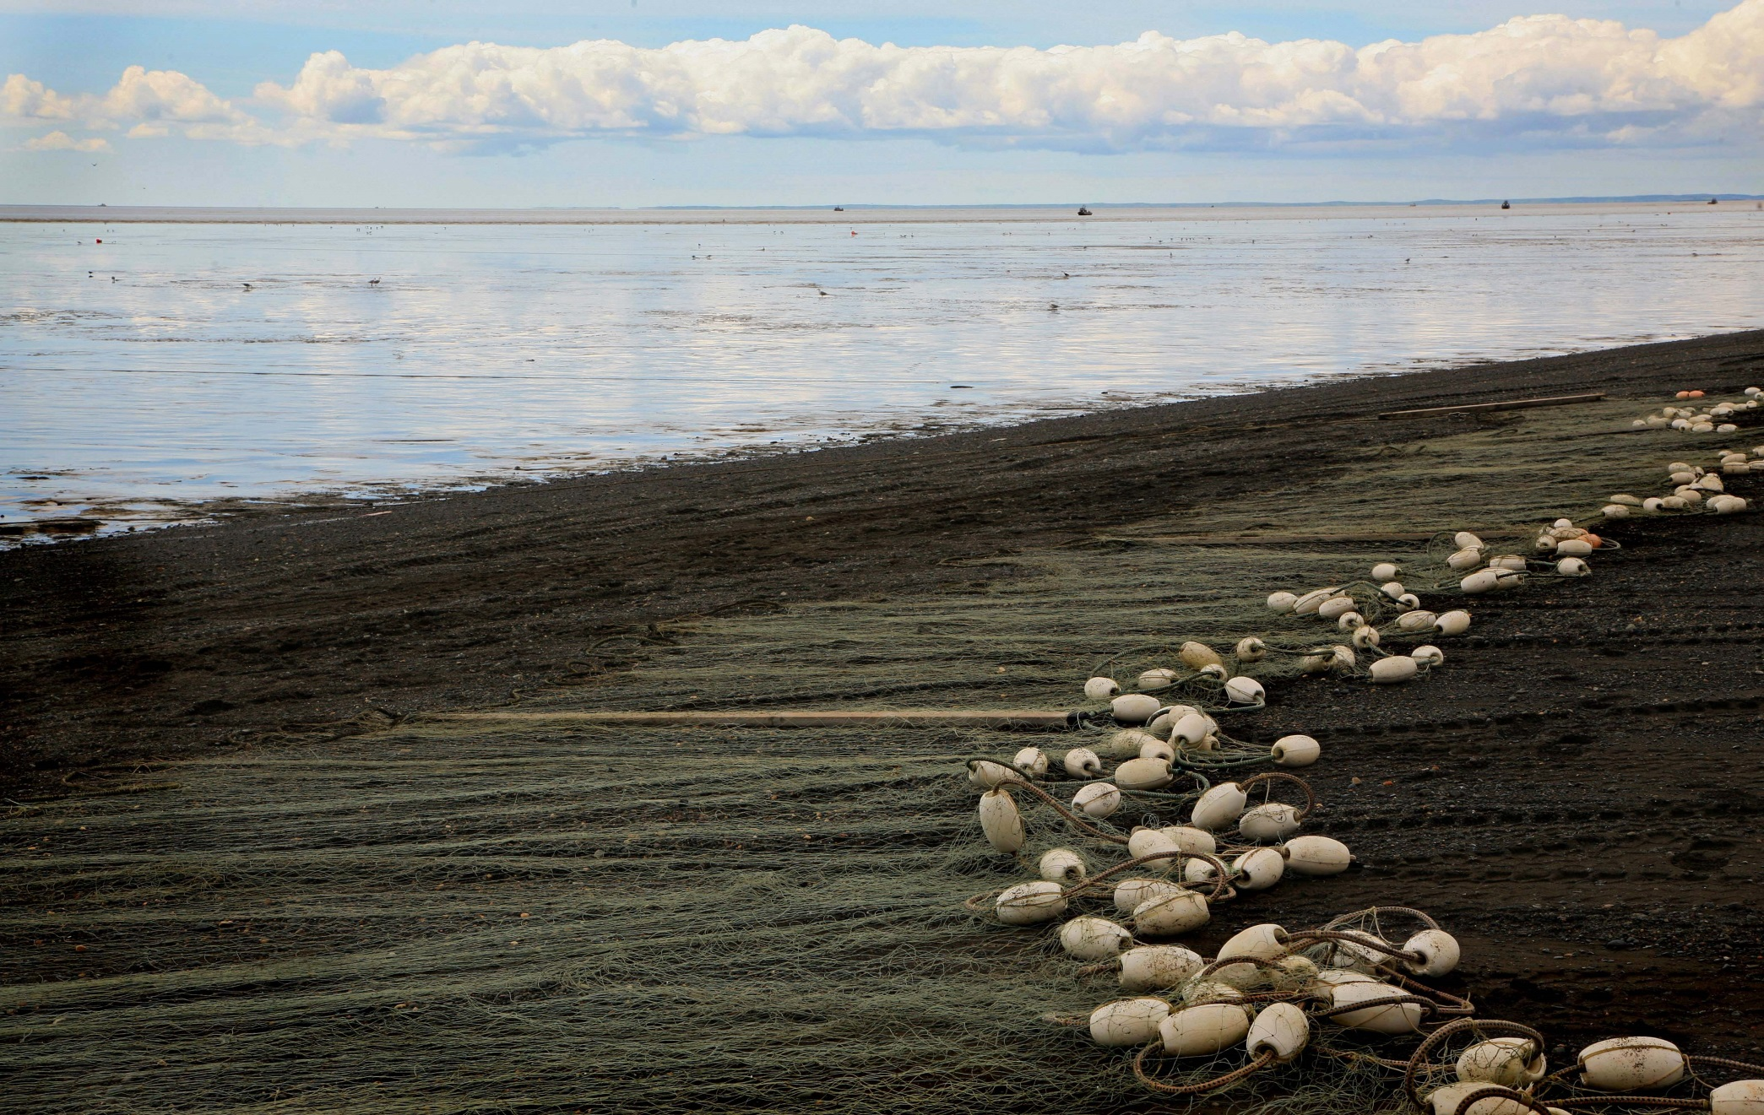
Processor Tender Interface

Slide 37

Processor Tender Interface
The PTI is downloaded from our eLandings WIKI annually.
Why: to obtain the most recent version with all updates, new features and enhancements to both the PTI and tLandings.
Each tender should have at least 3-4 thumb drives on the boat. With the PTI, you can configure as many as 10 thumb drives at once for a single tender, at the beginning of the season.

Slide 38
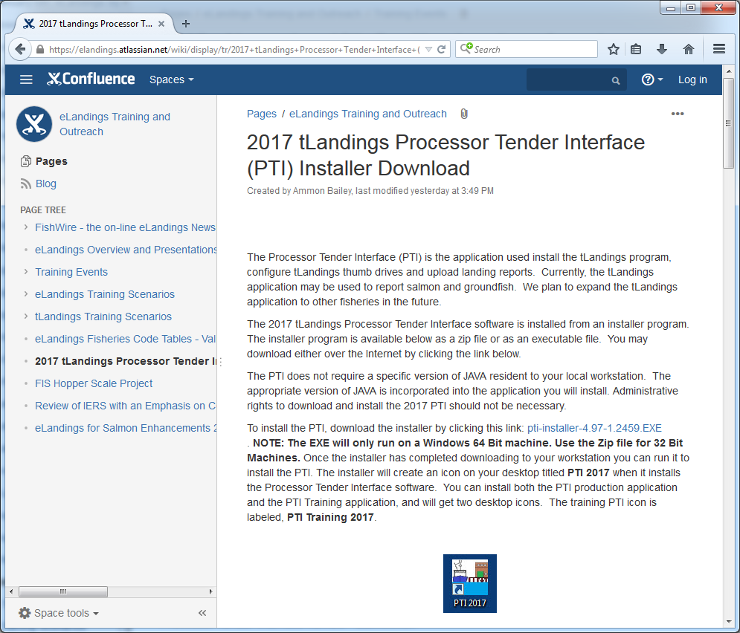
Processor Tender Interface
Notes:
Ammon

Slide 39
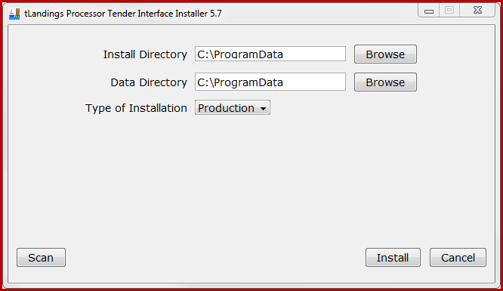
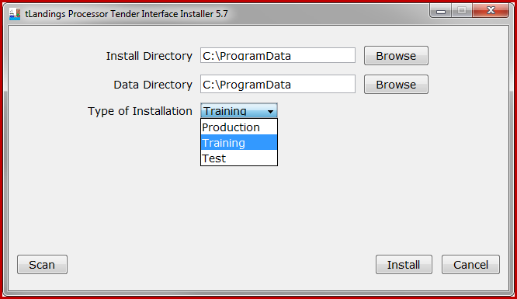
Processor Tender Interface
Notes:
Ammon

Slide 40
Processor Tender Interface
The PTI configures thumb drives and uploads landing reports
Let’s start with ‘configures’ ~
that means it customizes the thumb drive to your company specifications
Notes:
Ammon

Slide 41

Preparing thumb drives
Be sure to delete old installs of tLandings on your thumb drives before installing 2018 tLandings!
Notes:
Ammon

Slide 42
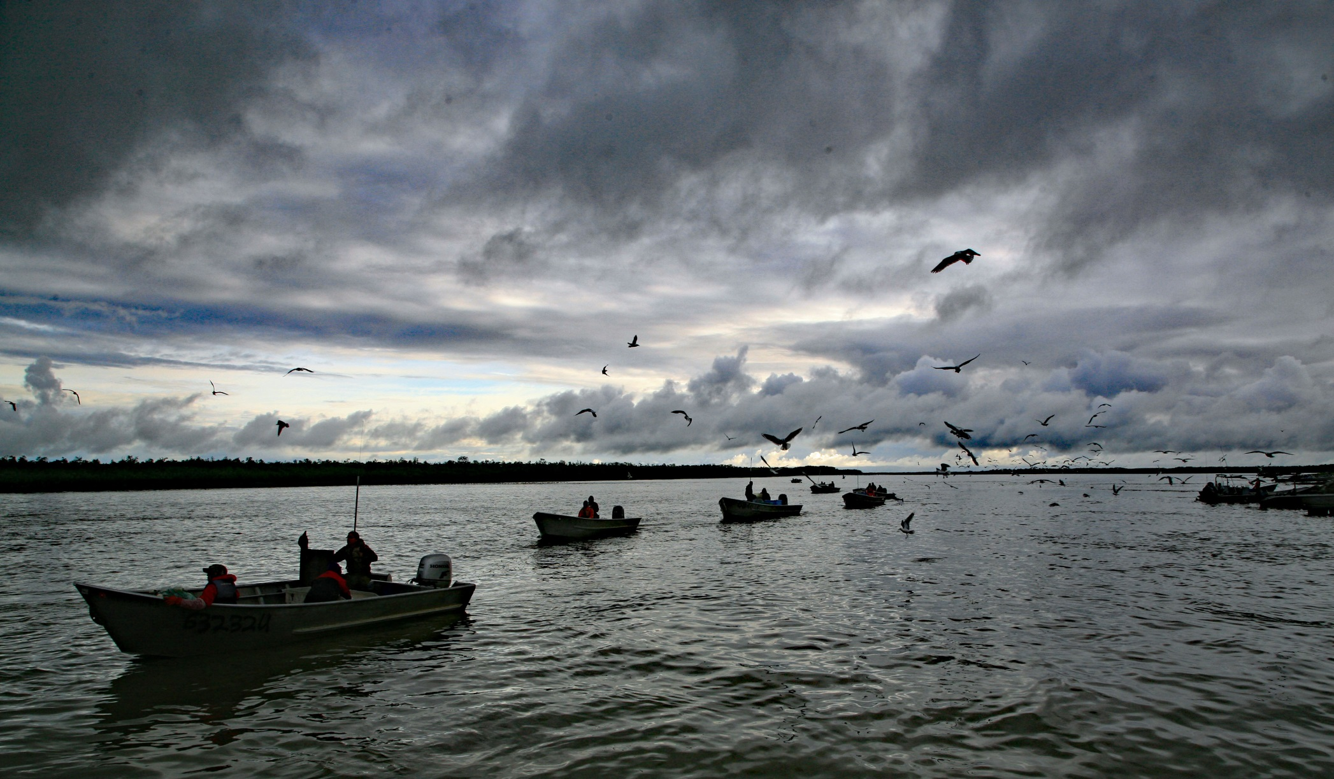
Processor Tender Interface Demo
Configuration
Notes:
Ammon

Slide 43
Processor Tender Interface
The PTI loads the following on the thumb drive:
The tLandings application
A list of eLandings users authorized to login to the tLandings application
Your office staff and the tender operator
Your company’s licenses and the tender vessel’s name and ADF&G vessel number
A list of species that will be delivering to the tender
A unique set of fish ticket numbers that will be assigned to each landing report
Your special defaults – like delivery limit threshold
Notes:
Ammon

Slide 44
Processor Tender Interface
PTI looks slightly different for 2018, when preparing a tLandings thumb drive
You can select an operation and a tender associated with that operation.
You can add or remove tender vessels on operations easily
You can select the configuration profile for the tender, the buying station or the truck if using a tablet
Notes:
Ammon

Slide 45
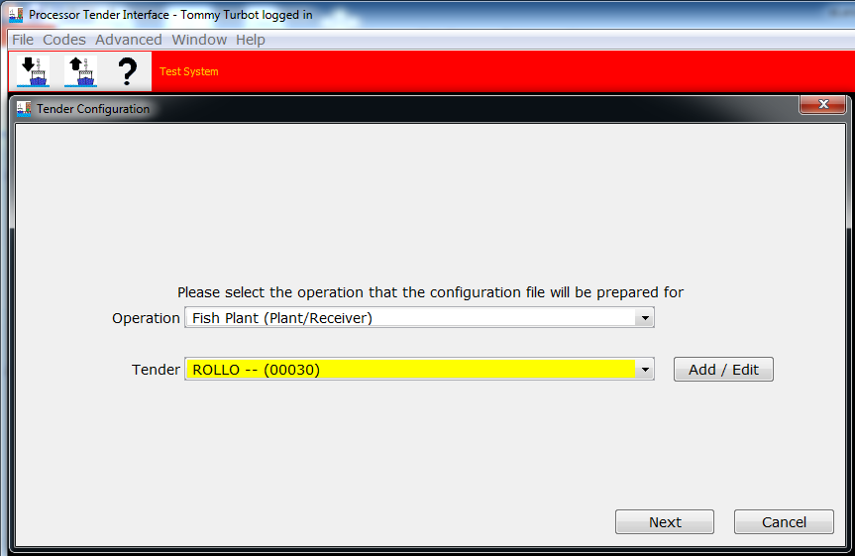
Processor Tender Interface
Notes:
Ammon

Slide 46
Processor Tender Interface
The PTI can be used to configure tLandings for:
  Salmon/Salmon Troll
  Groundfish
The tLandings application is not designed to document IFQ groundfish in the salmon troll or groundfish fisheries.
Notes:
Ammon

Slide 47
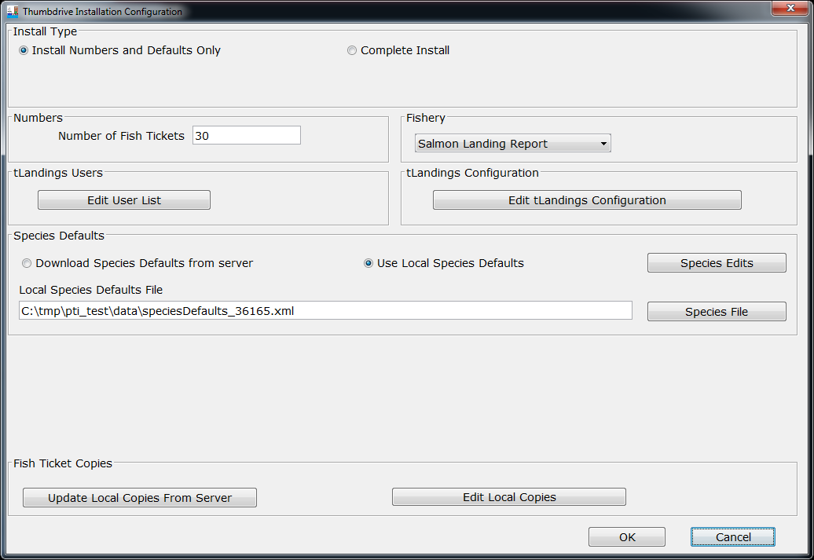
Processor Tender Interface

Slide 48
Processor Tender Interface
You can create multiple species lists for distinct fisheries.
You can change prices within the PTI and tLandings.
We have eliminated the need for vessel lists, as this information is harvested from the CFEC permit card.
Notes:
Ammon

Slide 49
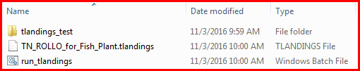
Processor Tender Interface
Once configured the thumb drives contains three files:
Note that this thumb drive is configured for the tender (TN) ROLLO.
Notes:
Ammon

Slide 50

15 minute break

Slide 51
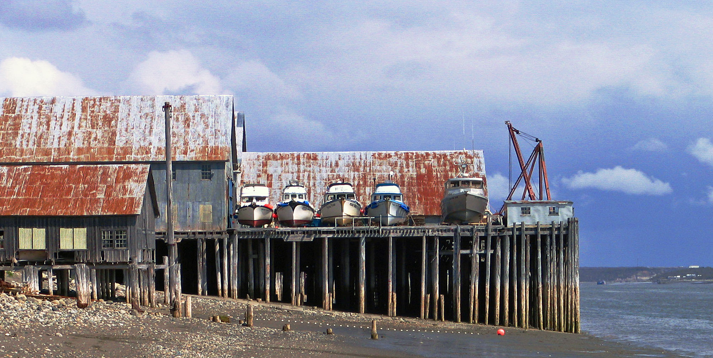
tLandings Demo

Slide 52
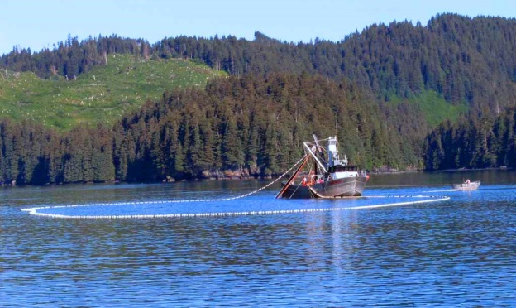
tLandings Demo
Simple Salmon Report
  Record average weight
  Unique stat area on line item
  Record tare weight
  Total weight documentation
  Review of Tally Report

Slide 53
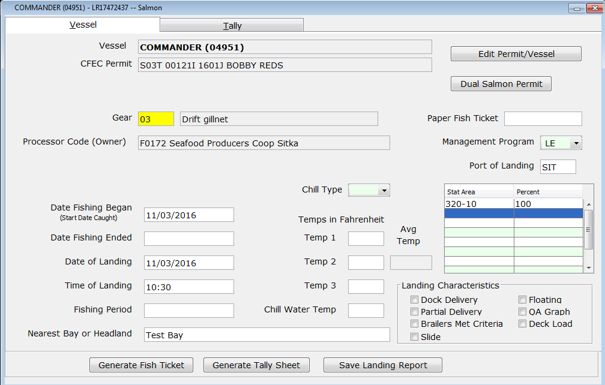
tLandings Display all Fields
Notes:
Ammon

Slide 54
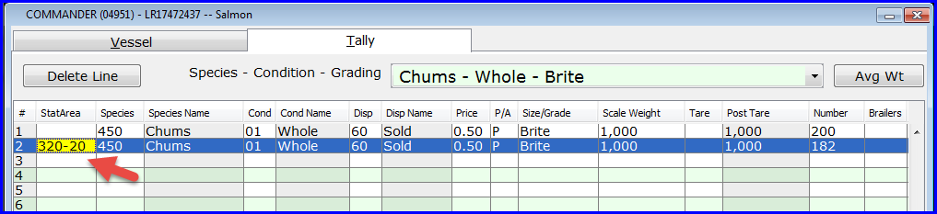
tLandings
You can enter a tally line item stat area if needed:
Outlier from the rest of the ticket
Groundfish stat area on a salmon troll ticket
Notes:
Ammon

Slide 55
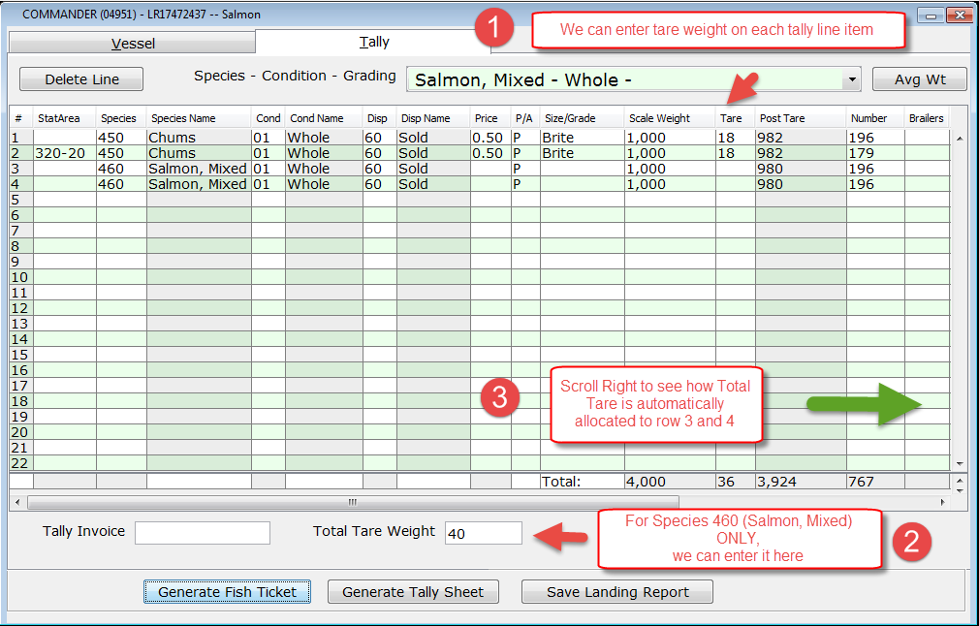
tLandings
Notes:
Ammon

Slide 56
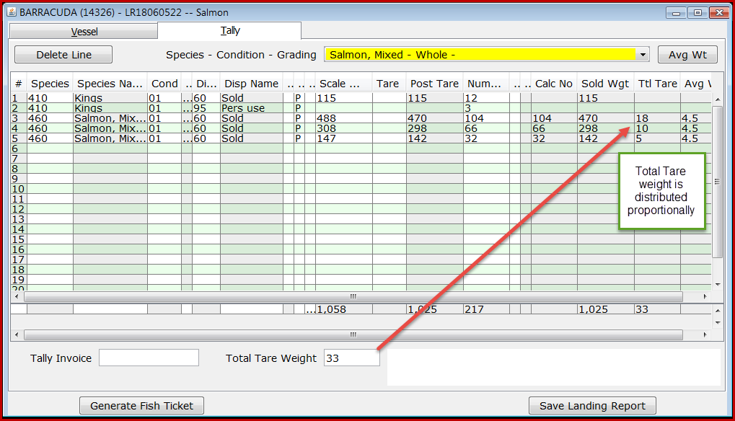
tLandings

Slide 57
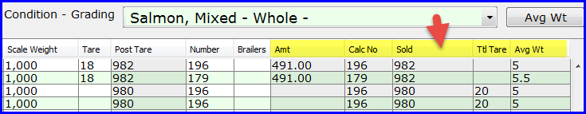
tLandings
The new tally line item columns, on the right side of the table, document system calculates, and help make them more transparent.
Helpful in debugging
Notes:
Ammon

Slide 58
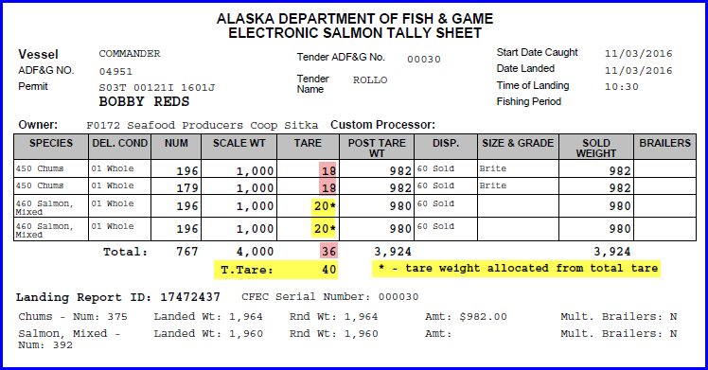
tLandings
The Tally Sheet reports both tare and total tare weights and labels them.
Notes:
Ammon

Slide 59
tLandings Demo
Salmon Troll
Salmon Troll Reporting
  Allocation of number of king salmon
Small kings and Jack kings
  Documentation on the tender log
Notes:
Gail

Slide 60
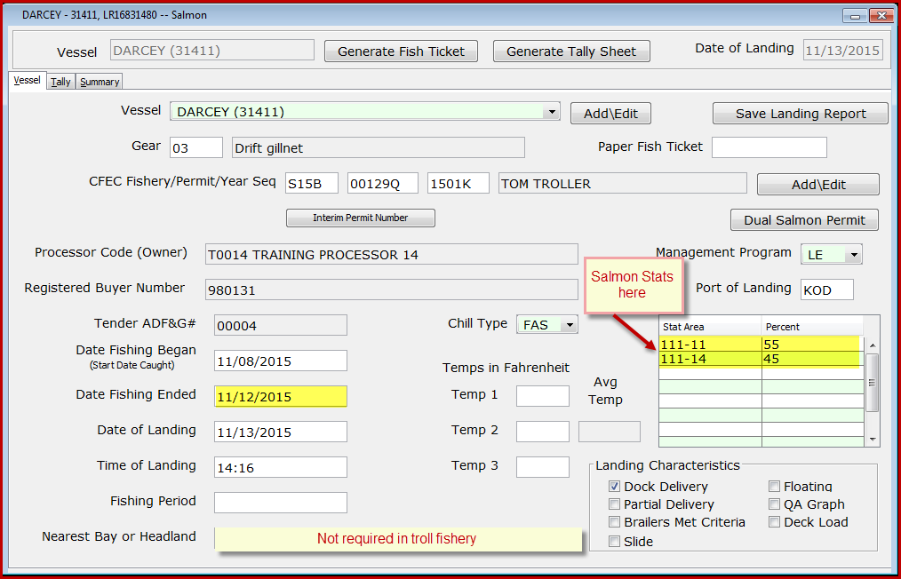
Salmon Troll Reporting
Notes:
Gail

Slide 61
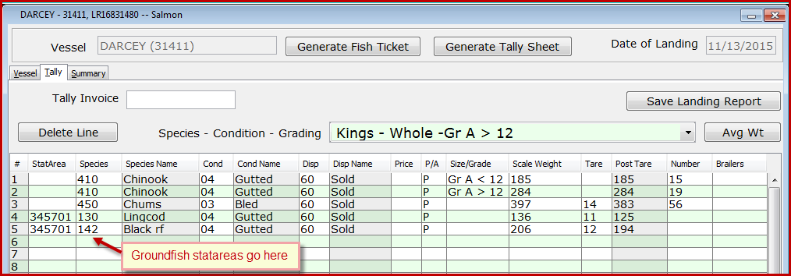
Salmon Troll Reporting
Notes:
Gail

Slide 62
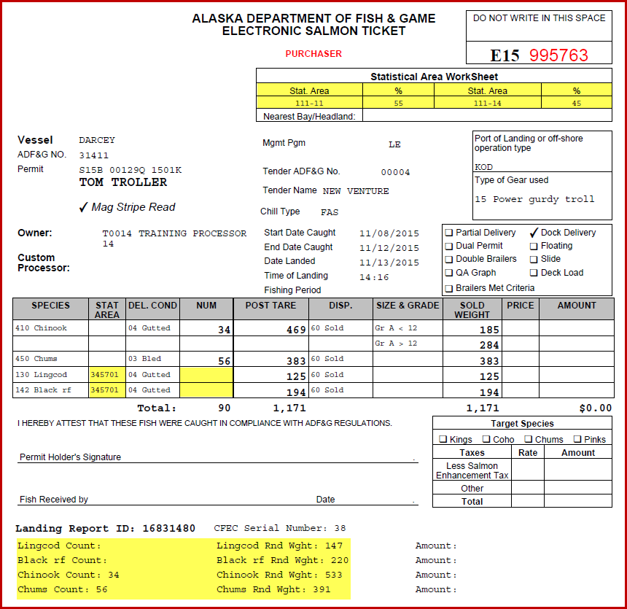
Salmon Troll Reporting

Slide 63
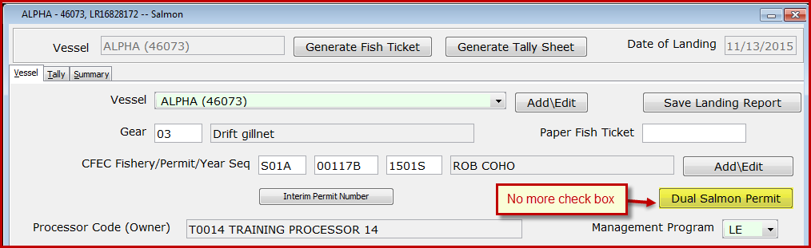
Dual Permit Documentation
Notes:
Gail

Slide 64
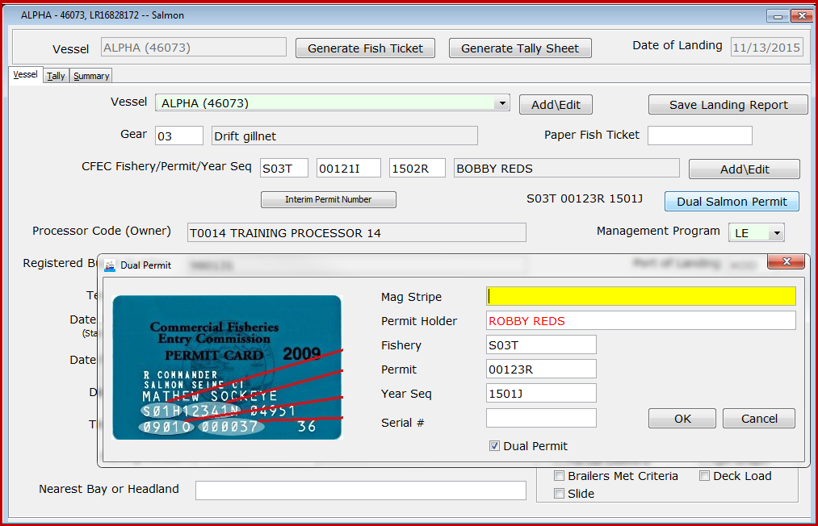
Dual Permit Documentation
Notes:
Gail

Slide 65
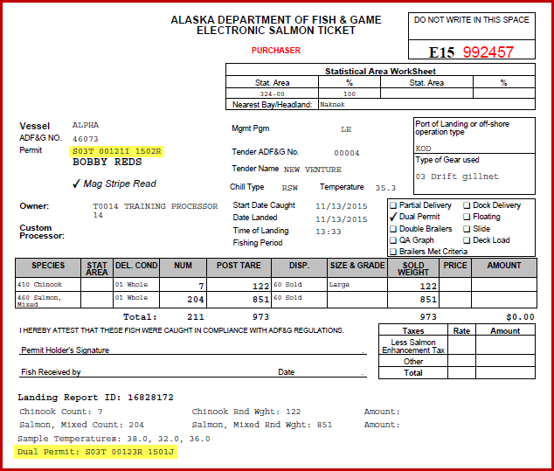
Dual Permit Documentation
Notes:
Gail

Slide 66
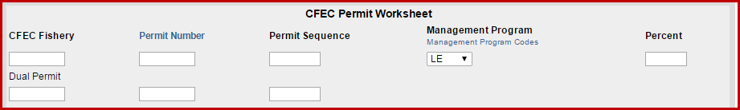
Dual Permit Documentation eLandings Web
Notes:
Gail

Slide 67
tLandings Reports
Summary Reports
  Species Summary
  Species and Statarea Summary
Personal Use Report
Tender Log Report
Notes:
Gail

Slide 68
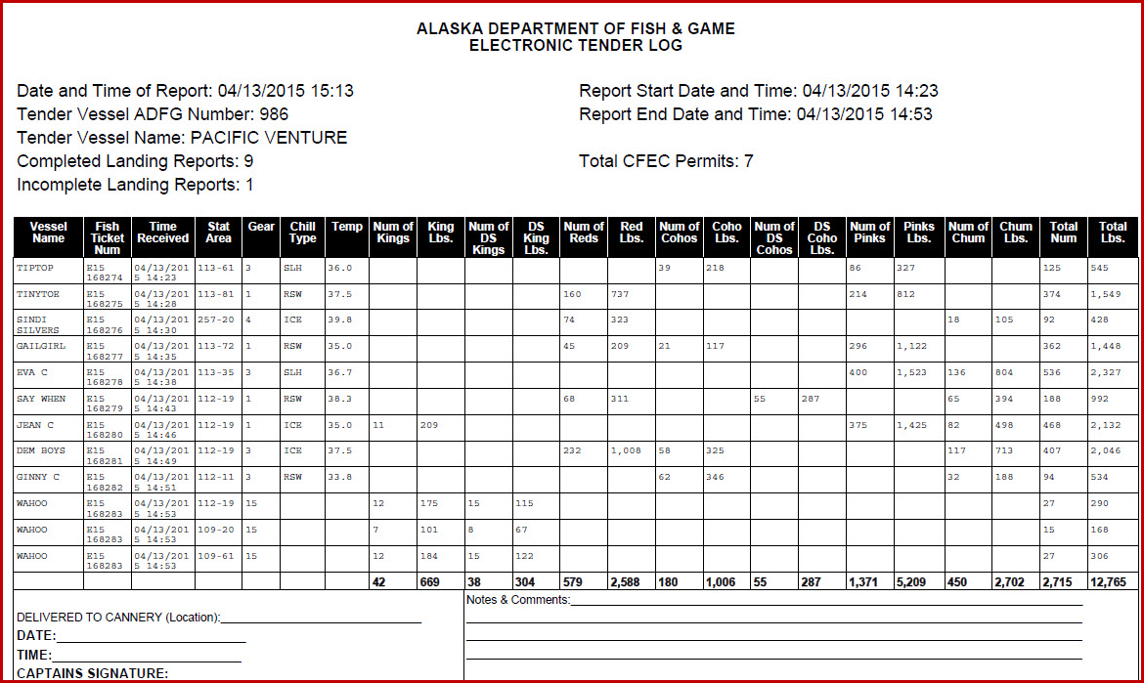
tLandings Generated Reports
Tender Trip Log
Notes:
Gail

Slide 69

New 2018 Features Re-Cap
Customized Display for Vessel tab and Tally tab
Storable configuration profiles
eTablet display with ten key
Notes:
Ammon

Slide 70
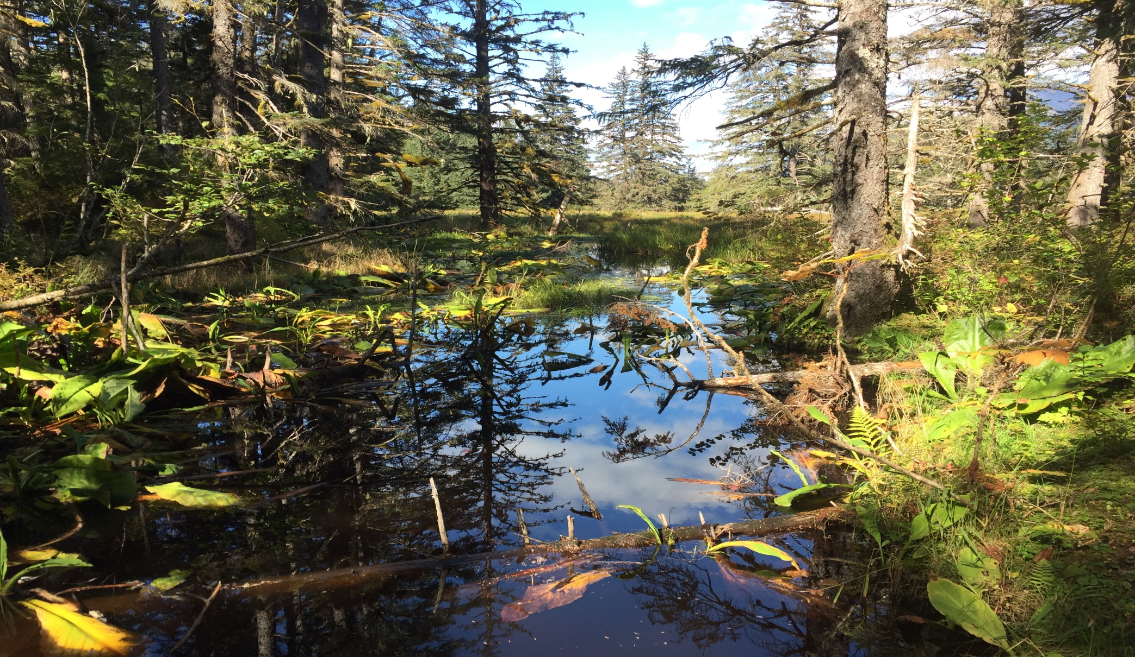
Break

Slide 71
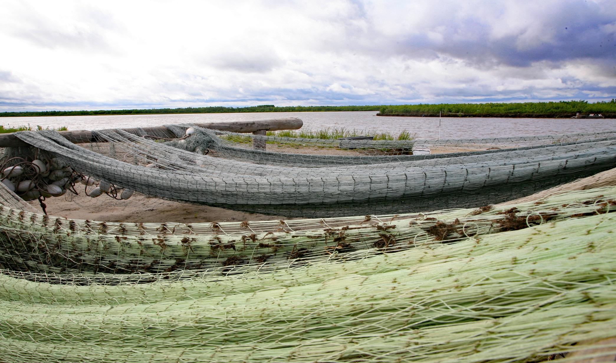
PTI Demo

Slide 72
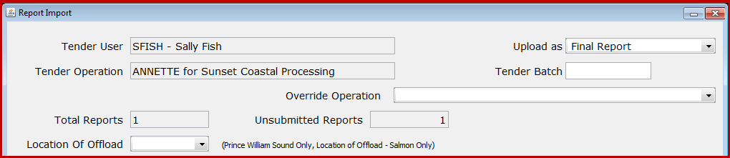
PTI Data Upload
Assignment of Tender Batch ID
How to modify a processor and port code
Data Correction
Notes:
Gail

Slide 73
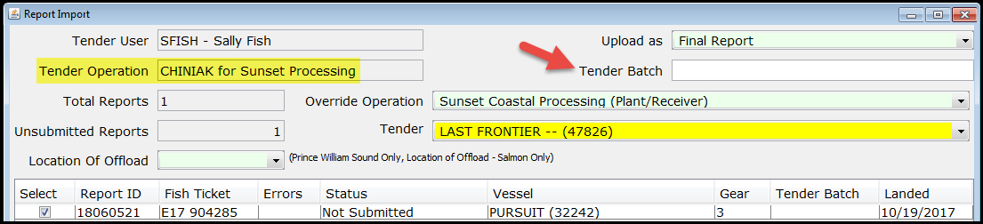
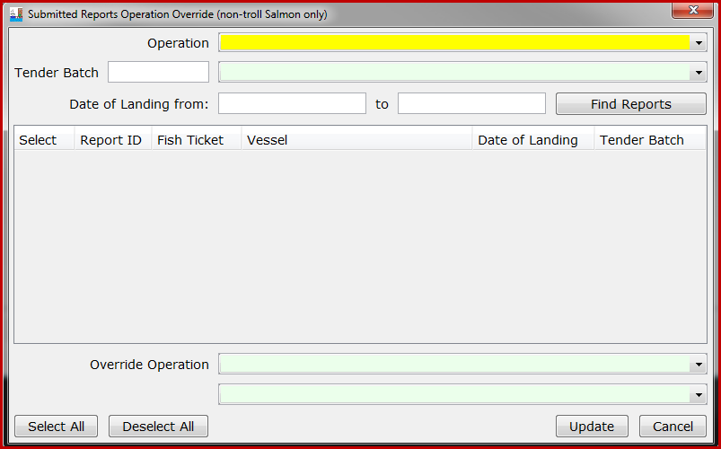
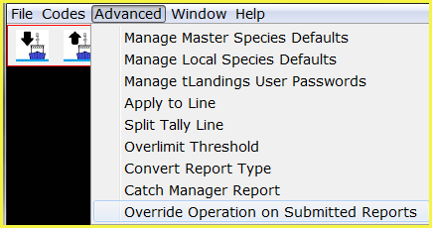
Convert Processor Code, Port and Tender

Slide 74
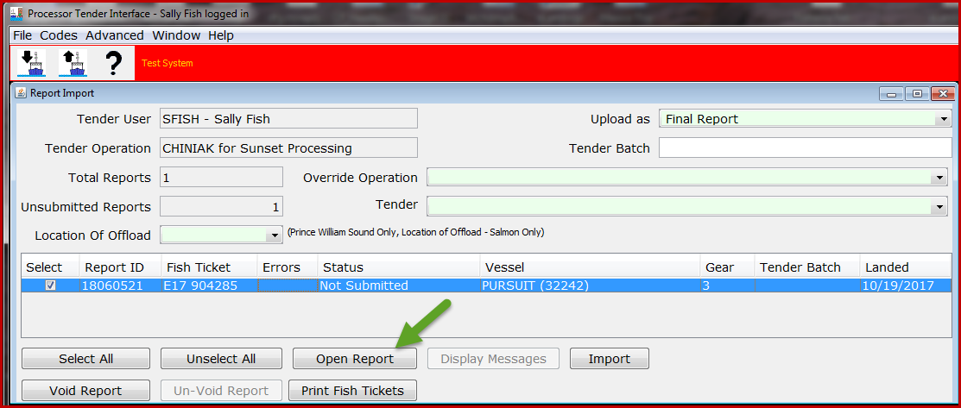
Open, Review and Correct Report

Slide 75
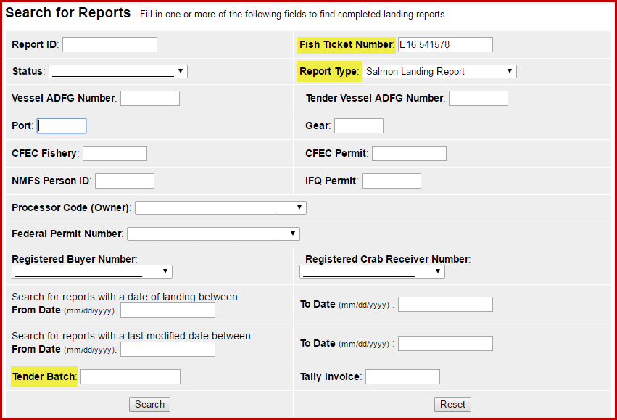
Corrections within eLandings
Search for report(s)
Notes:
Gail

Slide 76
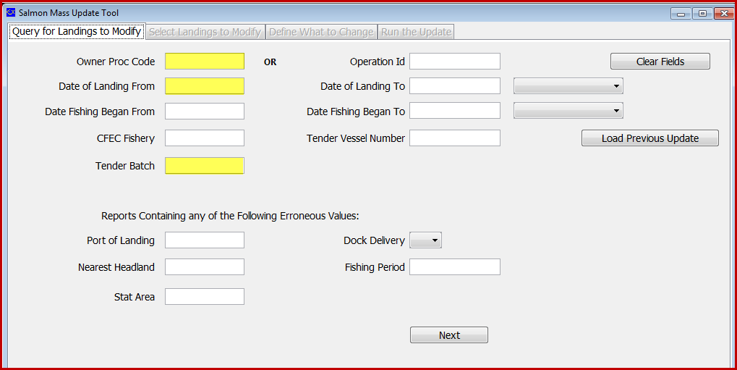
Mass Salmon Update
Notes:
Gail

Slide 77
Mass Salmon Update
Fields I can edit:
  Date of Landing
  Date Fishing Began
  Statistical Area
  Nearest Bay or Headland
  Dock Delivery
  Fishing Period
  Port of Landing
  Tender Batch
  Operation Info – processor code
  Overlimits Threshold
  Tender ADF&G
  Final Submit
Notes:
Gail

Slide 78
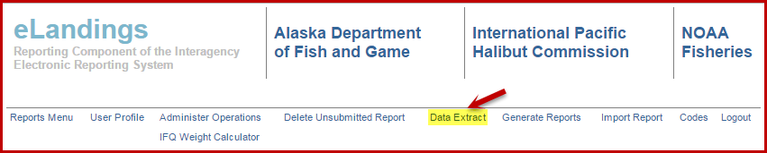
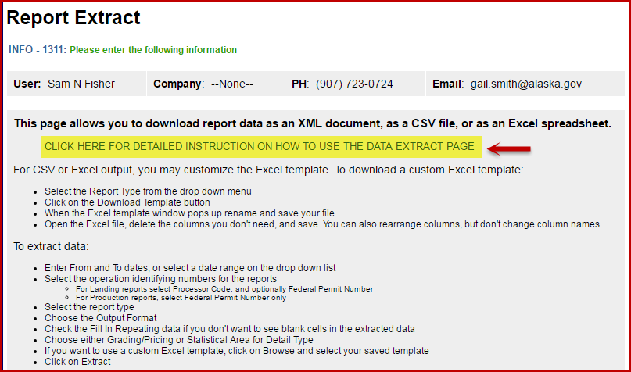
Data Extraction Tool
Notes:
Gail

Slide 79


Data Extraction Tool
Download template.
Create a unique report template.
Save report template locally with unique name.
Report can be run again and again with different date ranges.
Report results will be email.
Notes:
Gail

Slide 80
Web Services Data Interface
eLandings provides a public web service interface for 3rd party developers to connect to.
This allows them to:
  Search for and Download eLandings data directly into 3rd party applications
  Submit Non-IFQ Landing Reports to eLandings directly from 3rd party applications
https://elandings.atlassian.net/wiki/display/ifdoc/Public+Web+Service+Documentation
Notes:
Ammon

Slide 81


Slide 82
Web Services Data Interface
If you are using eLandings public web services be aware of the following:
Release Notes Documentation
  https://elandings.atlassian.net/wiki/display/doc/Release+Notes
XML Schema Change Documentation
  https://elandings.atlassian.net/wiki/display/ifdoc/Schema+Version+History

Slide 83


eLandings Generated Reports
Notes:
Gail

Slide 84


eLandings Generated Reports
Mixed Salmon Update
All fish tickets with the species code 460 – Mixed Salmon must be updated before running the Bristol Bay Weekly Report
Notes:
Ammon

Slide 85

Notes:
Ammon

Slide 86

Notes:
Ammon

Slide 87

Notes:
Ammon

Slide 88

User Support Resources
Training DVD for 2018 PTI and training exercises
Bottom of every eLandings Page:
Gail is available to assist with Mass Updates
Programmer Support
Notes:
Gail/Ammon

Slide 89
eLandings System
Equipment
Office
        Workstation to install PTI
        Thumb drives (No longer provided by ADF&G)
Tender
        Inexpensive laptop computer
        Inexpensive B/W laser printer
        Magnetic card swipe – Keyboard Emulation
Notes:
Ammon

Slide 90
Seasonal Procedures
Spring
Download new version of PTI
Delete all prior versions of tLandings from thumb drives
Assure that all equipment is operational and updated
Start of season
Train tender operators
End of Season
Inventory equipment and thumb drives
Clean all equipment to remove salt residue
Determine if repairs or replacements need to occur
Possibly delete all files off of thumb drives
Notes:
Gail

Slide 91

Break

Slide 92
ADF&G Information Services
Shellene Hutter, Seafood Industry Coordinator 907-465-6131
Jennifer Shriver, Information Services, 907-465-6133
There is now a $25 permit processing fee for all ADF&G only permits, catcher seller, fish transporter, EEZ-Only, and Intendent Buyer.

Slide 93
Web Resources
CFEC Website: https://www.cfec.state.ak.us/
Alaska Department of Revenue: https://online-tax.alaska.gov/ATP/WebDoc/_/
ADF&G Division of Commercial Fisheries: http://www.adfg.alaska.gov/index.cfm?adfg=fishingCommercial.main

Slide 94
COAR Resources
http://www.adfg.alaska.gov/index.cfm?adfg=fishlicense.coar

Slide 95
eTablet
Designed to facilitate electronic reporting for beach-based deliveries ~ set net sites
Successful proof of concept field trials summer 2017
Notes:
Gail

Slide 96

eTablet Demo

Slide 97
eTablet Equipment Recommendations

Slide 98


QUESTIONS?
Notes:
All

Slide 99

tLandings for Groundfish
Demo
Notes:
Gail/Suja

