Slide 1
How to Use the eFISH Portal to Pay Your 2013 Observer Fees

Slide 2
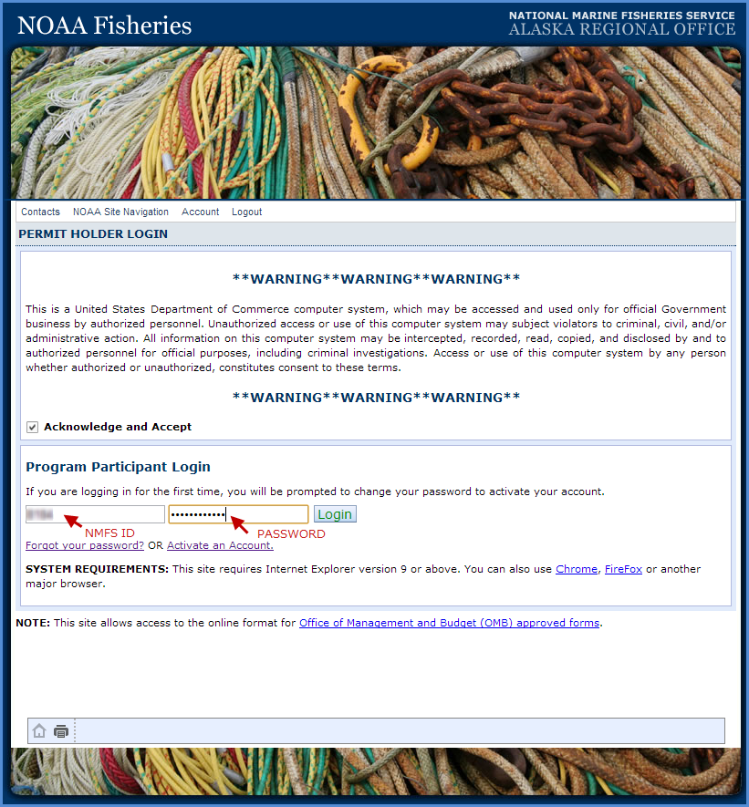
Go to: https://alaskafisheries.noaa.gov/webapps/efish/login
Make sure you check the Acknowledge and Accept checkbox
Enter your NMFS ID
Enter your Password
Click on the Login button

Slide 3
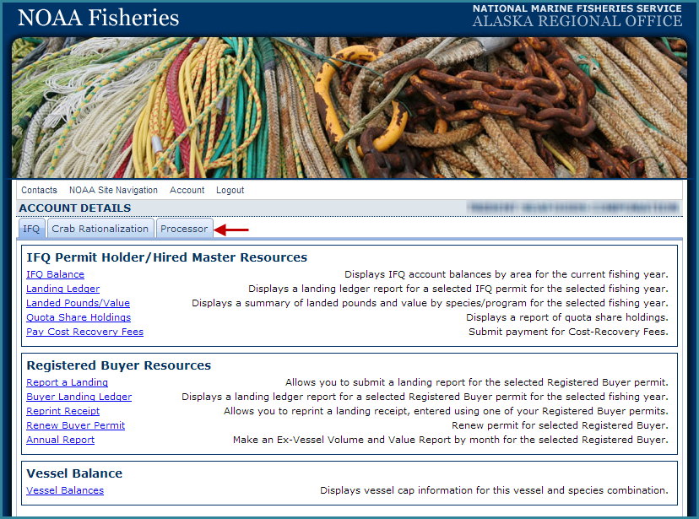
The default menu opens on the IFQ tab
Click on the Processor tab to display those menu items

Slide 4
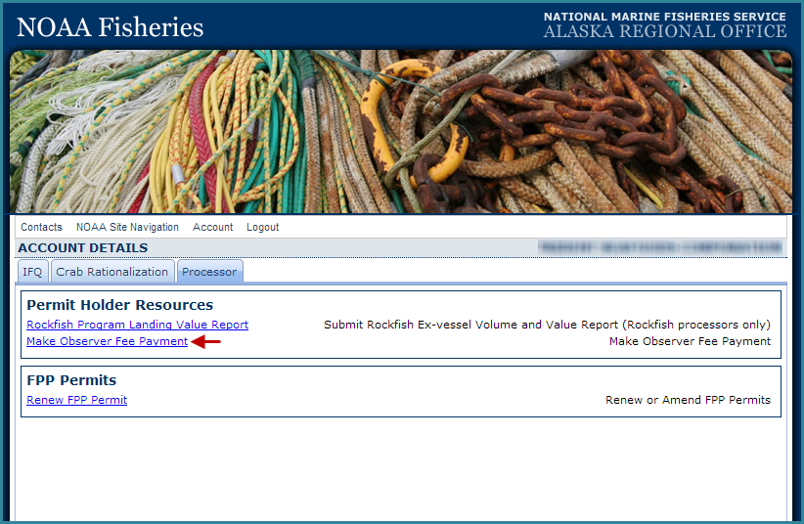
Click on the Make Observer Fee Payment link in blue text

Slide 5
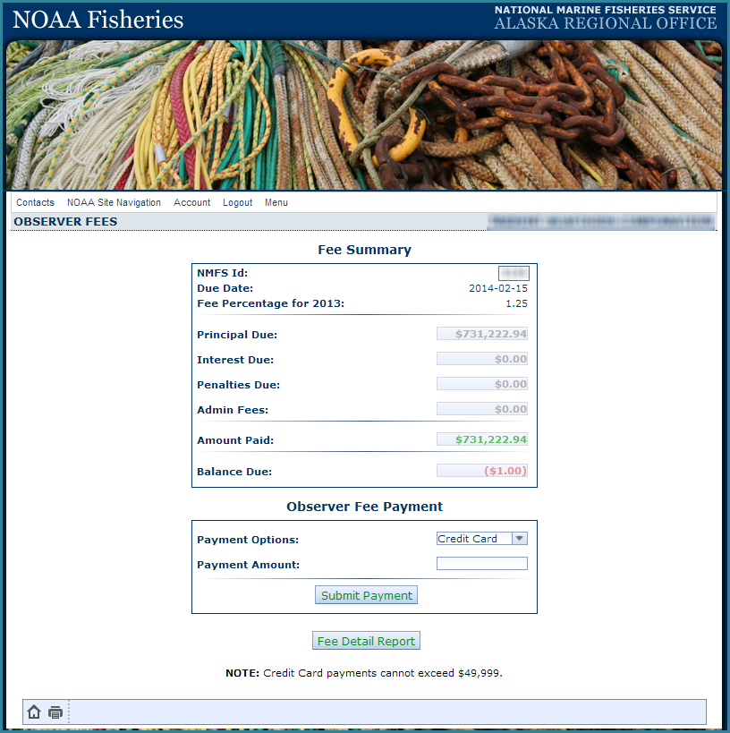
Observer Fees – Payment Options
You can pay your fees via credit card* or ACH**
Once you select your payment method, click on the Submit Payment button
Visa
MasterCard
American Express
Discover
*Credit card payments cannot exceed $49,999.00
** Automated Clearing House (ACH) electronic debit from checking or savings accounts

Slide 6
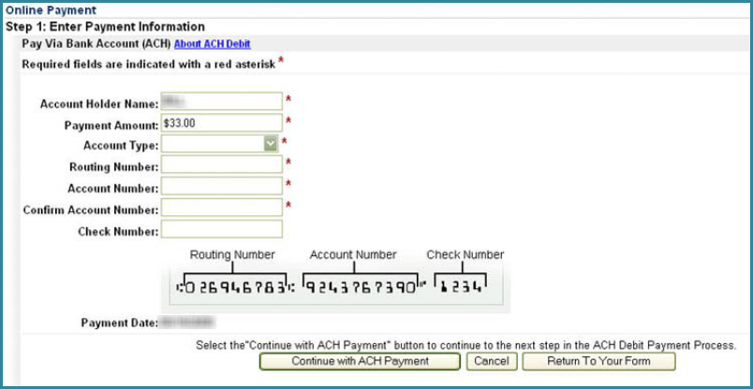
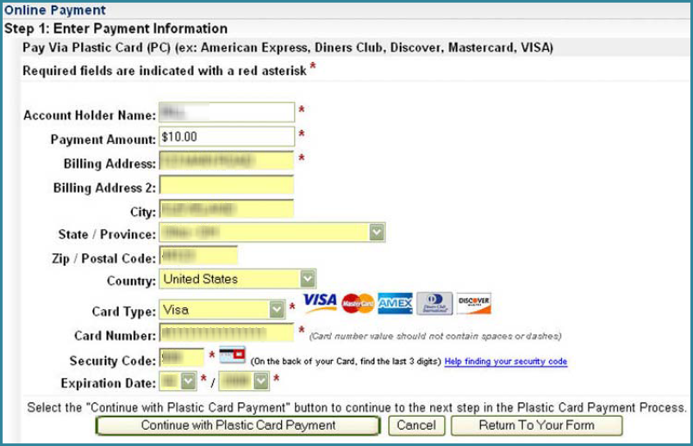
Online Payment Forms
ACH Payment Form - direct debit from checking or savings account
Credit Card Payment Form – cannot exceed $49,999.00
Once your payment has been submitted, a receipt will be generated

Slide 7
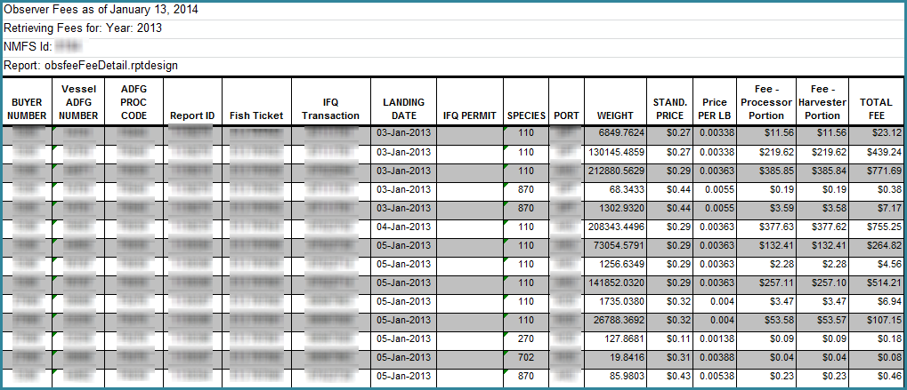
Observer Fees – Fee Detail Report
You can generate the Fee Detail Report by clicking on the button
Make sure you have your pop-up blocker turned off in your web browser
The report will be generated as an excel spreadsheet
A Microsoft window will pop-up telling you that you need to verify that you want to open the file

Slide 8
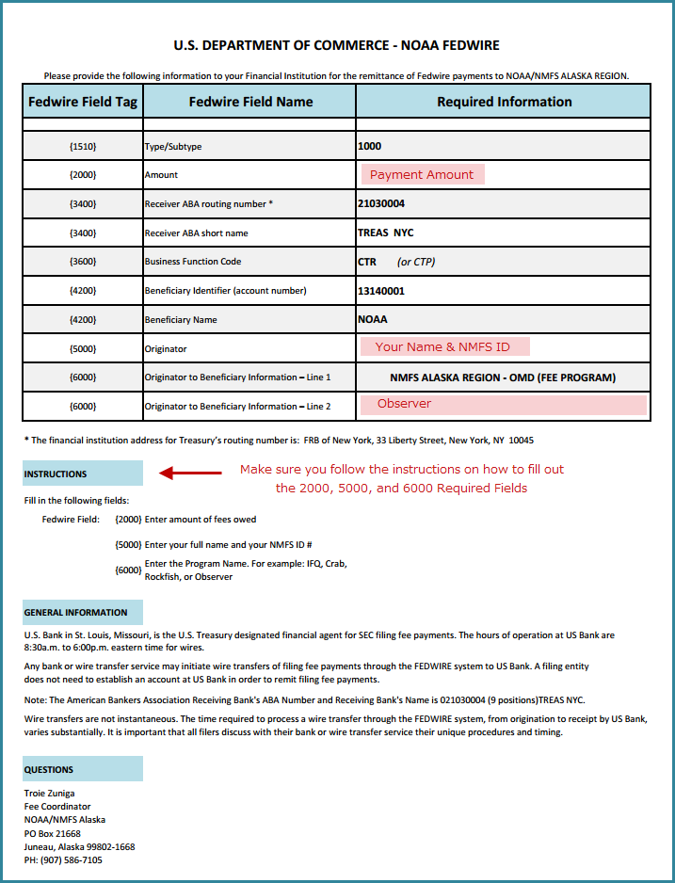
FedWire Payment
This method of payment uses your financial institution to push through your payment via a wire transfer
To locate this form, go to http://alaskafisheries.noaa.gov/sustainablefisheries/observers/default.htm
Click on FEDWIRE form in blue text
There are three required fields:
the Amount {2000}
the Name and NMFS ID of the person/company {5000}
the Originator to Beneficiary {6000}
Take the completed form to your financial institution
If you have any questions about the eFISH portal or eLandings contact NMFS.akr.ram@noaa.gov or call 1-800-304-4846 opt 2

