Slide 1
eLandings Help: Where, When, and How to Get Assistance

Slide 2
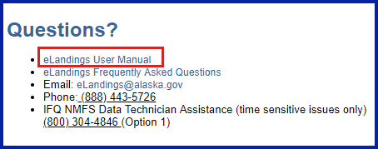
Website Assistance for eLandings
A link to the eLandings User Manual can be found at the bottom of each eLandings page
The User Manual can also be found at: https://elandings.atlassian.net/wiki/spaces/doc/pages/10427531/eLandings+User+Manual

Slide 3
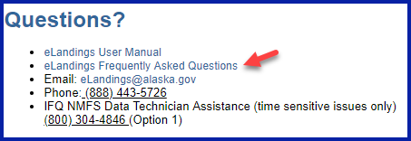
Other website that have helpful information are:
eLandings FAQ’s page:
https://elandings.atlassian.net/wiki/display/doc/eLandings+Reporting+System+FAQ%27s
ADF&G Commercial Fishing:
http://www.adfg.alaska.gov/index.cfm?adfg=fishingCommercial.main
The International Pacific Halibut Commission:
http://www.iphc.int/
The National Marine Fisheries Service (NOAA Fisheries)
https://alaskafisheries.noaa.gov

Slide 4
Have you been temporarily disconnect from Internet?
Instructions on how to report IFQ, groundfish, and salmon landings when you lose internet connectivity can be found here: https://elandings.alaska.gov/
Print out the instructions and forms in advance so that you will be prepared when/if you lose connectivity.

Slide 5
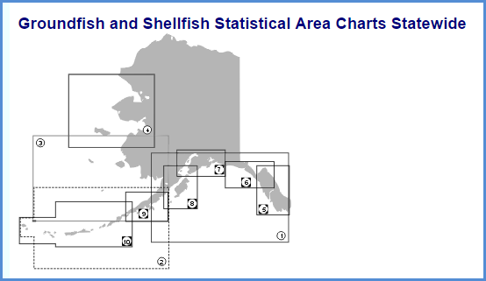
On-line Charts
Fishery Maps and Charts can be found in the following locations:
https://alaskafisheries.noaa.gov/maps
http://www.adfg.alaska.gov/index.cfm?adfg=fishingCommercialByFishery.statmaps

Slide 6
Is your problem time sensitive?
I need help right now!
IFQ report, IFQ permit
NMFS Enforcement data technicians: (800) 304-4846, Option 1
Problems with CFEC permit:
https://www.cfec.state.ak.us/
Use Interim Values until you can speak with a support person
Contact the eLandings group at elandings@alaska.gov
It can wait until Monday...
I accidentally created a duplicate report and need to have one deleted
I need to edit a report but it’s past the 90 day cut off
We are thinking of setting up a new custom processing operation
I am getting an error on the pricing and grading page
eLandings@alaska.gov

Slide 7
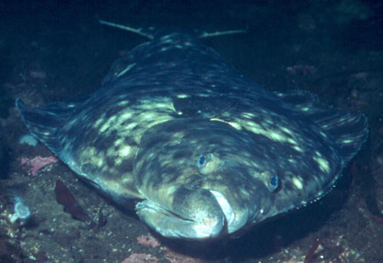
Who to Contact: email us anytime at: eLandings@alaska.gov
Guy Becken
eLandings Support: (907) 586-7462 elandings@alaska.gov
Sara.Villafuerte@noaa.gov and Claire.Minelga@noaa.gov
Suja.Hall@noaa.gov
Regular Business hours Mon-Fri
Groundfish & IFQ landings, Production reports, seaLandings, ELB, Observer fees
Gail Smith, Gail.Smith@alaska.gov ADF&G
Business hours, Mon-Fri
Fish tickets, tLandings & PTI, salmon troll bycatch reporting
Lara Erikson, Lara@iphc.int IPHC
Business hours, Mon-Fri
Halibut issues, vessel clearances, Area 4 reporting
NMFS Enforcement data technicians: (800) 304-4846 option 1
18 hours/day, 7 days a week; nights/weekends
Time-sensitive issues, IFQ questions, MLR’s, PTR’s

