Slide 1

tLandings for Groundfish and Salmon
2019
Elaine Brewer, ADF&G
Johnathan Fultz, ADF&G
Jennifer Womack, eLandings Support
Wostmann and Associates

Slide 2

Welcome
Housekeeping
Breaks and snacks
Agenda review
We plan to present this information quickly and provide time after the formal workshop to review again
Questions – ask if you do not understand!
Handouts
Notes:
Elaine

Slide 3
32 Bit laptops will not be supported beginning January 1, 2020
Please review your hardware and plan accordingly.

Slide 4

eLandings
Quick Overview
eLandings =
Interagency Electronic Reporting System (IERS)
tLandings =
Electronic reporting application for tenders and buying stations without internet service
Notes:
Elaine

Slide 5



eLandings for Salmon Components
Processor-Tender Interface
Web-based application to configure thumb drives and upload landing reports
eLandings
Web-based reporting of landings
tLandings
Reporting from tender vessels via USB drive
eLandings Repository Database
Notes:
Elaine

Slide 6
eLandings System
eLandings Database stores:
    Your Operation licenses and permits
    Your User Accounts
    Species and pricing
    Configuration profiles
    Your landing reports (fish ticket records)
    Remember! 2016 Landing Reports will be archived Jan 1, 2019.
Notes:
Elaine

Slide 7
eLandings System
tLandings Thumb drive stores:
    The tLandings application
    Your Operation licenses
    The Tender Vessel information
    Your user accounts to access the thumb drive
    Your species list
    Unique landing report and fish ticket numbers
    and landing reports
Notes:
Elaine

Slide 8

eLandings System
Processor – Tender Interface (PTI)
  Web-based application
    Loads data on thumb drive – license/permits, user accounts, vessel and species information and unique numbers
    Allows you to view & correct reports
    Allows you to assign a tender batch ID
    Allows you to modify the processor (buyer) and port
    After the tender trip – uploads report
Notes:
Elaine

Slide 9
eLandings System
tLandings application
    Loaded on the thumb drive
    Used by tenders, buying stations and even office locations to report salmon and groundfish landings
    Each configured thumb drive is unique to tender
    Generates tender reports:
        Species summary
        Species/statarea summary
        Tender trip log report
        Personal Use Report
    Does not require the internet
Notes:
Elaine

Slide 10
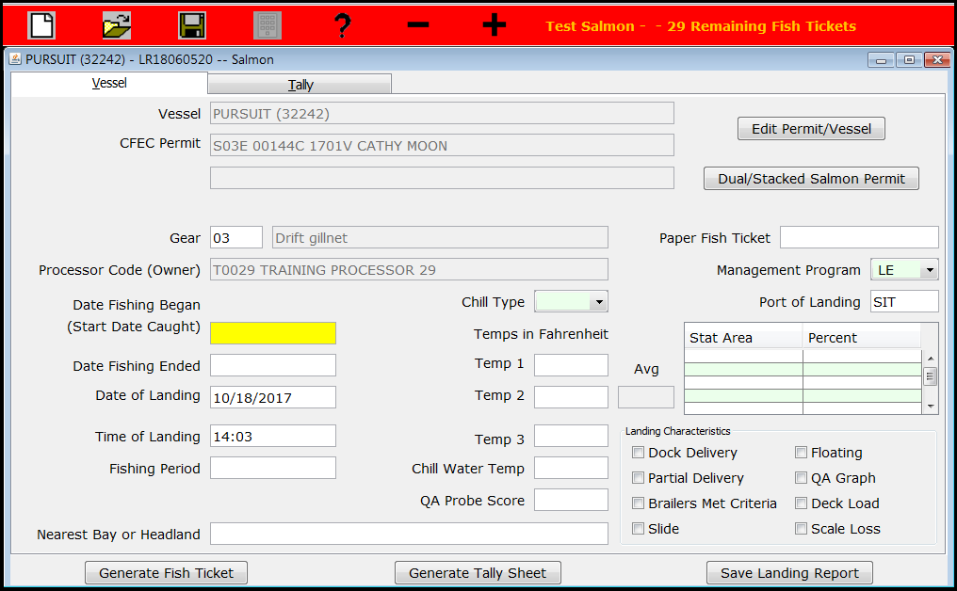
Customized Display
Standard Default

Slide 11
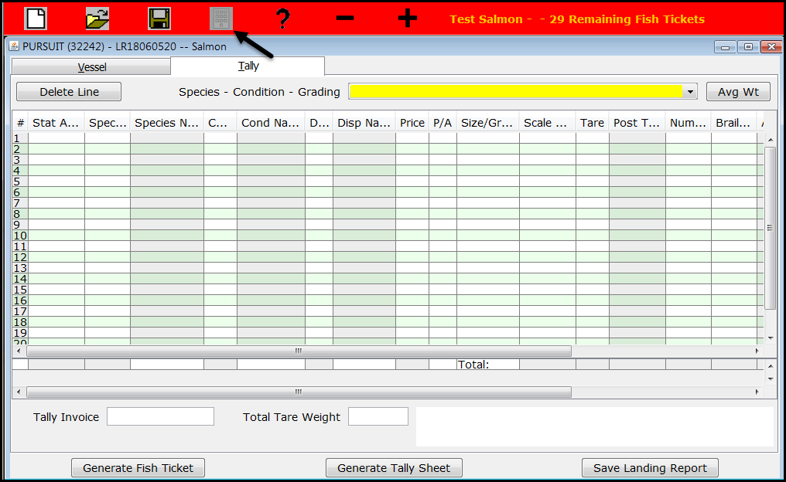
Custom Display
Standard Default

Slide 12
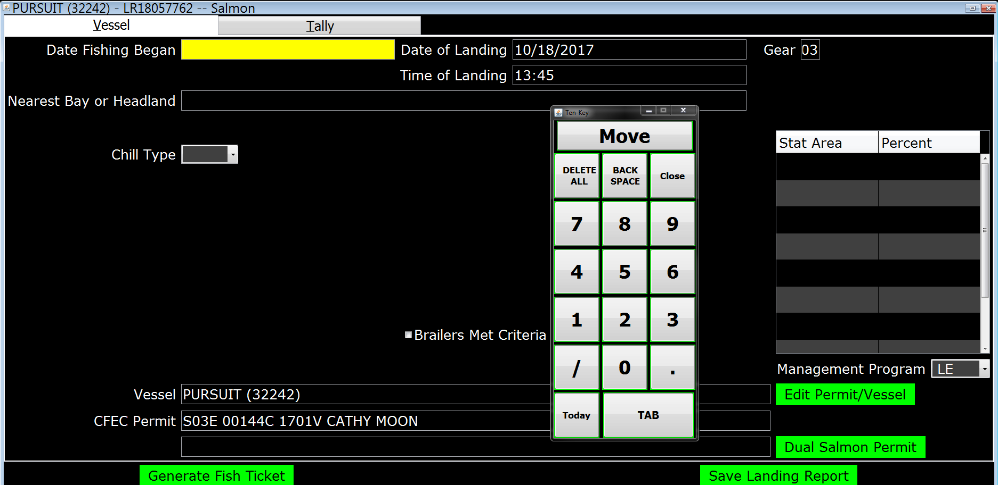
eTablet Display
Vessel page
Notes:
Need to ask who’s used the tablet this year in production?

Slide 13
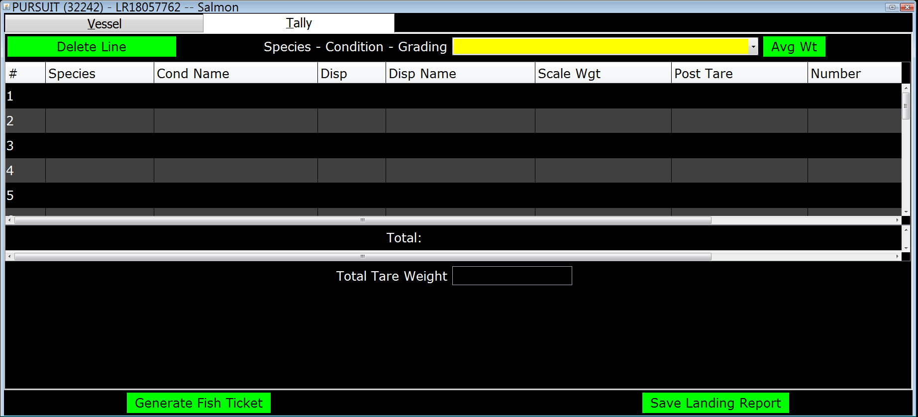
eTablet Display
Tally page

Slide 14
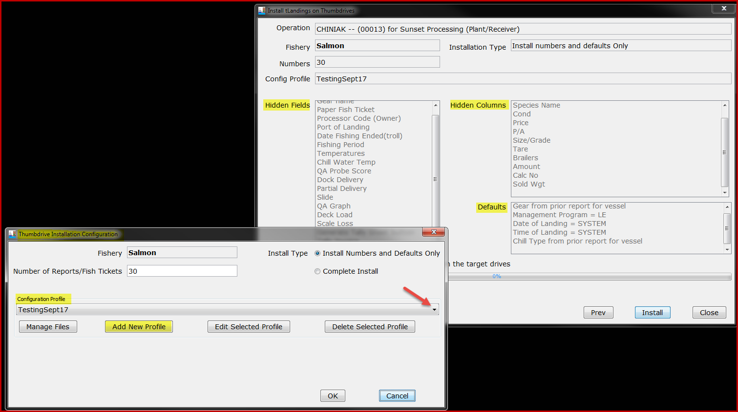
Configuration Profiles
Stored and Selectable

Slide 15
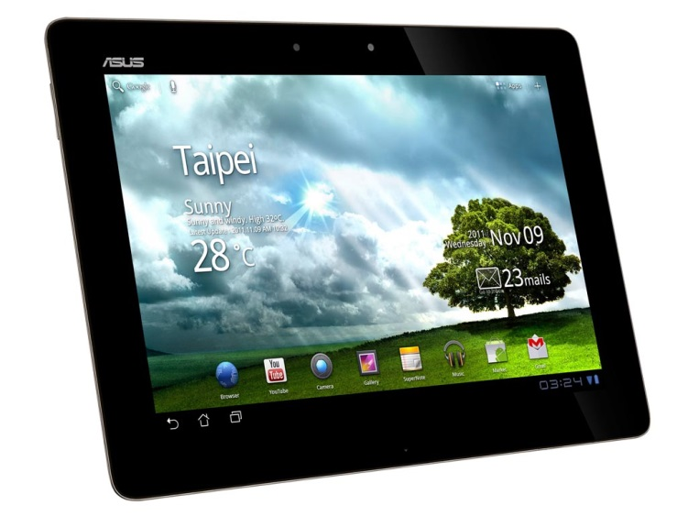
eTablet
Designed to facilitate electronic reporting for beach-based deliveries ~ set net sites
Successful use in production 2018 season

Slide 16
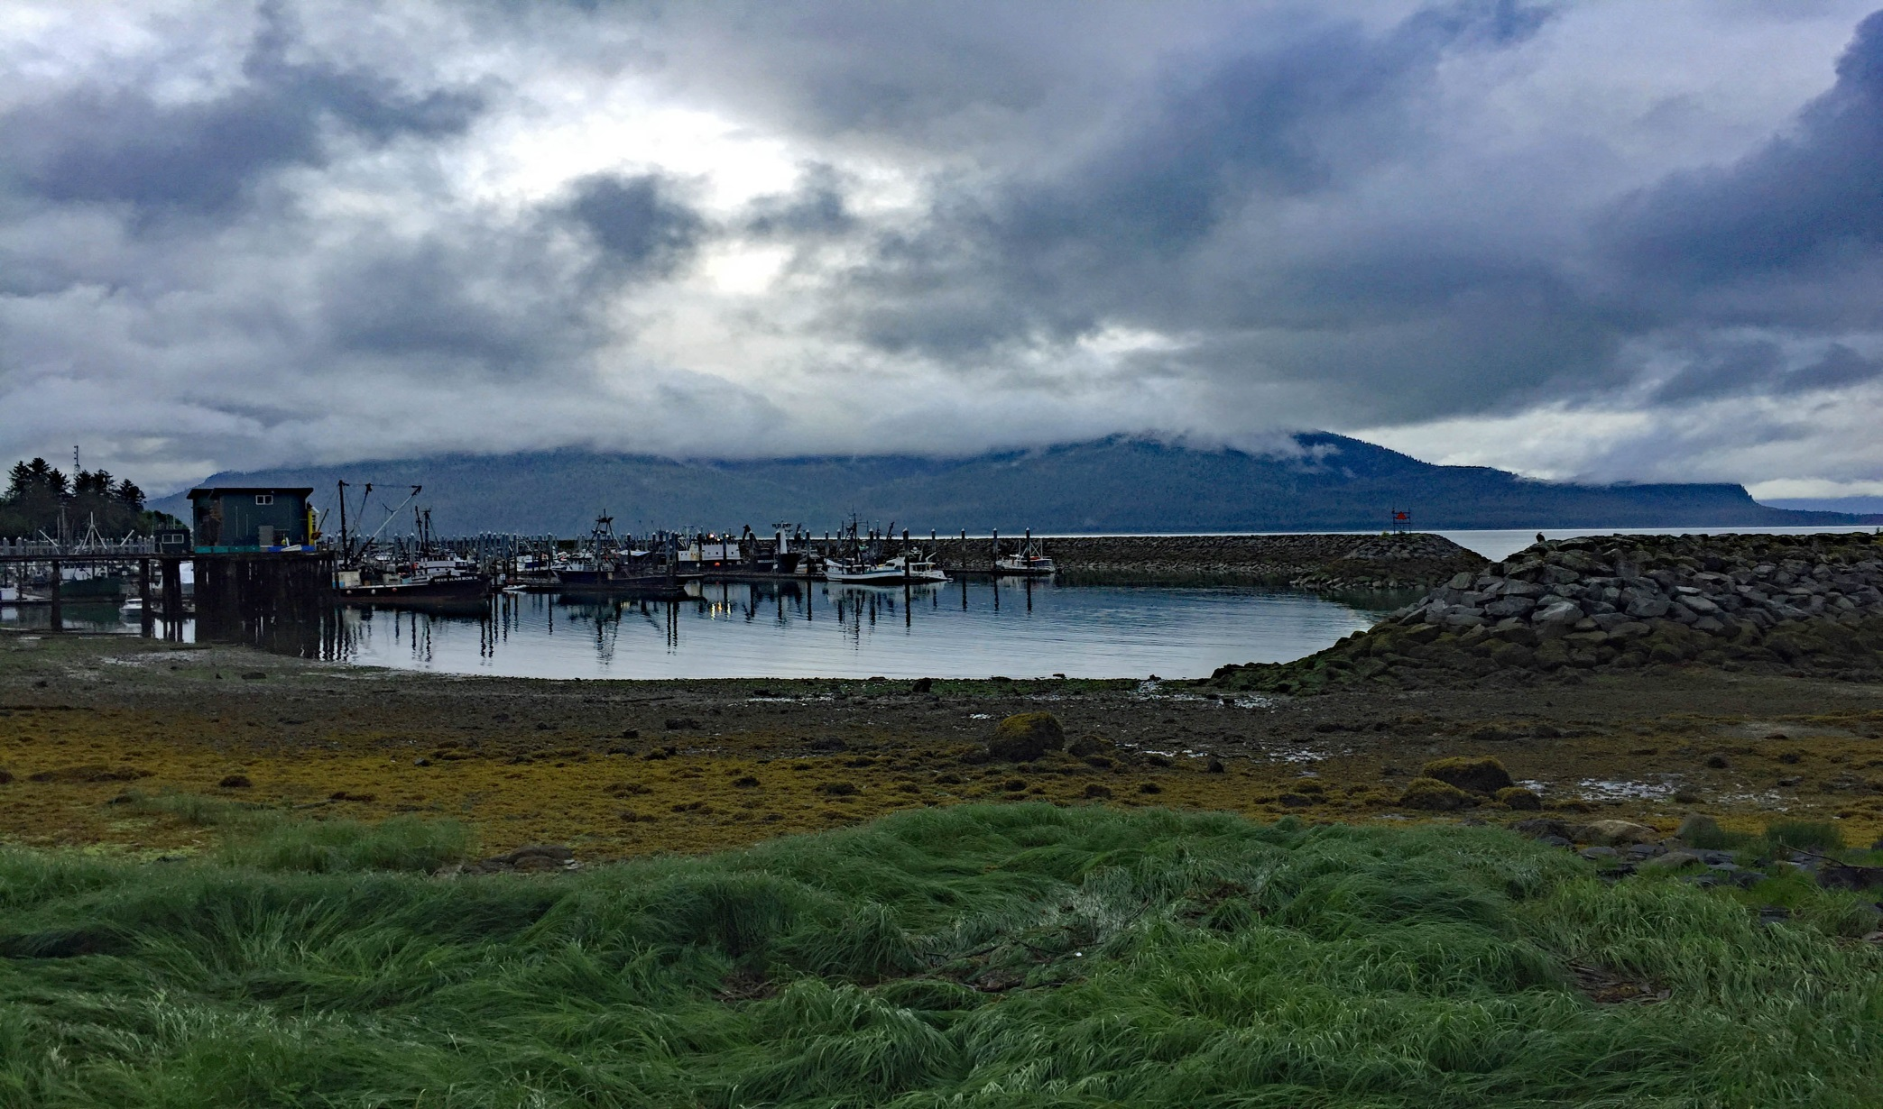
ADF&G Reporting Requirements and Expectations
Notes:
Jen

Slide 17
ADF&G Reporting Requirements
Commercial Fisheries reporting requirements are located in each regulatory book:
General Provisions - 5 AAC 39.130
Fishers and processing staff must be familiar with this regulation, including seasonal staff, to assure compliance.
Each delivery must be recorded on a fish ticket.
Each fish ticket must be signed by the fisher or fishers if dual fishery.
Signed copies of each completed fish ticket must be submitted to ADF&G within 7 days.
Bristol Bay processors must update mixed salmon species to unique species prior to the submission of the Bristol Bay Weekly Report.
Notes:
Jen

Slide 18
Additional Requirements from Area Management Biologists (AMB)
Check with your local area office they will have specific reporting requirements for that area
BRISTOL BAY
Both permit holder signatures on fish tickets for dual drift operations.
All kings either sold or personal use shall be reported on a fish ticket.
Apply chum percentages prior to uploading to tLandings on the Eastside.
Coho to must be reported on fish tickets as well and chum percentages should be applied for the Westside
Use correct stat areas (we provide maps).
Fish tickets shall be submitted within 7 days.
Include the copy of the B ticket if they are entered into tLandings.
Notes:
Jen

Slide 19
Upper Cook Inlet
For those e-tickets that were created from a yellow paper ticket, especially when the paper ticket has the fisherman’s signature, please remember to attach the paper ticket with the e-ticket when submitting these to the ADF&G office.
It also would be very helpful for processors to attach a copy of the tender log (lists all tickets) to tickets being submitted to ADF&G.
Make sure you are buying fish from the permit card holder and it is the permit card holder signing the fish ticket.
Notes:
Jen

Slide 20
Commercial Operator’s Annual Report (COAR) Reporting
Due April 1, 2019
Very important data collection that is used for evaluating the total exvessel and wholesale value of Alaska Seafood.
Electronic submission is available.
Operations will receive an email in January.
No longer sending paper report out.
Notes:
Jen

Slide 21
eLandings COAR
Call Sabrina Larsen (907-465-6133)
We will set up authorized users and provide step by step instructions
Download report in excel format
Fill in and upload!
We have grant money for improvements to the system, so if you have feedback, let us know!
Notes:
Jen

Slide 22
Average Weight of Salmon
By salmon species
By location
By time
The average weight of salmon species vary significantly by location and time.
ADF&G manage salmon fisheries by number of fish – not pounds
Accurate documentation of average weight is crucial to good fisheries management
Notes:
Elaine

Slide 23
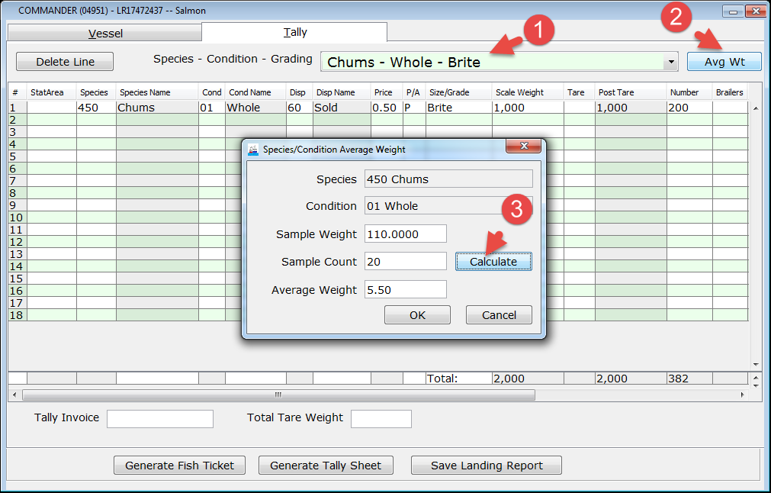
Automatic calculation of number of fish
Notes:
Elaine

Slide 24
Average Weights
Please contact your Area ADFG office for their scheduled procedure to calculate average weight. Ask them:
  When to calculate average weight?
  How to calculate average weight?

Slide 25
eLandings System
Reporting Process
Establish Operation and user accounts
Download PTI and establish configuration profile(s)
Configure thumb drives and distribute to tenders, buying stations, trucks

Slide 26
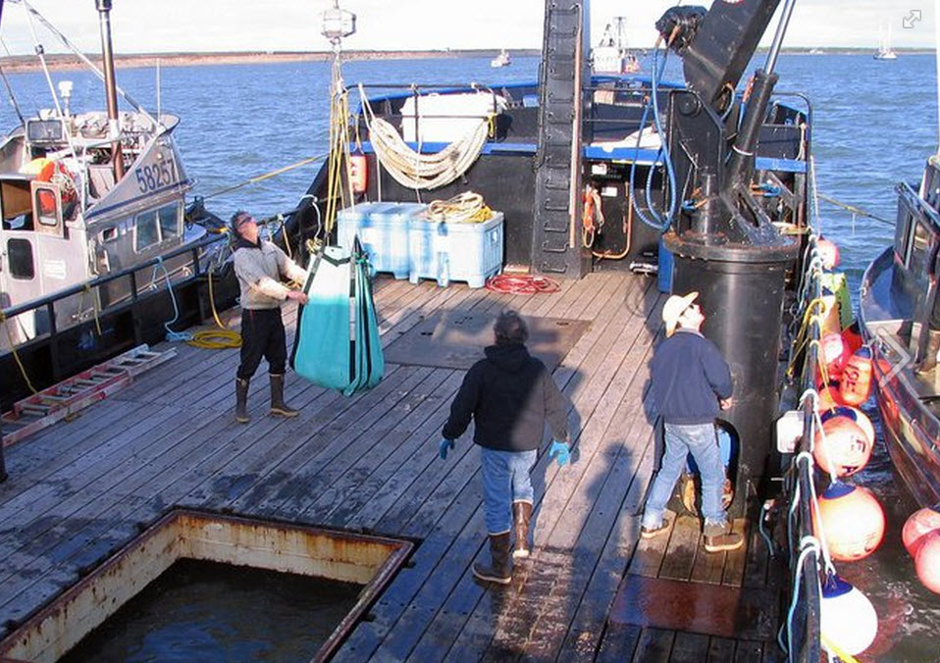
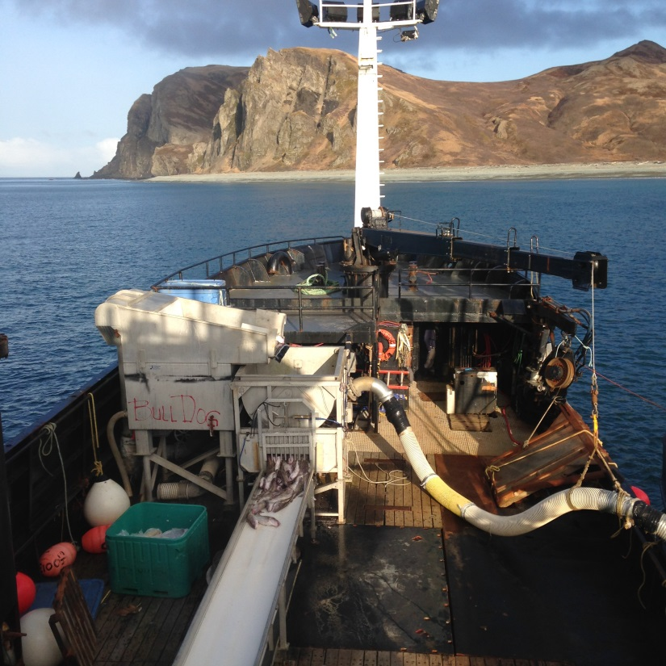
eLandings System
Record landings – salmon or groundfish in tLandings

Slide 27
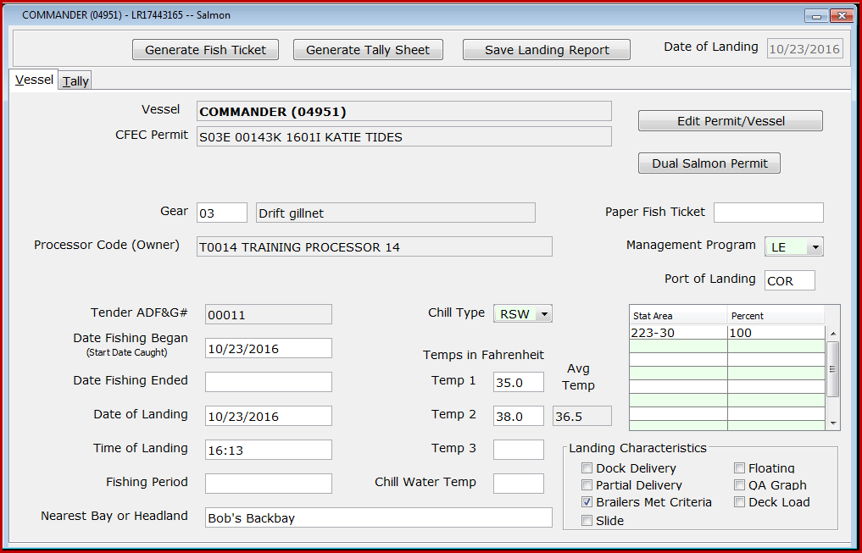
tLandings

Slide 28
eLandings System
Tender Operator generates Tender Trip Log Report
Returns signed copies of fish tickets and thumb drive to seafood office
Office staff review landings in PTI and upload data to eLandings Database
Notes:
Tender operators - important to show the tender operators how to open and close landing reports. Office staff- check for duplicate reports.

Slide 29
eLandings System
Re-configure thumb drives
Distribute to tenders
Create landing reports in tLandings
Provide fish ticket copies and thumb drive to office
Upload landing reports into eLandings database

Slide 30

Operations and User Accounts
INTERNET BASED REPORTING
Obligates both agencies staff and industry users to be sensitive to the confidential nature of the information.
Allows authorized users to enter landing reports documenting your company’s licenses and permits.
The operation structure allows us properly display your company’s data to authorized users.
Notes:
Jen

Slide 31
Operations
An operation is defined by:
  Processor Code
  Fed Proc Code
  Registered Buyer Number
  Registered Crab Receiver Number
  Port of Landing
eLandings now stores an operation_id on every landing report
User authorization is tied to opertion_id’s

Slide 32
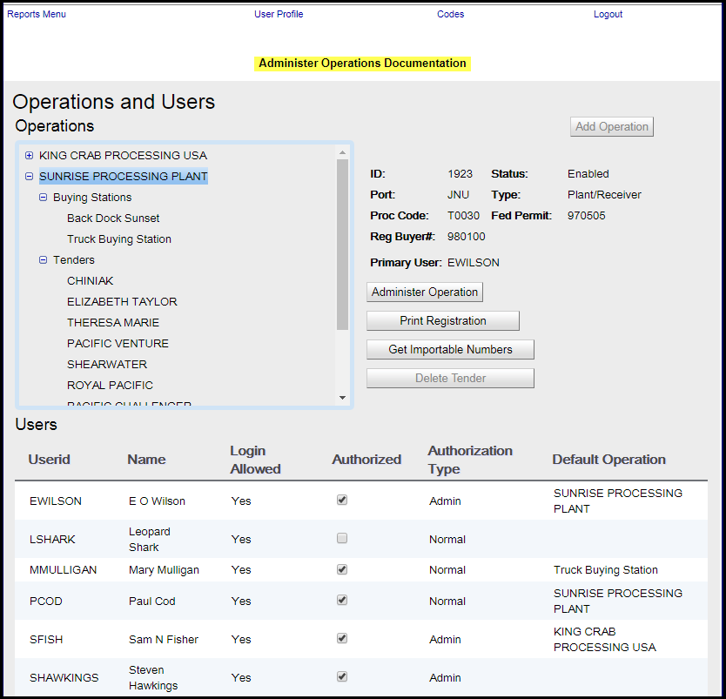
legacy

Slide 33
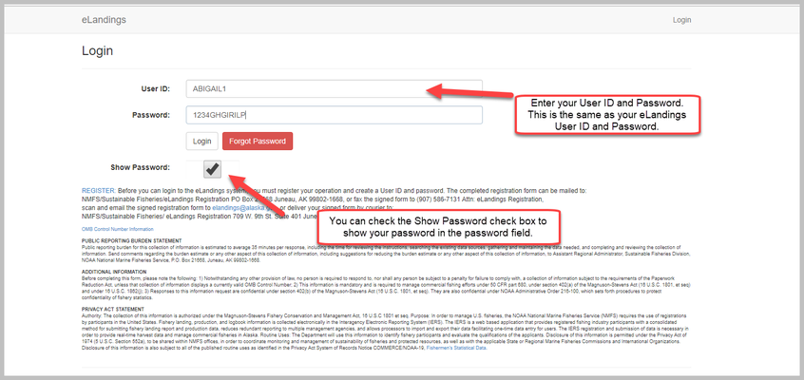
New Processor Web
Administering Operations
Notes:
Once you have created a custom processing relationship, the new custom processing operation will need to be enabled by a member of the eLandings Staff. If you do not hear from them please email the eLandings staff at eLandings@alaska.gov.

Slide 34
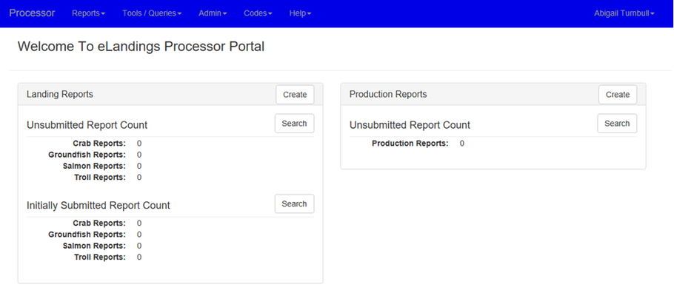
Processor Web Home Screen

Slide 35
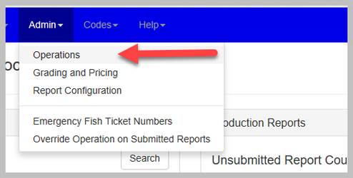
Navigate to Operations

Slide 36
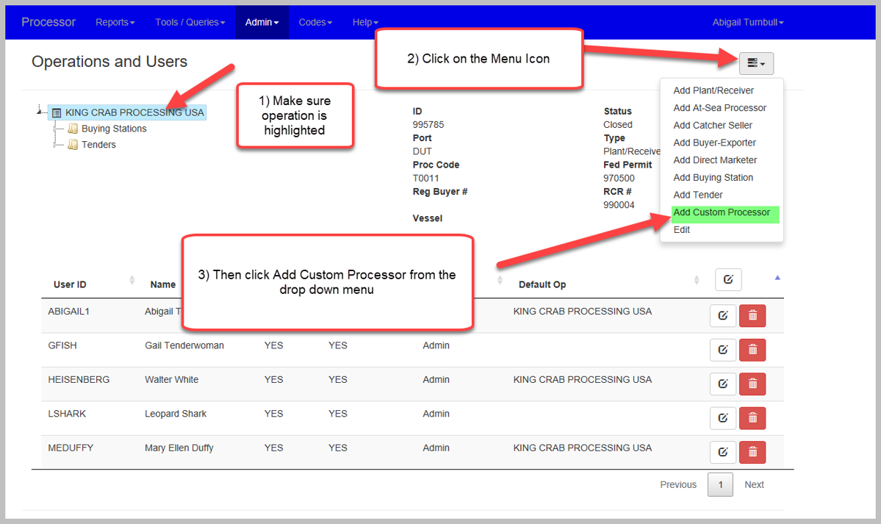
Administer Operations

Slide 37
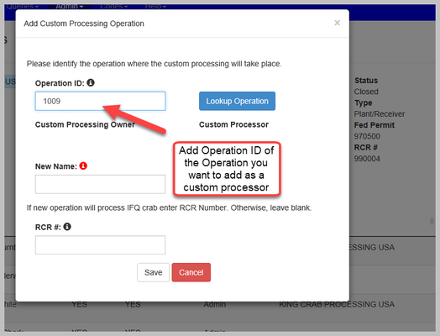
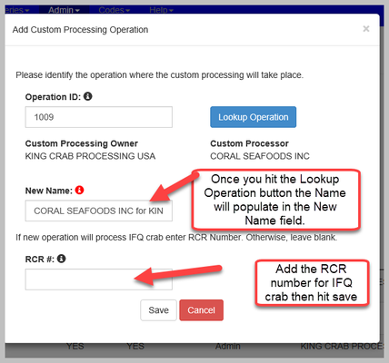
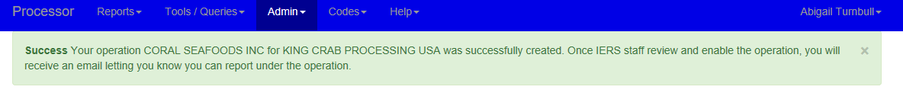
Add Custom Processing Operation
Notes:
Once you hit the Lookup Operation button the name of the custom processing operation you want to add will populate in the New Name field.
Add the RCR number of the operation if they will process IFQ crab for your operation.
Please note that you will need to apply for a new RCR number for the specific custom processing relationship between your company and the company you wish to custom process with.
You can find that application here: https://alaskafisheries.noaa.gov/sites/default/files/rcrapp.pdf .
Make sure that your company is the applicant but identify the custom processor as the physical processor location and company on the application.
Once you have created a custom processing relationship, the new custom processing operation will need to be enabled by a member of the eLandings Staff. If you do not hear from them please email the eLandings staff at eLandings@alaska.gov.

Slide 38
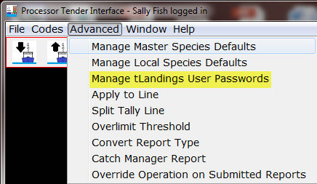
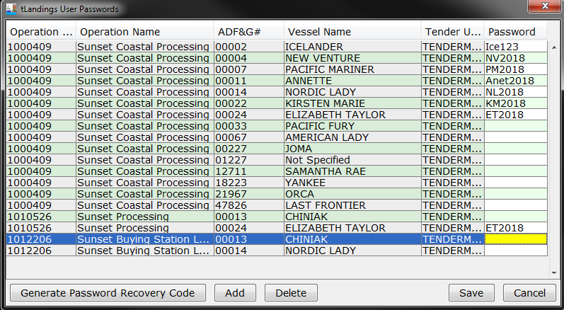
Tender and Buying Station Accounts
Notes:
Elaine

Slide 39
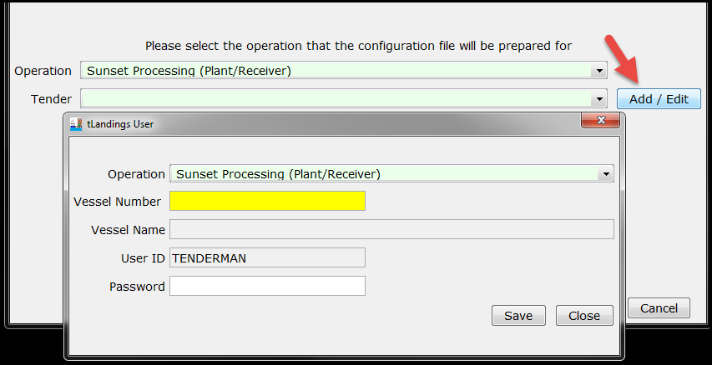
Tender Operations

Slide 40
Tender Operations
Who can see/edit tender operations and passwords?
  Normal and Admin users
Who can run reports in the elandings web?
  Normal and Admin users
Who can correct or modify, and even void a landing report while still on a thumb drive?
  The tender operator and authorized users to access the thumb drive.
Who can correct or modify a landing report uploaded to the eLandings database?
  Normal and Admin users.
  You can request to have a landing report voided by contacting elandings.alaska.gov (include explanation)
  All landing reports are locked 90 days after date of creation. You can request a report be opened for editing by contacting eLandings.alaska.gov
Notes:
Elaine

Slide 41
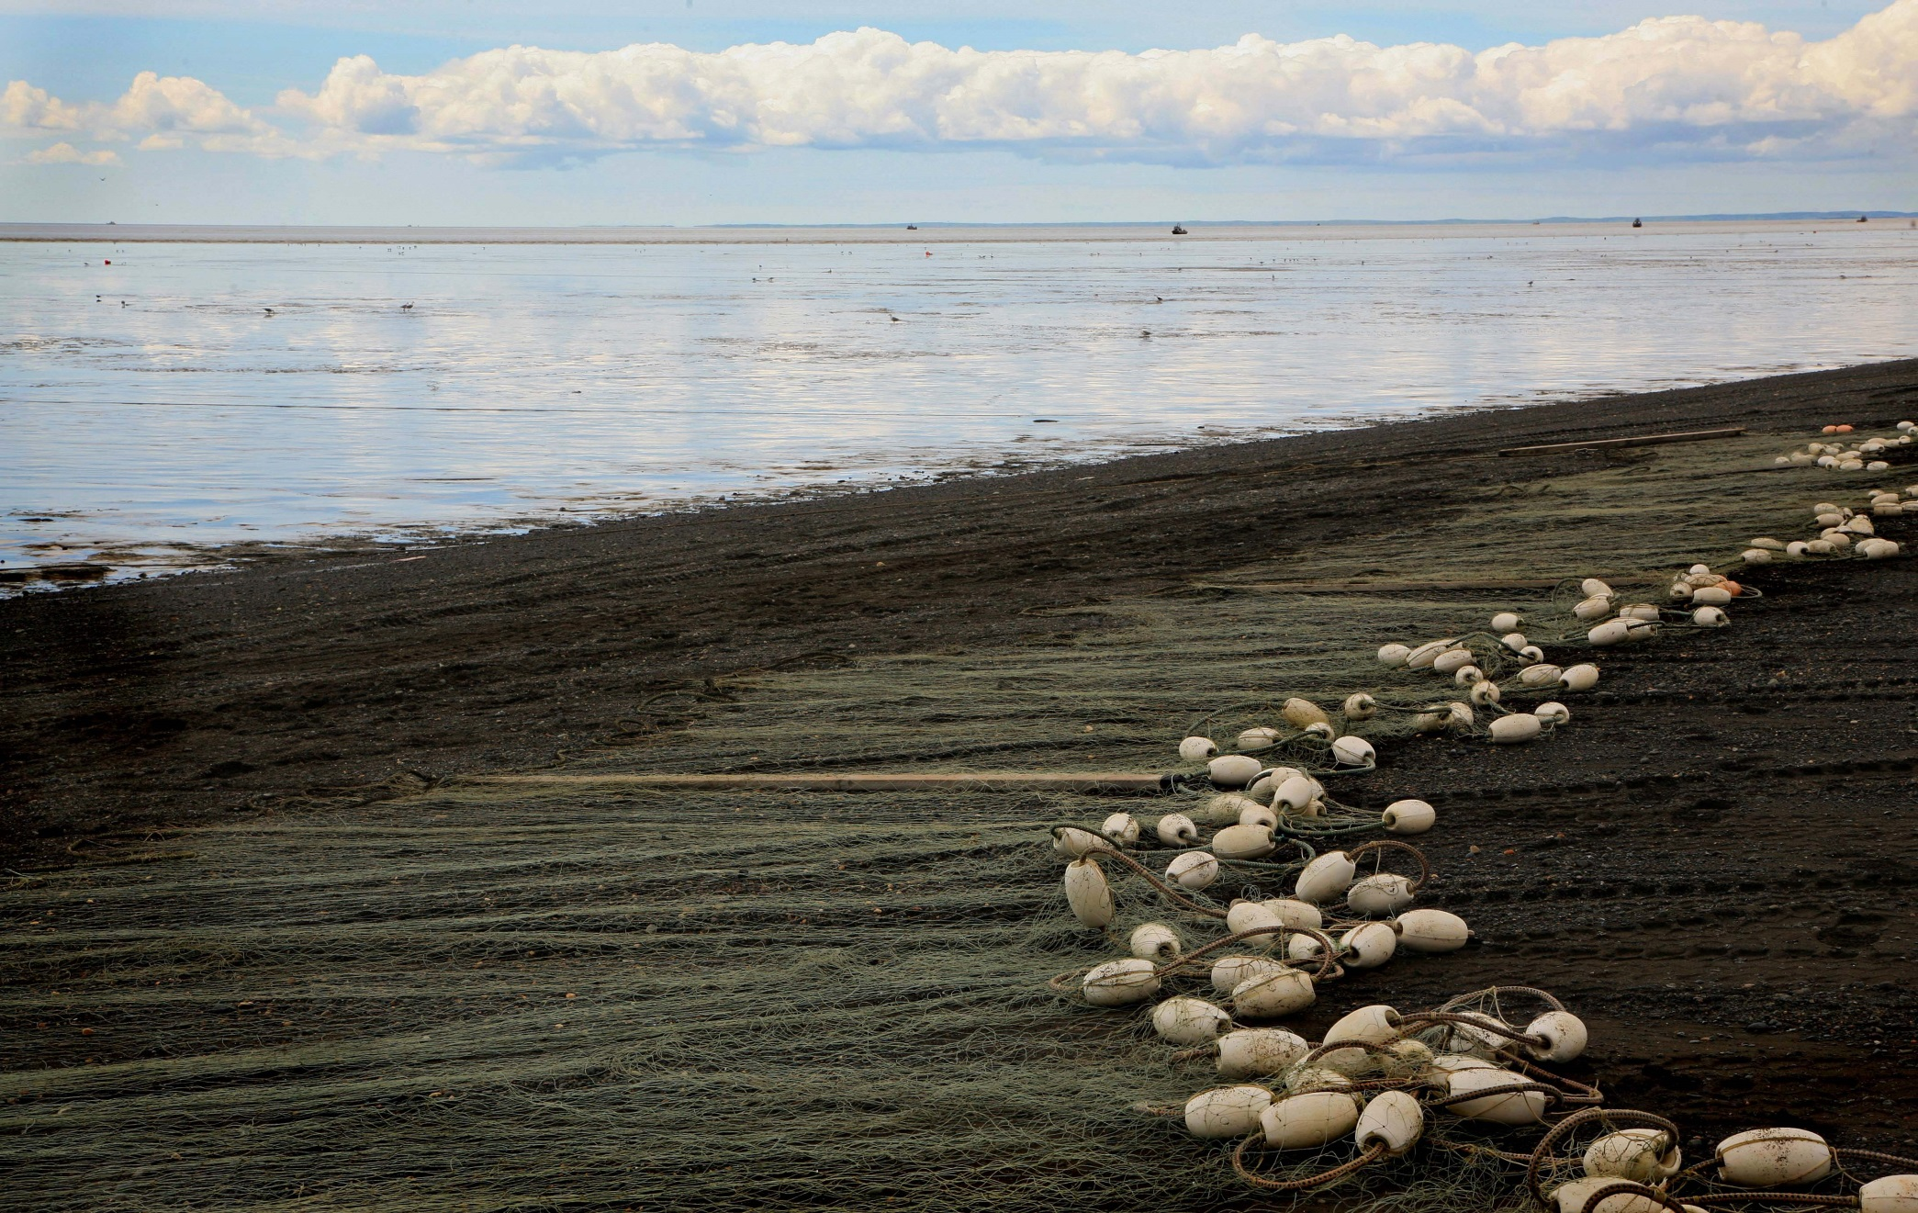
Processor Tender Interface

Slide 42

Processor Tender Interface
The PTI is downloaded from our eLandings WIKI annually.
Why: to obtain the most recent version with all updates, new features and enhancements to both the PTI and tLandings.
Each tender should have at least 3-4 thumb drives on the boat. With the PTI, you can configure as many as 10 thumb drives at once for a single tender, at the beginning of the season.
A note about unpowered USB hubs - Don’t use them!

Slide 43
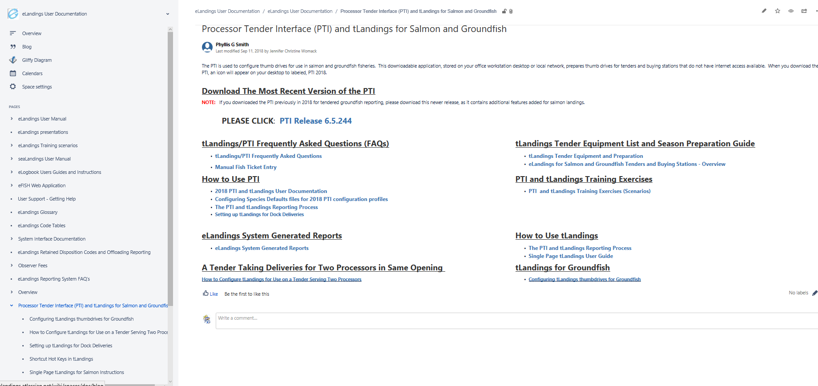
PTI/tlandings Documentation
Notes:
https://elandings.atlassian.net/wiki/spaces/doc/pages/140087157/Processor+Tender+Interface+PTI+and+tLandings+for+Salmon+and+Groundfish
In PTI- Help tab – Help Index that will bring you to this one stop shop resource.

Slide 44
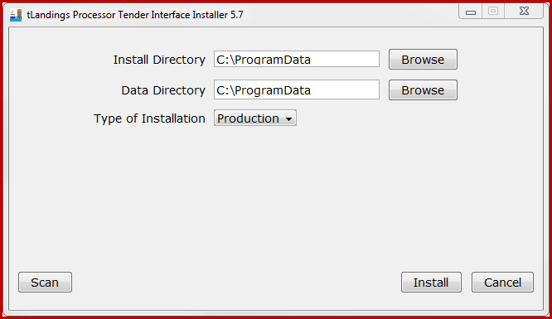
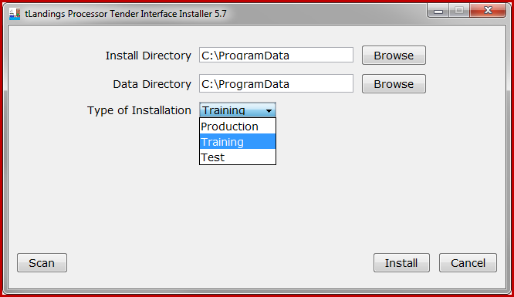
Installing the Processor Tender Interface
Notes:
Point out the scan

Slide 45
Processor Tender Interface
The PTI configures thumb drives and uploads landing reports
Let’s start with ‘configures’ ~
that means it customizes the thumb drive to your company specifications

Slide 46
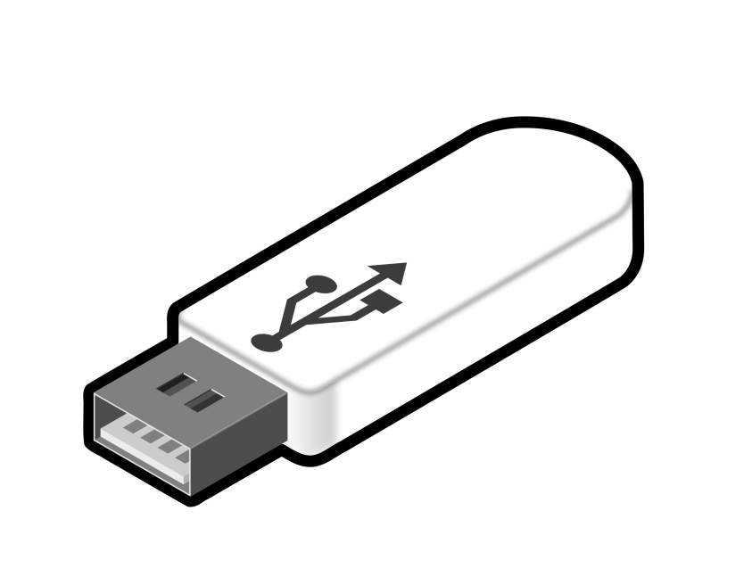
Preparing thumb drives
Be sure to delete old installs of tLandings on your thumb drives before installing 2019 tLandings!

Slide 47
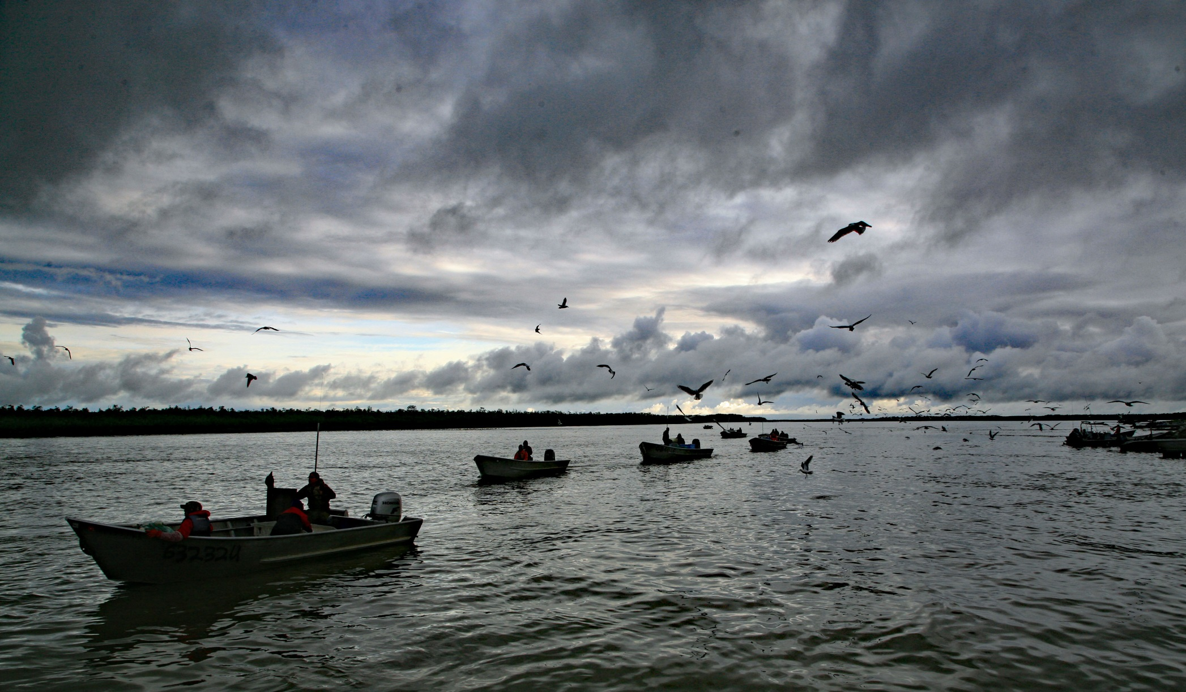
Processor Tender Interface Demo
Configuration
Notes:
Johnathan

Slide 48
Processor Tender Interface
The PTI loads the following on the thumb drive:
The tLandings application
A list of eLandings users authorized to login to the tLandings application
Your office staff and the tender operator
Your company’s licenses and the tender vessel’s name and ADF&G vessel number
A list of species that will be delivering to the tender
A unique set of fish ticket numbers that will be assigned to each landing report
Your special defaults – like delivery limit threshold

Slide 49
Processor Tender Interface
When preparing a tLandings thumb drive
You can select an operation and a tender associated with that operation.
You can add or remove tender vessels on operations easily
You can select the configuration profile for the tender, the buying station or the truck if using a tablet

Slide 50
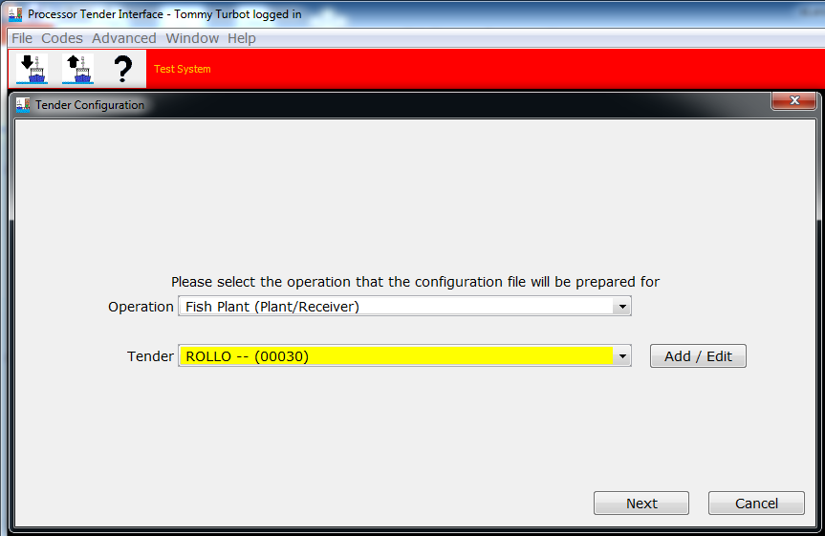
Processor Tender Interface

Slide 51
Processor Tender Interface
The PTI can be used to configure tLandings for:
  Salmon/Salmon Troll
  Groundfish
The tLandings application is NOT designed to document IFQ groundfish in the salmon troll or groundfish fisheries.

Slide 52
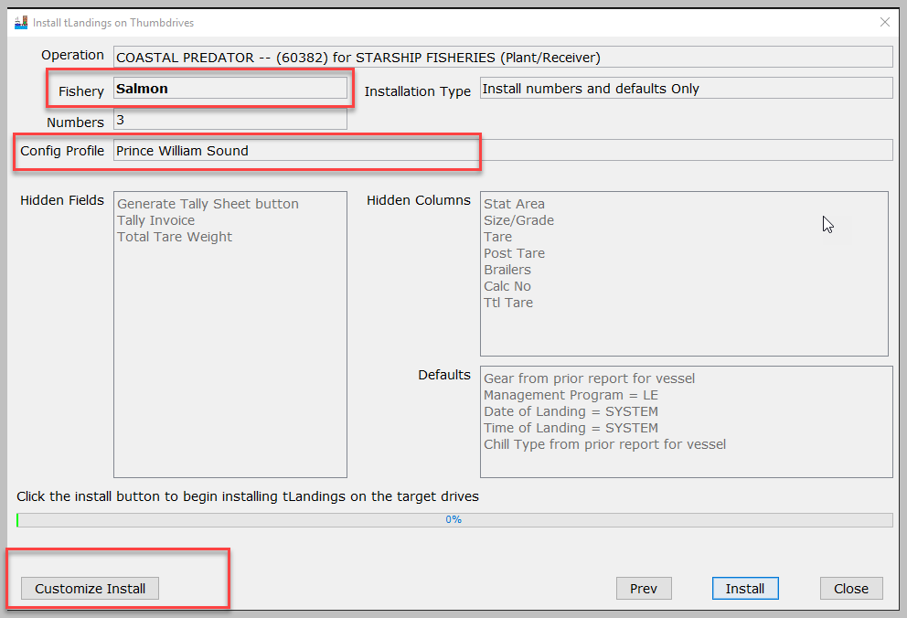
Processor Tender Interface
Notes:
After we have selected an operation and tender this will bring us to the Install tLandings on Thurmbdrives window. This gives us an overview of the operation, fishery, installation type, number of fish tickets, configuration, hidden fields, hidden columns, defaults. We can customize the installation if these are not what we want.

Slide 53
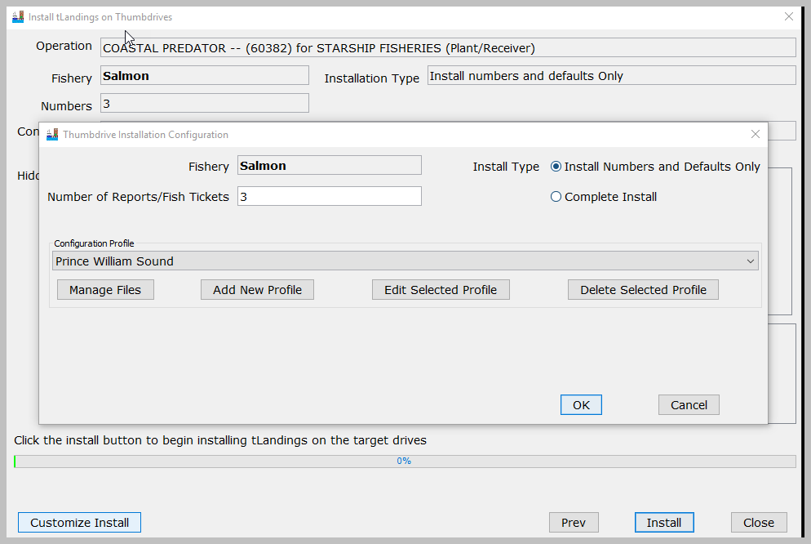
Notes:
When we select the Customize Install button to change the configuration.

Slide 54
Processor Tender Interface
You can create multiple species lists for distinct fisheries.
You can change prices within the PTI and tLandings.
We have eliminated the need for vessel lists, as this information is harvested from the CFEC permit card.

Slide 55
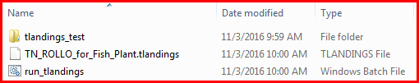
Processor Tender Interface
Once configured the thumb drives contains three files:
Note that this thumb drive is configured for the tender (TN) ROLLO.

Slide 56

15 minute break

Slide 57
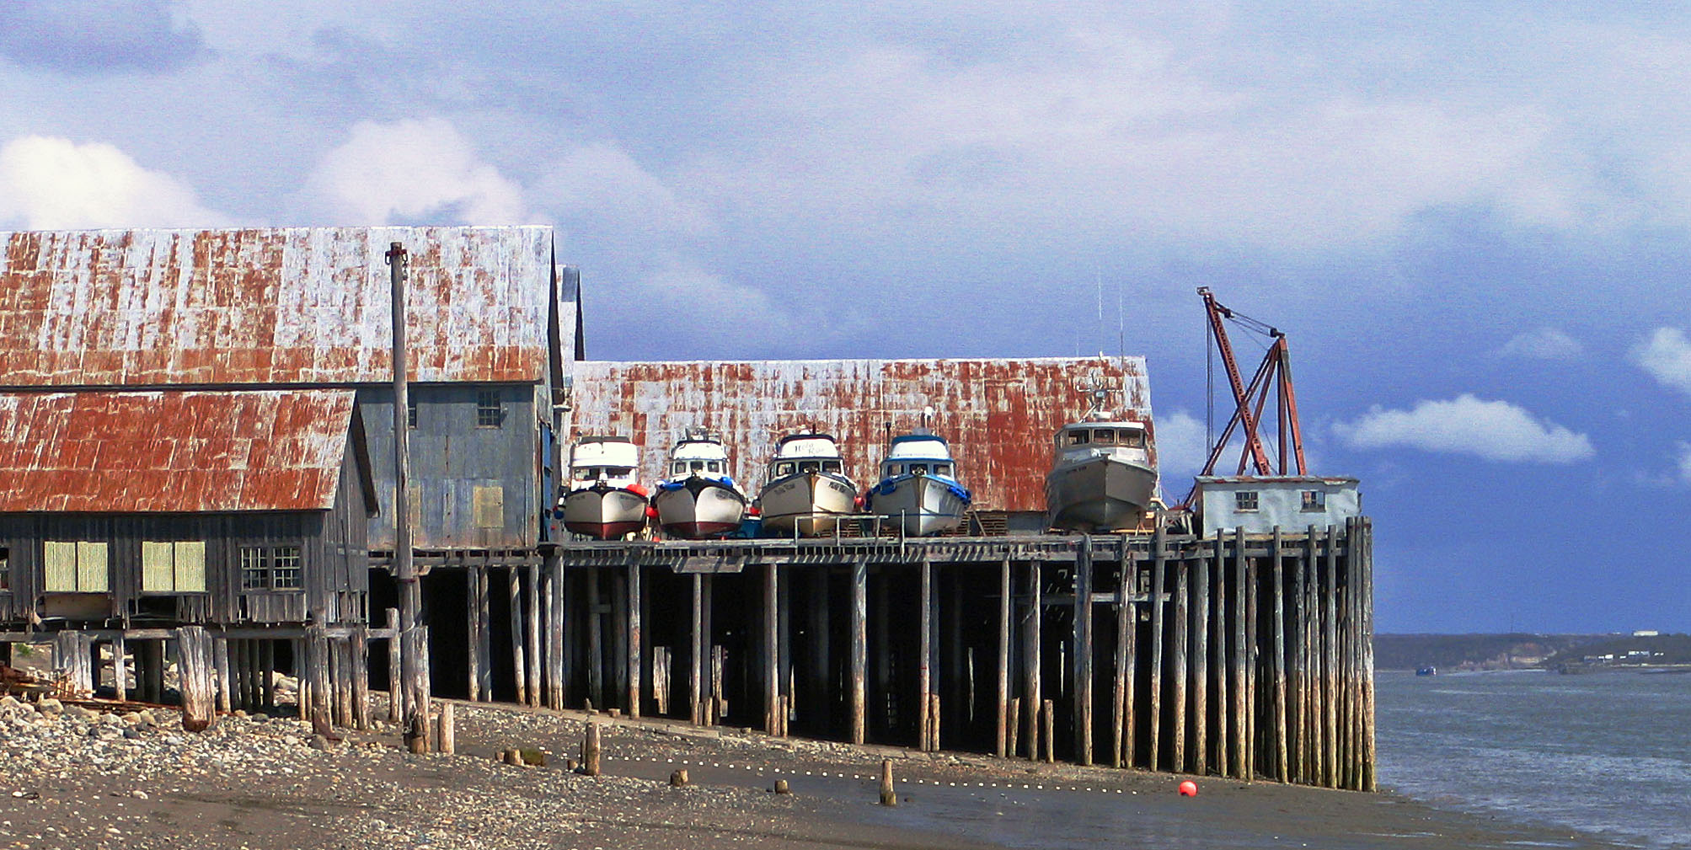
tLandings Demo
Notes:
Johnathan

Slide 58
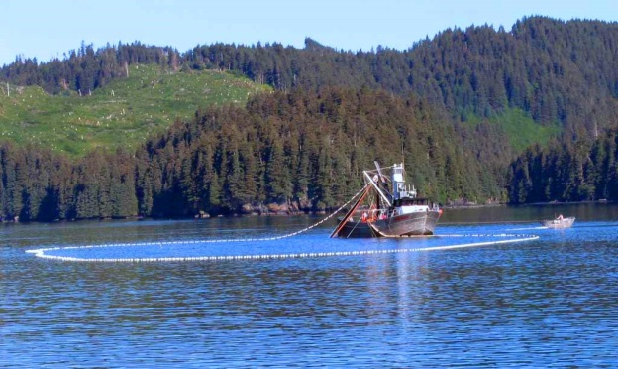
tLandings Demo
Simple Salmon Report
  Record average weight
  Unique stat area on line item
  Record tare weight
  Total weight documentation
  Review of Tally Report

Slide 59
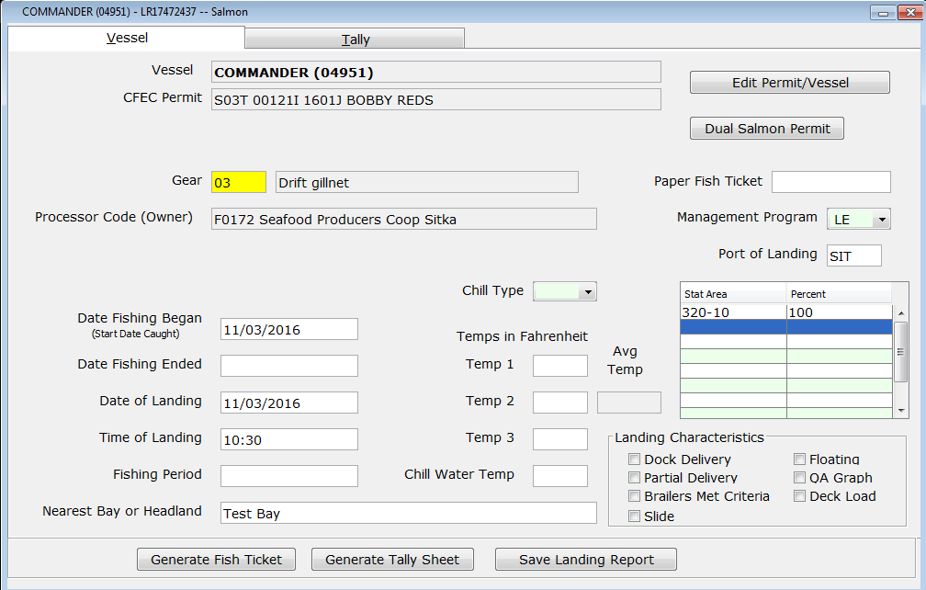
tLandings Display all Fields

Slide 60
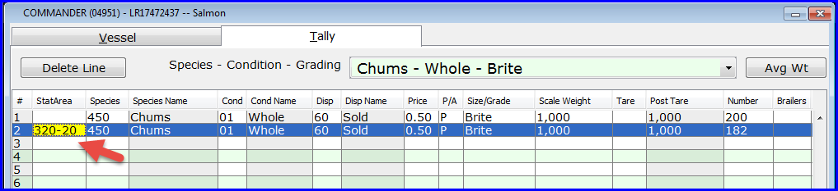
tLandings
You can enter a tally line item stat area if needed:
Outlier from the rest of the ticket
Groundfish stat area on a salmon troll ticket

Slide 61
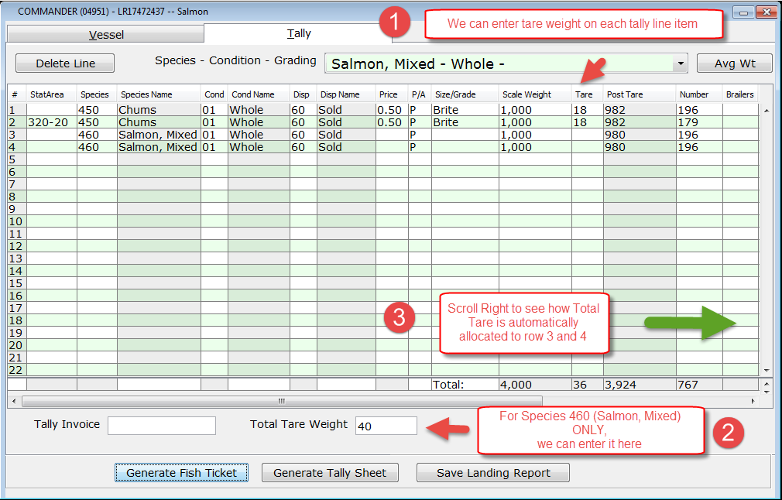
tLandings

Slide 62
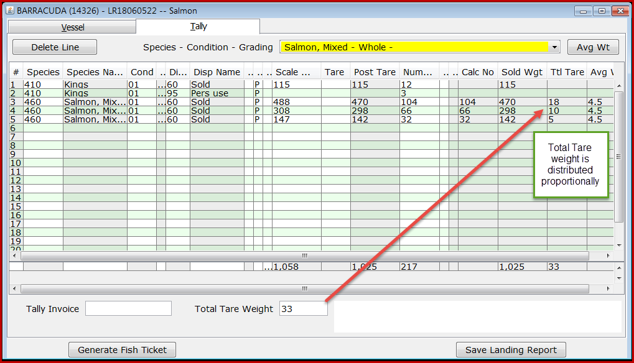
tLandings total tare (460)

Slide 63
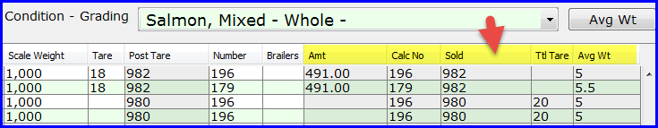
tLandings
The new tally line item columns, on the right side of the table, document system calculates, and help make them more transparent.
Helpful in debugging

Slide 64
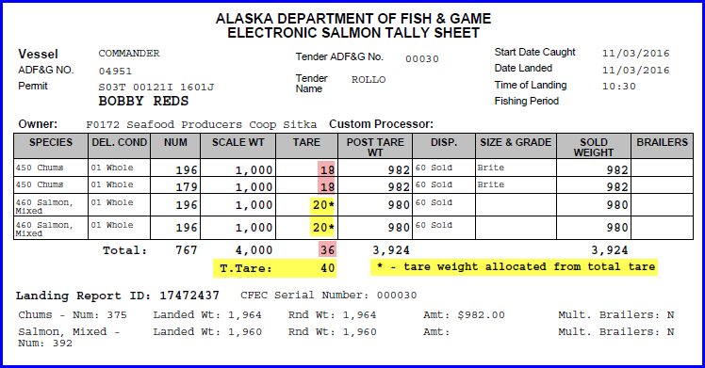
tLandings
The Tally Sheet reports both tare and total tare weights and labels them.

Slide 65
tLandings Demo
Salmon Troll
Salmon Troll Reporting
  Allocation of number of king salmon
Small kings and Jack kings
  Documentation on the tender log

Slide 66
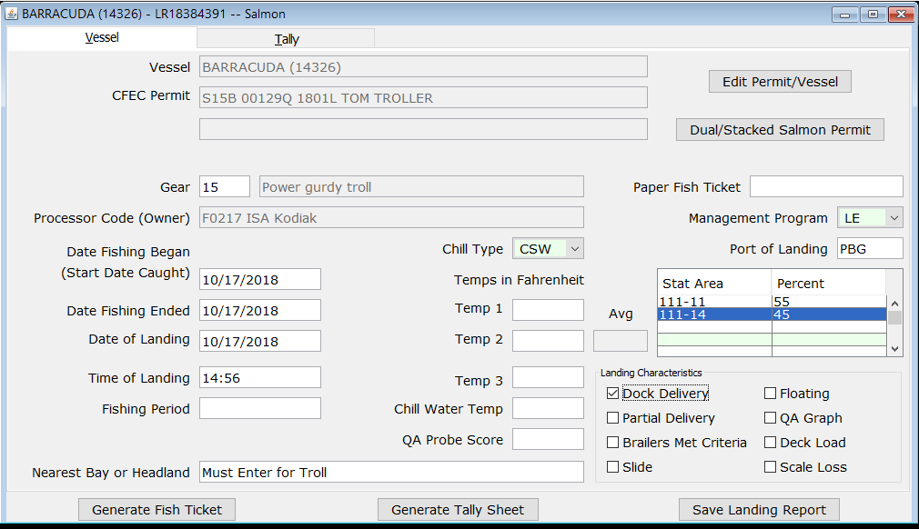
Salmon Troll Reporting
Notes:
Must enter nearest bay or headland for troll at request of AMB

Slide 67
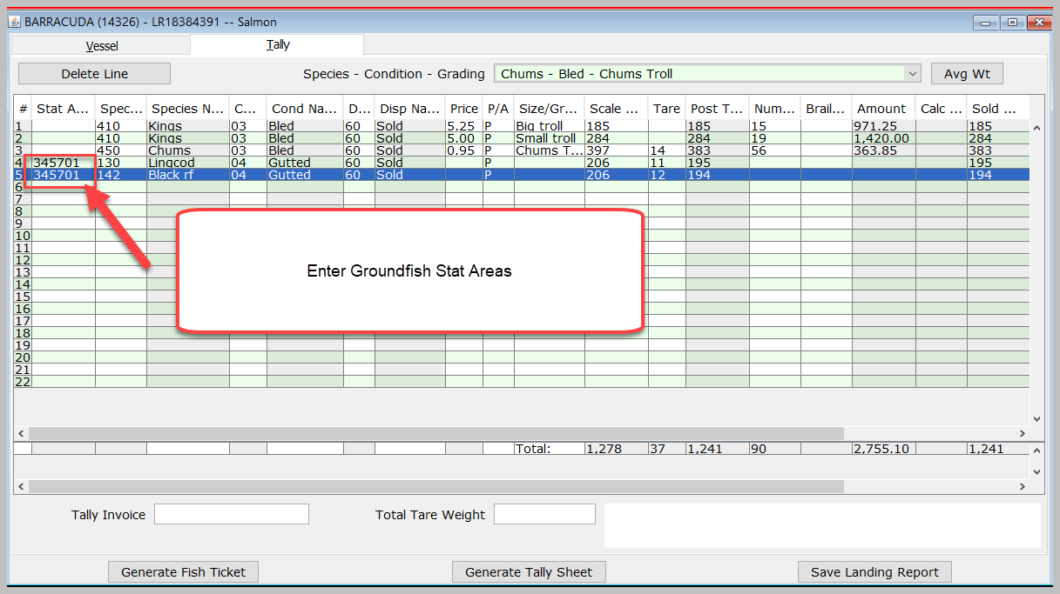
Salmon Troll Reporting

Slide 68
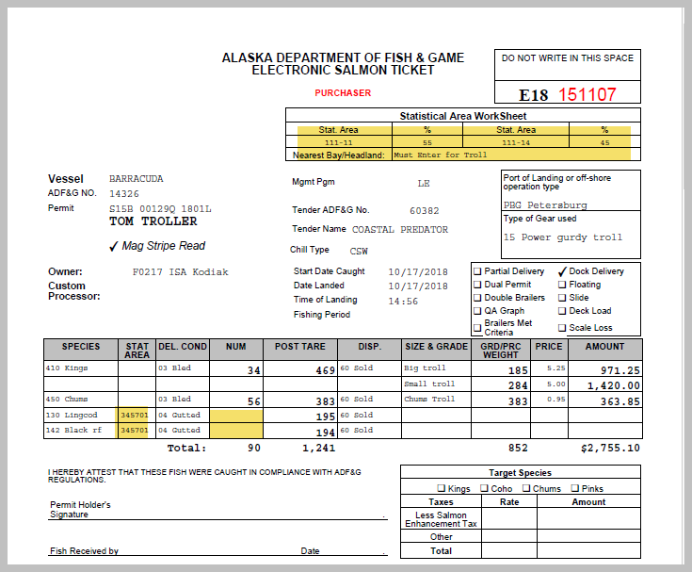
Salmon Troll Reporting

Slide 69
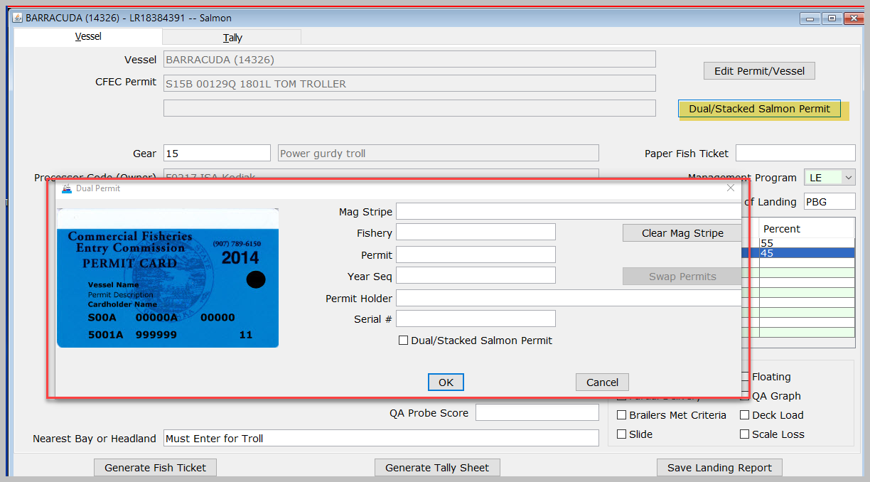
Dual Permit Documentation
Notes:
Jen

Slide 70
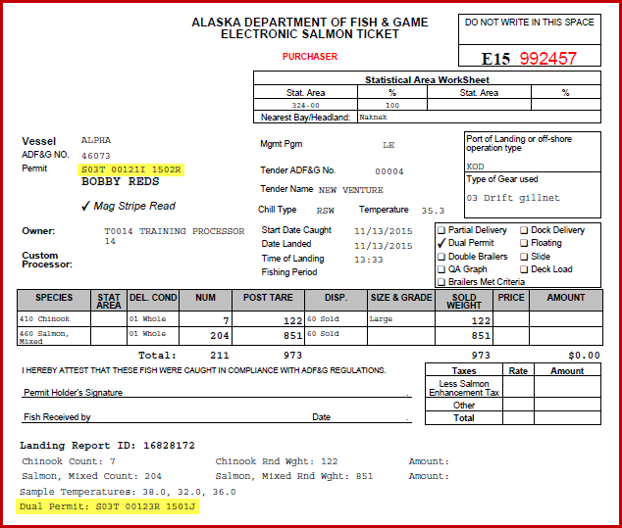
Dual Permit Documentation

Slide 71
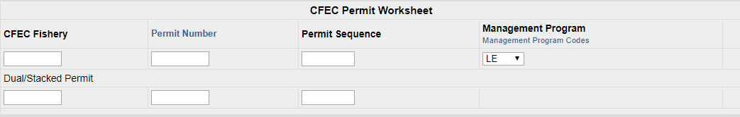
Dual Permit Documentation eLandings Web

Slide 72
tLandings Reports
Summary Reports
  Species Summary
  Species and Stat Area Summary
Personal Use Report
Tender Log Report
Notes:
We did receive feedback that users would like customization of the Tender Log report – and we will consider that for development for the 2020 season.

Slide 73
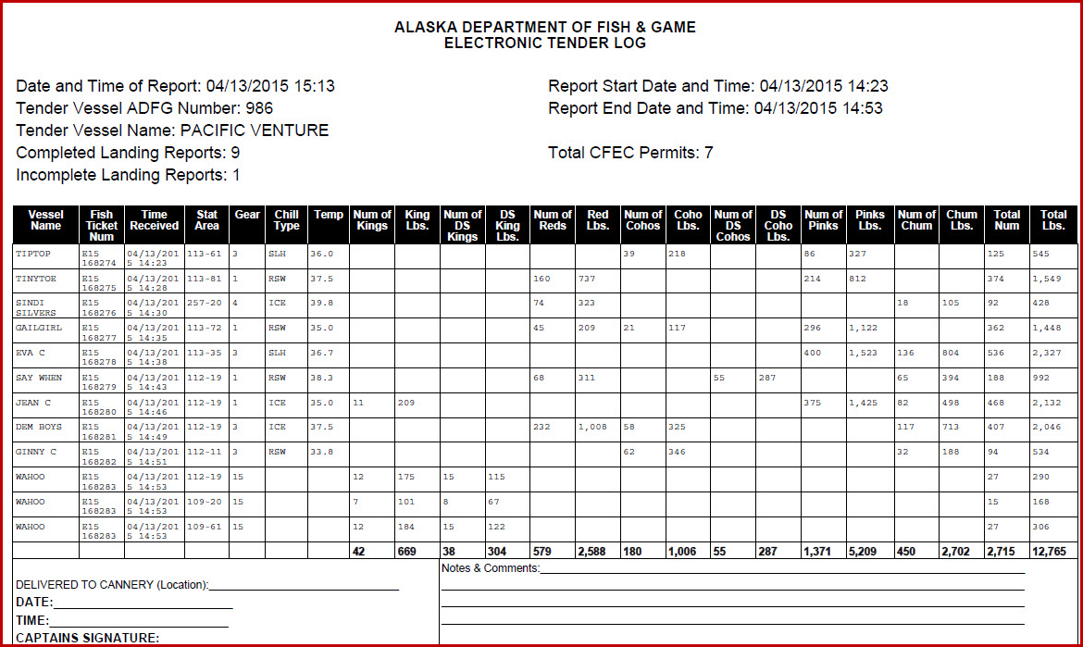
tLandings Generated Reports
Tender Trip Log

Slide 74
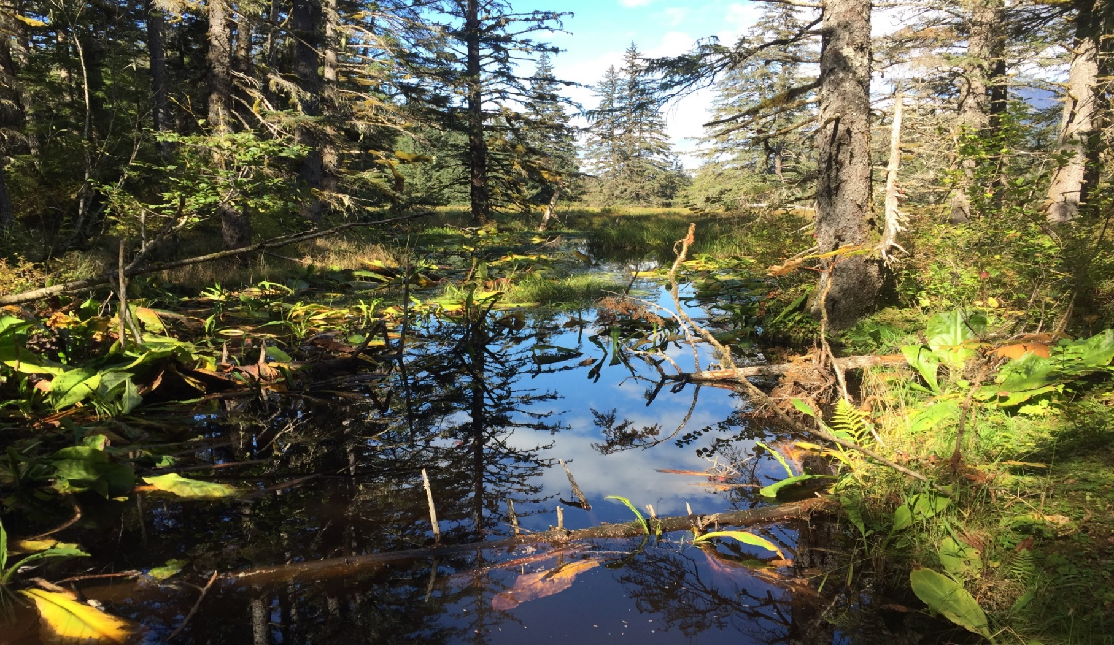
Break

Slide 75
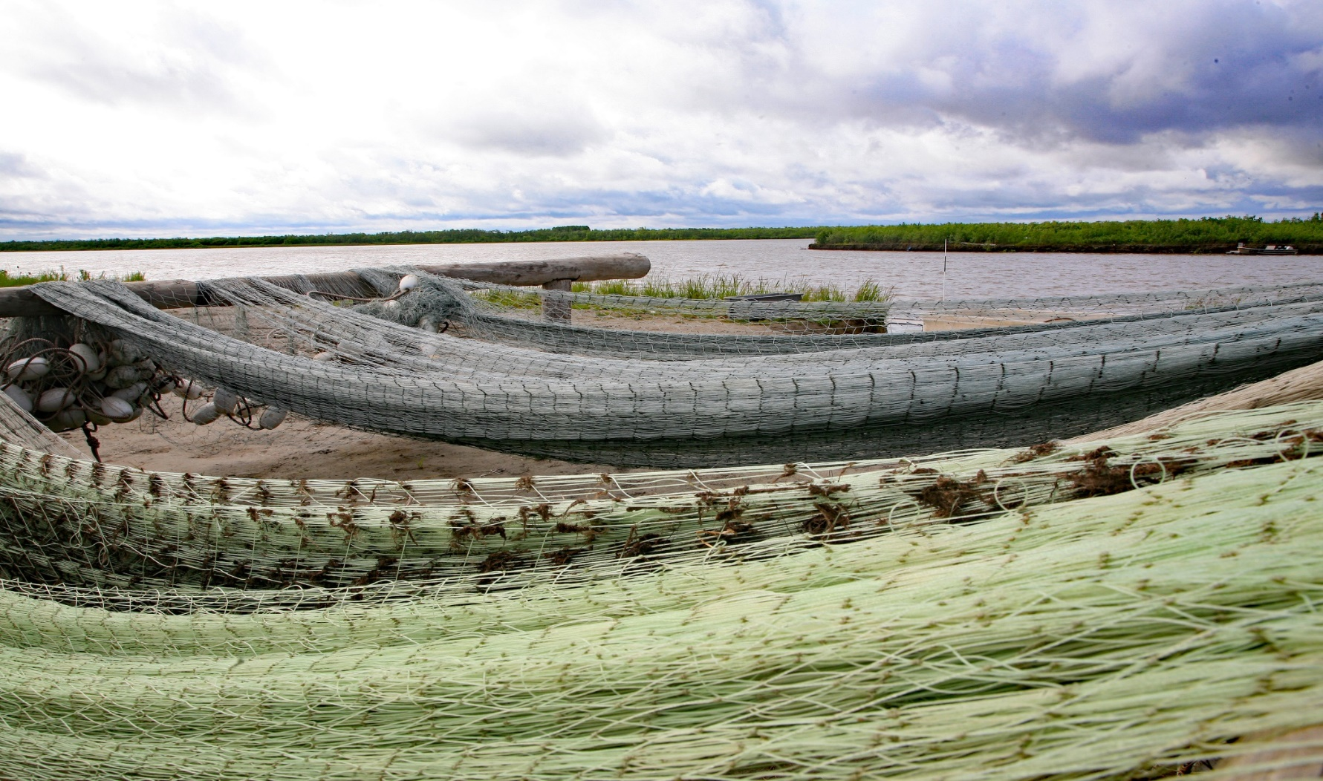
PTI Upload
Notes:
Johnathan

Slide 76
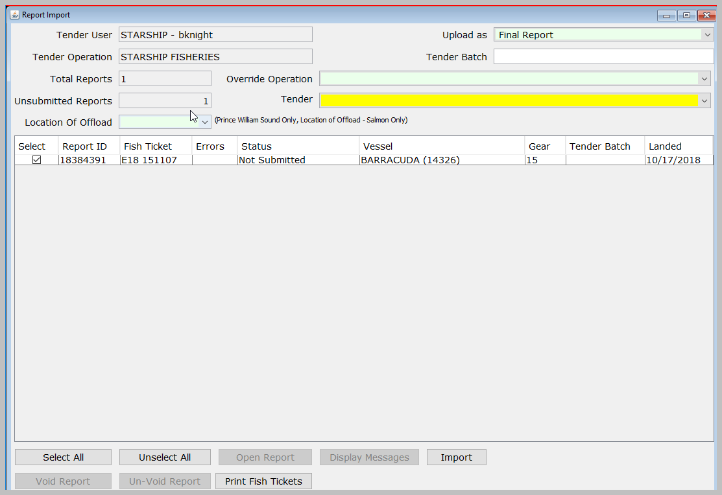
PTI Data Upload
Notes:
Elaine

Slide 77



Convert Processor Code, Port and Tender

Slide 78

Open, Review and Correct Report

Slide 79

Corrections within eLandings
Search for report(s)

Slide 80

Mass Salmon Update

Slide 81
Mass Salmon Update
Fields we can edit:
  Date of Landing
  Date Fishing Began
  Statistical Area
  Nearest Bay or Headland
  Dock Delivery
  Fishing Period
  Port of Landing
  Tender Batch
  Operation Info – processor code
  Overlimits Threshold
  Tender ADF&G
  Final Submit

Slide 82


Data Extraction Tool

Slide 83


Data Extraction Tool
Download template.
Create a unique report template.
Save report template locally with unique name.
Report can be run again and again with different date ranges.
Report results will be email.

Slide 84
Web Services Data Interface
eLandings provides a public web service interface for 3rd party developers to connect to.
This allows them to:
  Search for and Download eLandings data directly into 3rd party applications
  Submit Non-IFQ Landing Reports to eLandings directly from 3rd party applications
https://elandings.atlassian.net/wiki/display/ifdoc/Public+Web+Service+Documentation

Slide 85


Slide 86
Web Services Data Interface
If you are using eLandings public web services be aware of the following:
Release Notes Documentation
  https://elandings.atlassian.net/wiki/display/doc/Release+Notes
XML Schema Change Documentation
  https://elandings.atlassian.net/wiki/display/ifdoc/Schema+Version+History

Slide 87


eLandings Generated Reports

Slide 88


eLandings Generated Reports
Mixed Salmon Update
All fish tickets with the species code 460 – Mixed Salmon must be updated before running the Bristol Bay Weekly Report

Slide 89


Slide 90


Slide 91


Slide 92

User Support Resources
Help Documentation Online
Bottom of every eLandings Page:
eLandings is available to assist with Mass Updates
Programmer Support

Slide 93
eLandings System
Equipment
Office
        Workstation to install PTI
        Thumb drives (No longer provided by ADF&G) there is a limit to how long they are good for.
Tender
        Inexpensive 64bit laptop computer
        Inexpensive B/W laser printer
        Magnetic card swipe – Keyboard Emulation
Notes:
https://elandings.atlassian.net/wiki/spaces/doc/pages/430571690/tLandings+Tender+Equipment+and+Preparation

Slide 94
32 Bit laptops will not be supported beginning January 1, 2020
Please review your hardware and plan accordingly.

Slide 95
Seasonal Procedures
Spring
Download new version of PTI
Delete all prior versions of tLandings from thumb drives
Assure that all equipment is operational and updated
Checking for 32 v. 64 bit
Start of season
Train tender operators
End of Season
Inventory equipment and thumb drives
Clean all equipment to remove salt residue
Determine if repairs or replacements need to occur
Possibly delete all files off of thumb drives

Slide 96
ADF&G Information Services
TBD, Seafood Industry Coordinator 907-465-6131
Sabrina Larsen, Information Services, 907-465-6133
There is now a $25 permit processing fee for all ADF&G only permits, catcher seller, fish transporter, EEZ-Only, and Intendent Buyer.
Notes:
Jen

Slide 97
COAR Resources
http://www.adfg.alaska.gov/index.cfm?adfg=fishlicense.coar

Slide 98
eTablet
Designed to facilitate electronic reporting for beach-based deliveries ~ set net sites
Successful use in production 2018

Slide 99

eTablet in Action

Slide 100

eTablet Equipment Recommendations

Slide 101
Feedback from processors
Does anyone use the color print capability for fish ticket printing?
IFQ reporting feedback?
eTablet feedback?
tLandings feedback?

Slide 102


QUESTIONS?
Notes:
All

Slide 103

tLandings for Groundfish

