Slide 1
eLandings Application
NOAA Data Technician Overview

Slide 2

Interagency Electronic Reporting
Program Components
seaLandings desktop reporting via email or direct transmission
eLandings web based reporting
Agency interface for reviewing and editing submitted data
Initial & final report submission
tLandings
desktop reporting via flashdrive

Slide 3
Elandings interfaces
eLandings Web Interface – users login to eLandings at https://elandings.alaska.gov reports are submitted online, initial submit and final submit.
seaLandings – stand alone software installed on vessel computer workstation. Reports are submitted via email.
Agency Desktop Application – interagency staff access landings and production data.

Slide 4
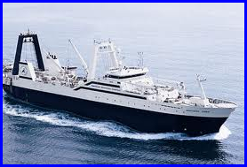
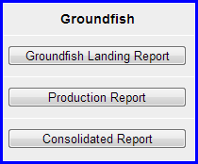
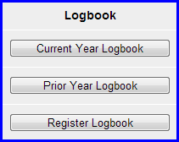
At-Sea Catcher Processor Reports
Landing reports
  Groundfish
  crab
Daily production reports
eLogbook

Slide 5
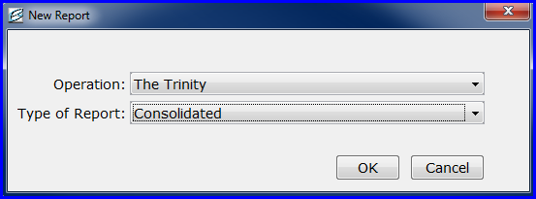
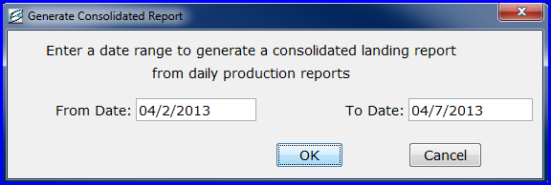
Consolidated Report
Used by at-sea catcher processors
  Enter a date range for the fishing trip
  Production reports within that date range are rolled into a landing report
  A fish ticket is generated from the landing

Slide 6
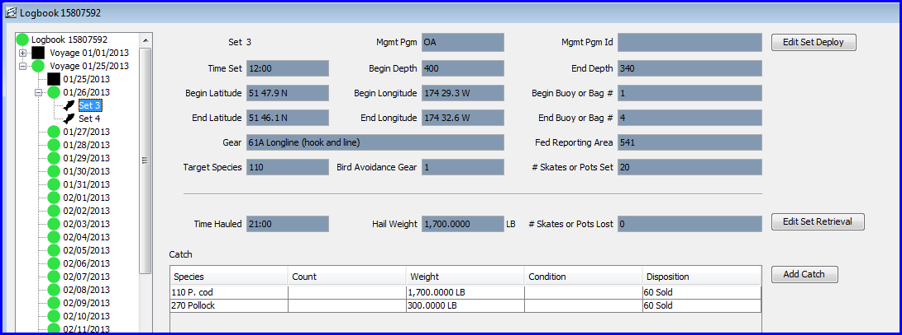
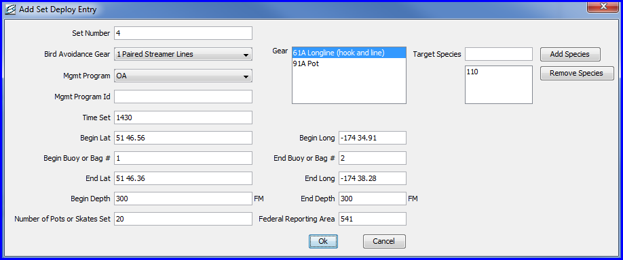
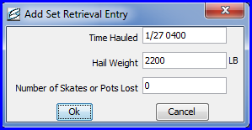
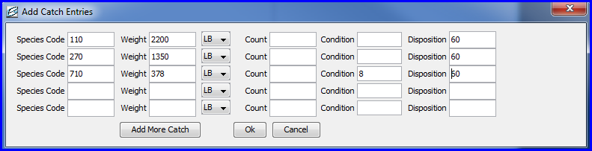
eLogbook
AFA trawl catcher processors
Freezer Longline catcher processors

Slide 7
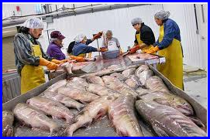
Shoreside processing plant
Receive deliveries from catcher vessels or tender vessels
Custom process fish for buyer/exporters
Daily production reports
Landing reports
  Groundfish
  Crab
Tender landings for salmon

Slide 8
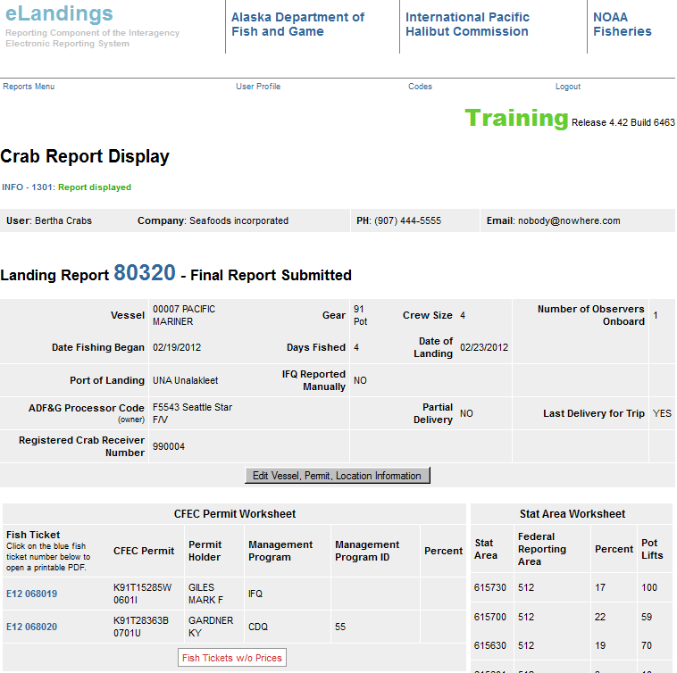
Landing Reports & “child” reports

Slide 9
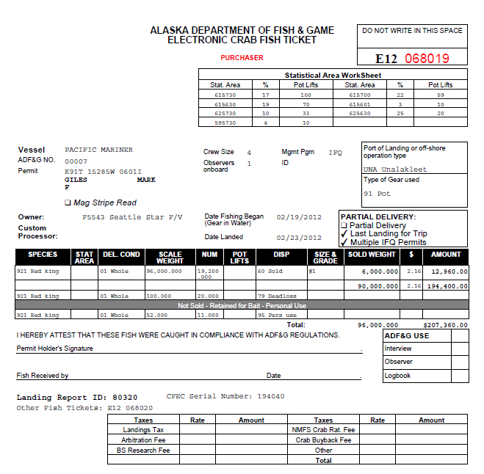

Slide 10
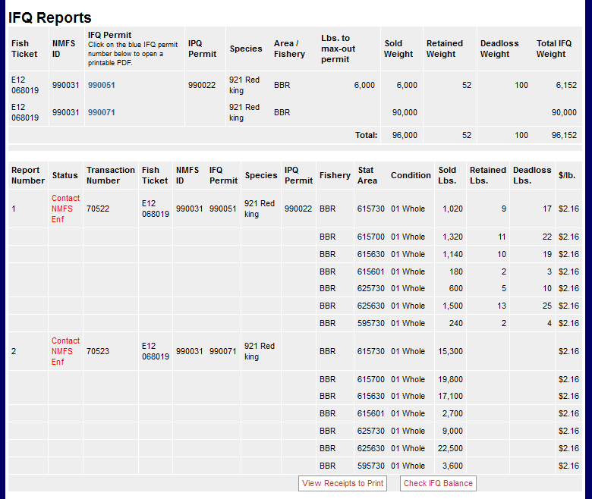
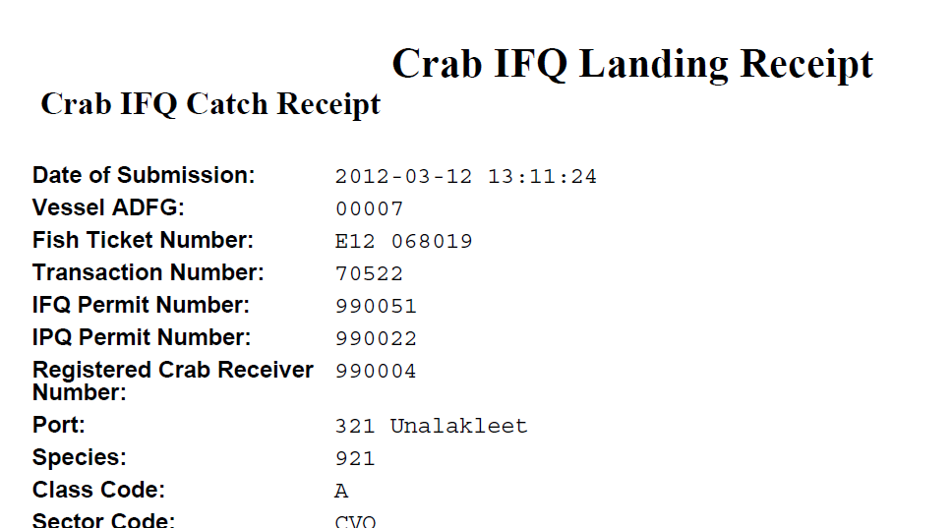

Slide 11
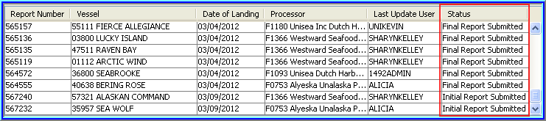
Report Status
Unsubmitted: Changes have been saved but data have not been submitted to agencies
Initial Report Submitted: Users have 7 days to final submit their reports; can find and edits reports easily in Reports Menu; deletions must be made by agency staff
Final Report Submitted: Users can edit reports for 90 days after final submit. After 90 days need to contact agencies to unlock

Slide 12
IFQ Max Out Pounds
This feature is used when more than one IFQ permit for the same IPHC area is used to allocate halibut or sablefish harvest.
For example, Bob Smith has an IFQ permit for Area 3A with 1,278 lbs of halibut left on it.
Bob also holds a Hired Skipper permit (QS belongs to someone else but they have designated that Bob can fish their pounds) for Area 3A with 32,000 halibut pounds on it.
Bob catches 24,650 lbs of halibut in Area 3A and he wants to max-out the remaining pounds on his permit and allocate the remaining 23,372 lbs to his Hired Skipper permit.

Slide 13
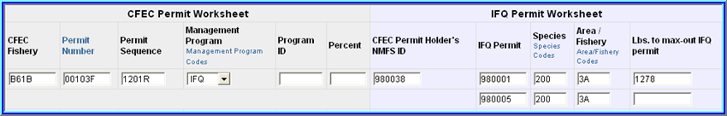
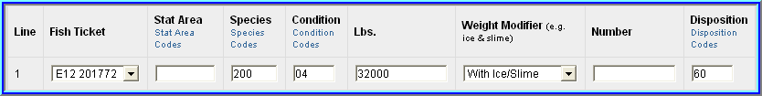
This is the permit holders personal IFQ permit which has 1,278 lbs left on it. No pounds should be entered for the other IFQ permit.
The user would enter the entire amount of halibut caught in the itemized catch section and save.

Slide 14
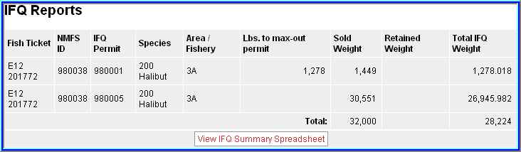
The user needs to generate the IFQ report before he/she can see how the total IFQ weights are allocated to the permits.
At this point they can still edit the IFQ report if needed before submitting it.

Slide 15
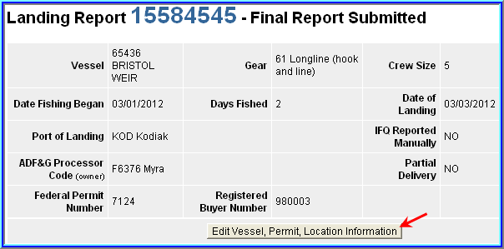
I created a landing report but ended up having to do a Manual Landing Report
1. The user needs to reopen his/her landing report and click on the Edit Vessel, Permit, Location Information button.

Slide 16
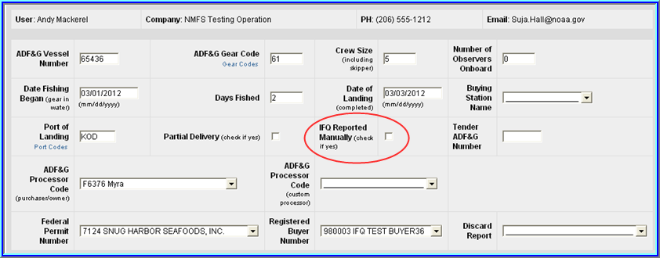
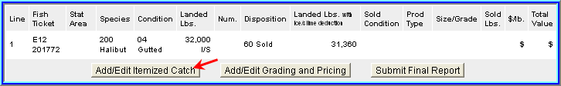
2. They need to locate IFQ Reported Manually text and check the box next to it.
3. Then they need to click on the Save button.
4. Once they are back on the main report screen they should click on the Add/Edit Itemized Catch button.

Slide 17
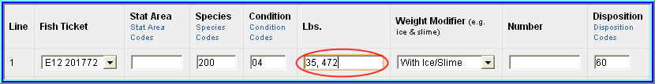
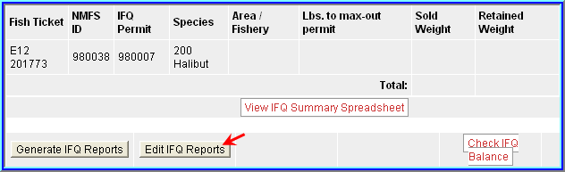
5. Now they need to edit the IFQ pounds so that it matches with the information on the MLR and then click on Save.
6. If the user generated their IFQ Report but did not submit their IFQ report, they will need to locate and click on the Edit IFQ Reports button at the bottom of the main report page.

Slide 18
7. The user needs to go to the bottom of the page and click on the Remove Unsubmitted Reports button.
8. They will be brought back to the main report page where they need to click on the Submit Final Report button.
Now they have completed all of the steps needed to account for a Manual Landing of their IFQ.

Slide 19
Creating a landing report after a Manual Landing Report is completed
The user needs to log into eLandings and create a groundfish landing report.
They need to check the IFQ Reported Manually checkbox in the Vessel, Permit, Location Information section.
They should add their IFQ species, pounds, and condition code to the Itemized Catch section.
Initial submit the report.
Do not generate IFQ report!
Final submit the report and print fish ticket & receipts.

Slide 20
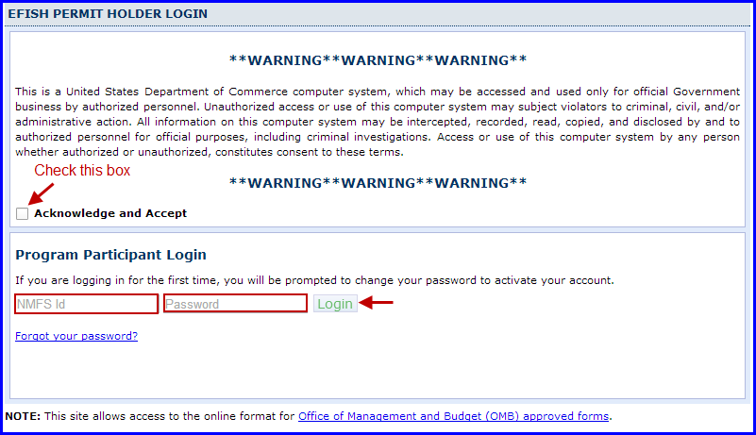
eFISH
  Account balances for quota programs
  Balance transfers
  User updates
  IFQ landings
  SHARC permits
  Fee payments

Slide 21
Resources elandings wiki
  Data technician script, support logs, and Agency Desktop installation documentation - https://elandings.atlassian.net/wiki/display/es/Home
  eLandings documentation - https://elandings.atlassian.net/wiki/display/doc/eLandings+User+Manual
  seaLandings documentation - https://elandings.atlassian.net/wiki/display/doc/seaLandings+User+Manual
  tLandings overview - https://elandings.atlassian.net/wiki/display/doc/tLandings+Overview+and+Equipment+Recommendations
  eLogbook documentation - https://elandings.atlassian.net/wiki/display/doc/eLogbook+Instructions
  User Accounts and Administer Operations documentation - https://elandings.atlassian.net/wiki/display/doc/eLandings+Operations+Administration
  NMFS Legacy IFQ reporting - https://elandings.atlassian.net/wiki/pages/viewpage.action?pageId=10427626

