Slide 1
Overview of Observer Fees
Alaska Region

Slide 2
New Observer Program
Full Coverage
At least 100% coverage on every trip
Vessels pays daily observer cost (“pay as you go”)
Partial Coverage
NMFS deploys observers (industry doesn’t pick the trips)
Annual Deployment Plan: describes how NMFS will deploy observers into partial coverage fleet
Can change each year
Coverage rates: depends on funds
Program funded by 1.25% fee on landings
Everyone pays, whether they are chosen to take an observer or not

Slide 3
Full Coverage
Cost = Pay As You Go
Full Coverage Vessels:
All CPs*
All Motherships
CVs when participating in catch share program with transferable PSC:
AFA & CDQ pollock in BS
CDQ groundfish, except for pot & jig
Checked into GOA Rockfish Program
Full Coverage Processors: when receiving BS pollock
*With 3 exceptions

Slide 4
Partial Coverage
Processing Plants:
In 2013, plant observers will monitor GOA pollock offloads to count & obtain genetic samples of salmon bycatch
Vessels: 2 partial coverage deployment methods
Vessel-selection
Trip-selection

Slide 5
Fees
Each year, NMFS publishes standard price by port, species, and gear (standard ex-vessel value)
1.25% fee applied to each all landings
Fee liability split 50/50 between processor & vessel
Estimate of fee will be displayed in eLandings
Final fee invoice Jan 15 each year
Fees due Feb 15
If fees are not paid, renewal of FFP or Registered Buyer permits may not approved
Annual FFP & RB permits (instead of 3-years)

Slide 6
Two ways to find observer fee info
1. Search for fees (at bottom of the Reports Menu page)

Slide 7
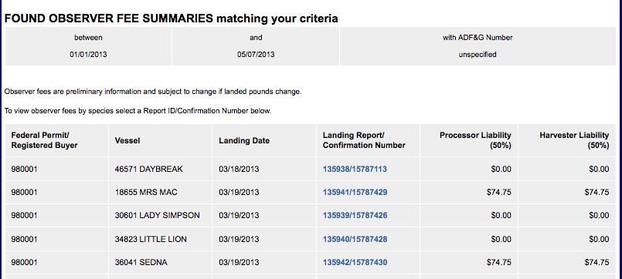
Search returns list of reports and Excel export option

Slide 8
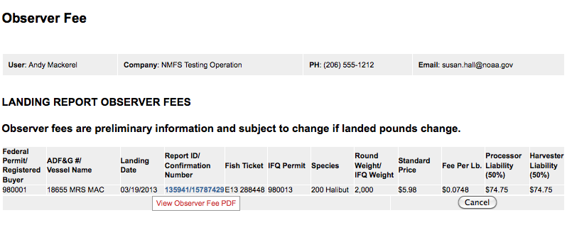

Slide 9
Two ways to find observer fee info
Search returns list of reports and Excel export option

Slide 10
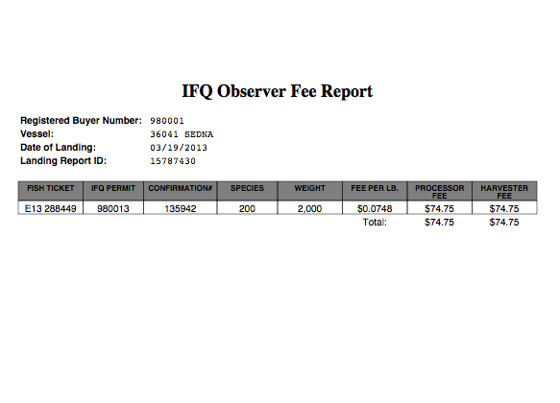
Observer Fee Report

Slide 11
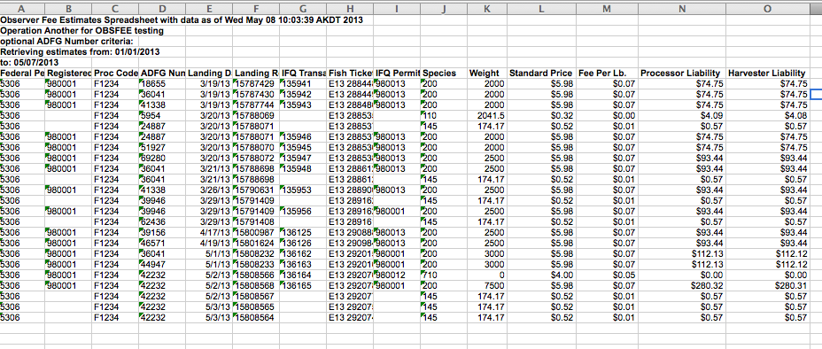
Excel export

Slide 12
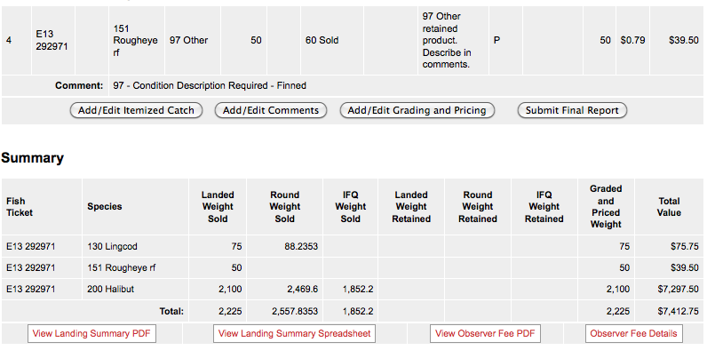
Two ways to find observer fee info
2. In ‘Summary’ section of Landing Report page

Slide 13
Observer Fee Report

Slide 14
Timing of Observer Fee Reports
IFQ/CDQ halibut & IFQ sablefish: available within 15 mins of IFQ report submission
Groundfish: non-pcod available within 15-30 minutes of initial report submission
Pcod: 24 hours after initial report submission

