Slide 1
eLandings
How to Add a Custom Processing Operation

Slide 2
Administer Operations
Keep in mind that the “Owner” of the fish/crab is the one that must create the Custom Processing Operation.
Once you’ve logged into eLandings, locate and click on the Administer Operations link at the top of the Reports Menu screen.

Slide 3
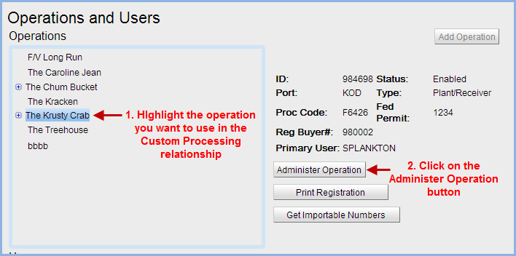
Operations and Users
Do Not click on the Add Operation button in the upper right corner of the screen to add a ‘child’ operation!
Follow the steps in the screen shot below.

Slide 4
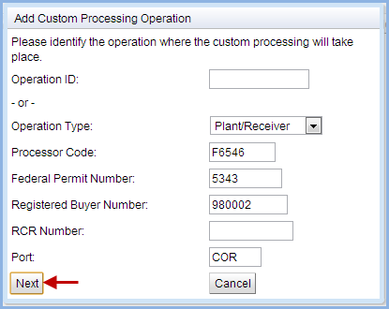
Add Custom Processor
Click on the Add Custom Processor button
Add the processing plant operation information and click Next
If you know the Operation ID number, you can skip entering the permit data to the dialog box.

Slide 5
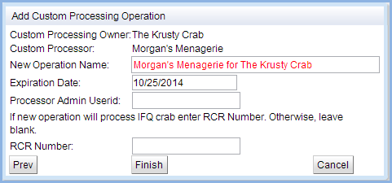
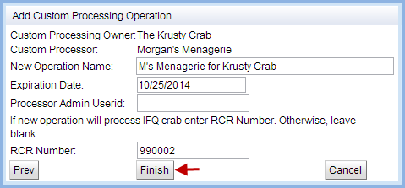
Custom Processing Operation
The eLandings system will create a New Operation Name based on the provided information. If the text is Red, the name is too long and needs to be shortened to 35 characters.
The primary admin users for each operation will be added as users.
If processing IFQ crab, a new, unique RCR permit will need to be obtained and added to the operation.
Click on the Finish button.

Slide 6
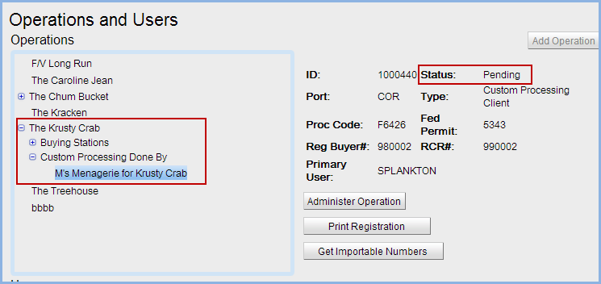
Operation Review
You will be on the Operations Management screen, click on the Back button.
You will be able to view the newly created custom processing operation by expanding the operation it was created under.
The operation has not yet been enabled as you can see by the Pending status. An email will be sent to interagency staff so they can review and enable the operation.
Admin users will then receive an email notifying them that the operation is now accessible.

