Slide 1

Electronic Reporting of Fisheries Information in Alaska

Slide 2
ELANDINGS - BACKGROUND
One-stop reporting of landings, production, and logbook information to multiple agencies electronically
Increases timeliness and accuracy of fisheries data entry
Creates an electronic record of landings, production, and logbook data that may be extracted by processors and agency staff
Immediate verification of permits and vessel ID’s

Slide 3
Interagency Electronic Reporting System
NMFS RAM
Catch and Production Reporting by Industry
NMFS
Sustainable Fisheries
Interagency
Server
ADF&G Commercial
Fisheries Division
IPHC

Slide 4

INTERAGENCY ELECTRONIC REPORTING
PROGRAM COMPONENTS
eLandingsWeb based reporting
seaLandings Desktop reporting via email
Agency Interface for review and editing submitted electronic data
eLogbook: web & desktop
tLandings Desktop reporting via flash drive
Elandings 24/7 Server

Slide 5
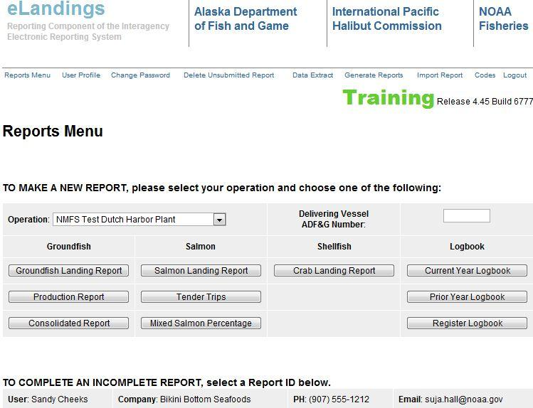
Three eLandings Interfaces
Web Interface

Slide 6
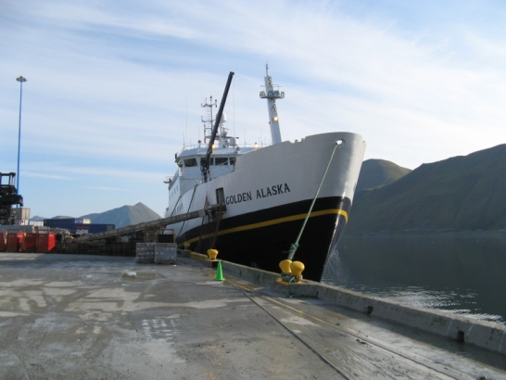
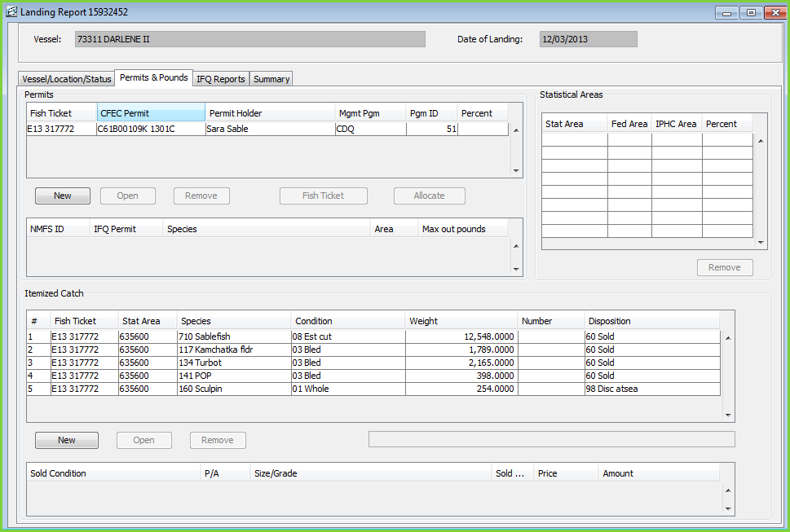
SEALANDINGS STAND ALONE SOFTWARE

Slide 7
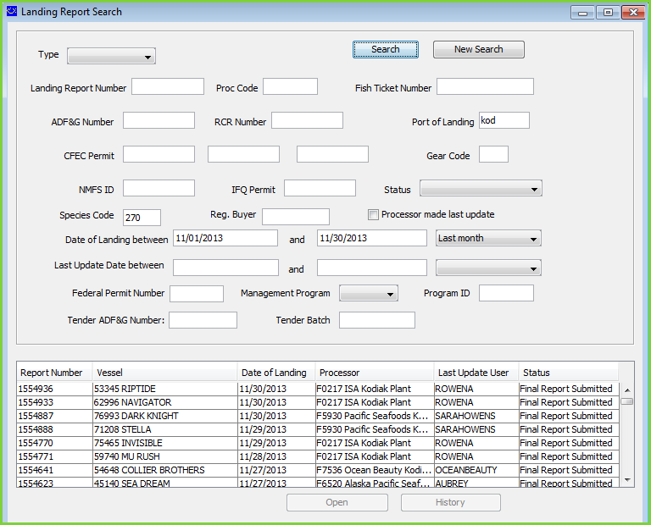
AGENCY
DESKTOP

Slide 8
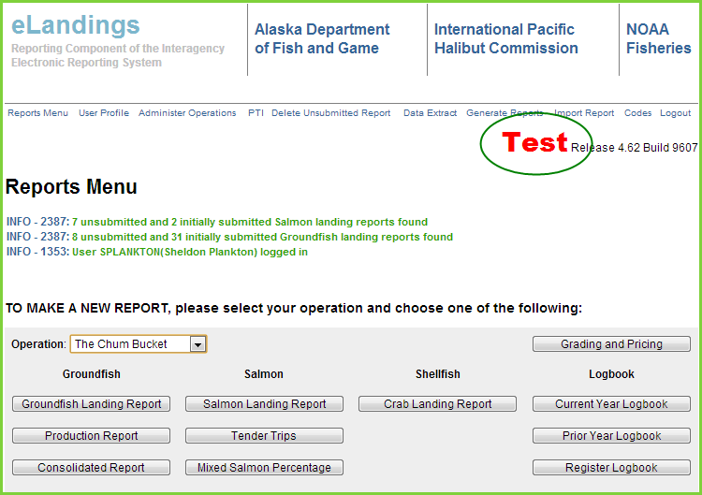
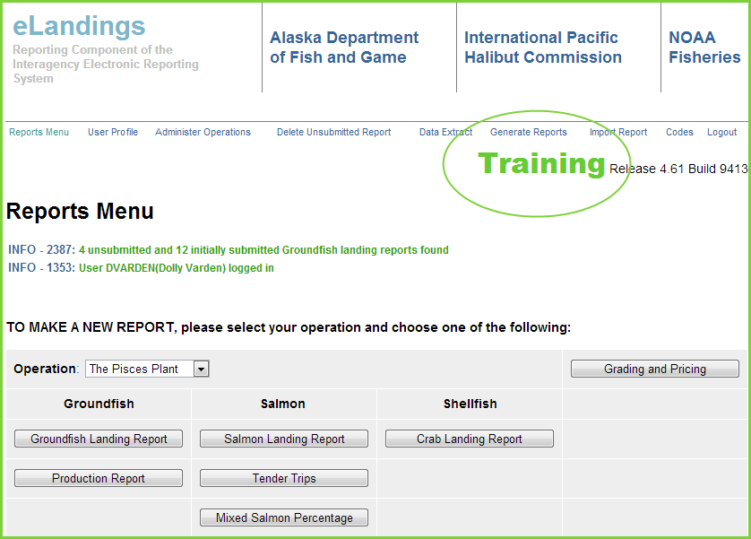
eLandings Environments
Production
Training
Test

Slide 9
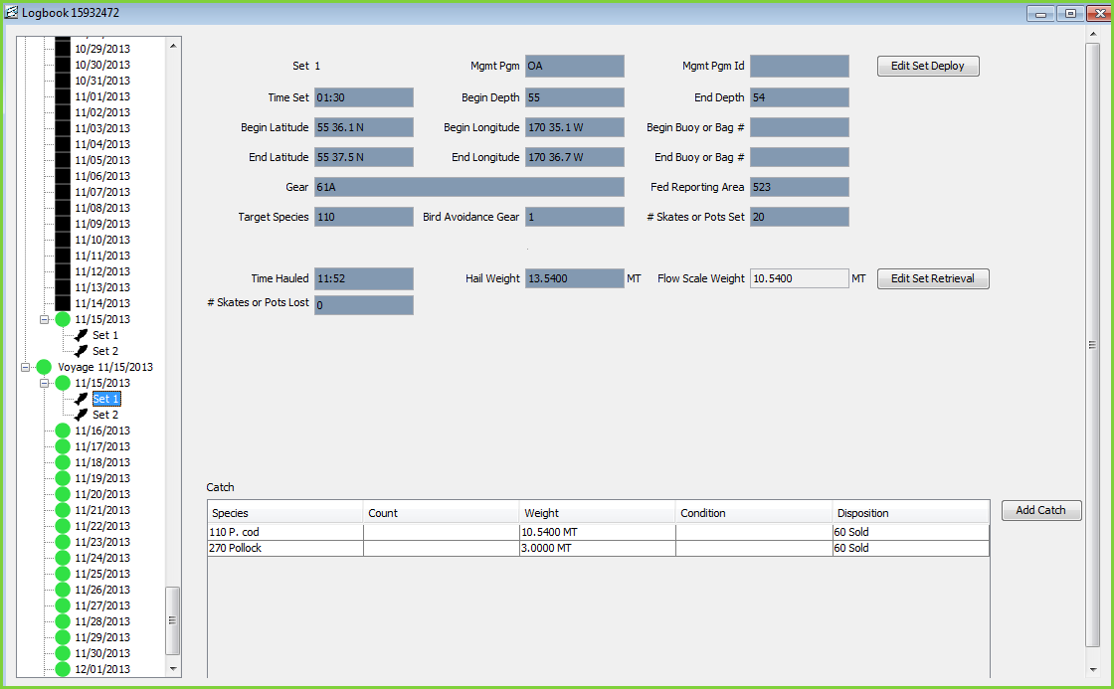
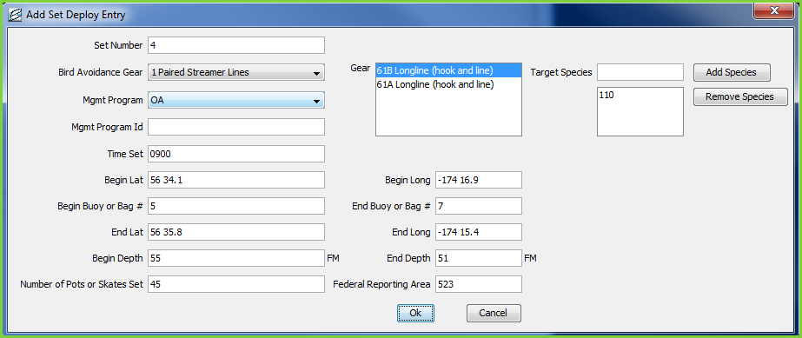
Elogbook

Slide 10
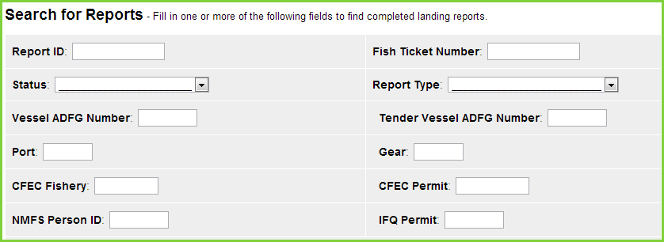
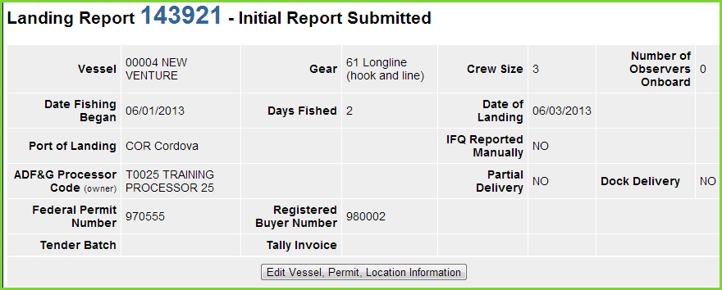
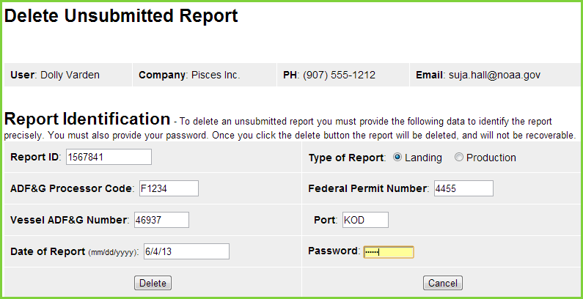
Search, edit, and delete unsubmitted Reports

Slide 11
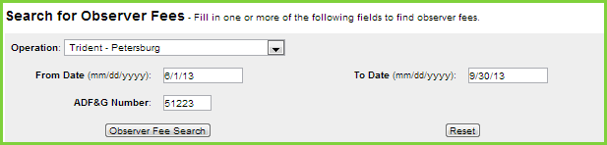
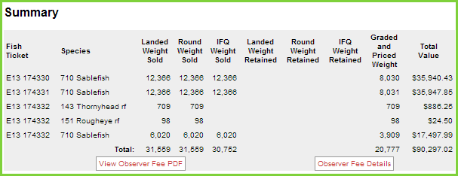
observer fees
Fees can be accessed within 5-15 minutes after submission in most cases
Check Observer Fee details for info on why fees may not have applied
Observer fee searches can be done for a date range or for a particular vessel
Editing line items or stat areas in a landing can cause minor changes in observer fees
Agency changes should not affect fee amounts

Slide 12
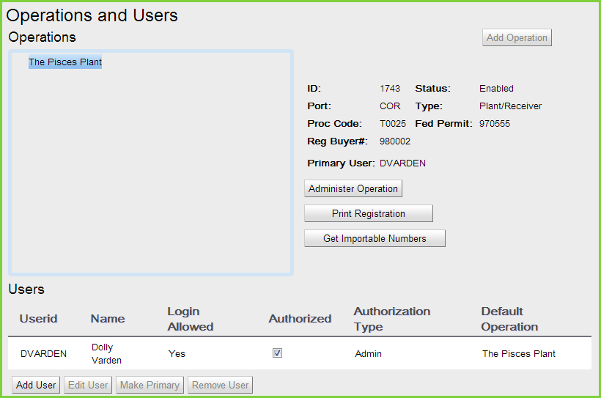
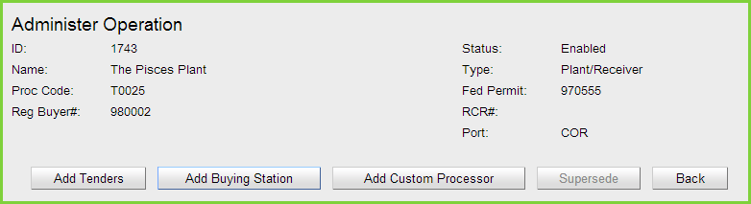
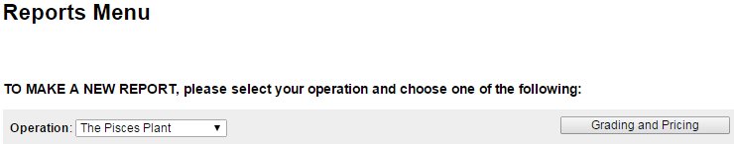
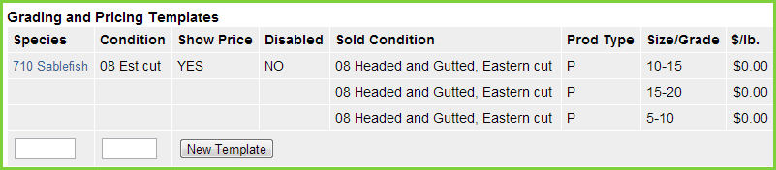
Operations administration

Slide 13
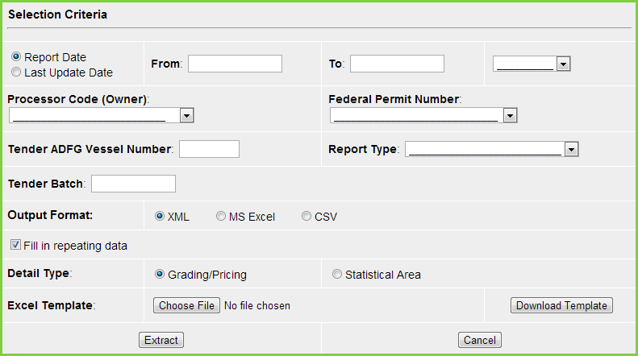
DATA EXTRACT REPORT TYPES
Customizable template
Groundfish, Salmon, and Crab Landing Reports
At-sea and Shoreside Production Reports

