Slide 1
Operations and User Accounts

Slide 2
What is an Operation?
A collection of identification codes issued by State/Fed Government, to identify a Plant, Tender, Buying Station, At-Sea Processor, …

Slide 3
What is an Operation? (Cont.)
In eLandings, you define an operation to auto-fill all of these codes on a Landing Report
Users are granted permissions to see landing reports by their permissions to operations

Slide 4
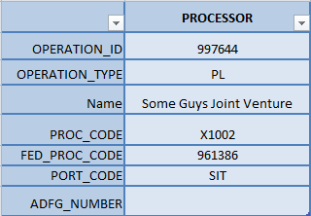
Operation Example

Slide 5
Operations authorization has changed

Slide 6
Old Way: Define user rights on every operation

Slide 7
New Way: Define rights on parent operation only

Slide 8
Operations Change
Old Way
New Way
Joe’s Processing Plant
Mary – Admin
Ben – Normal
Jenson’s Tender
Mary – Admin
Ben – Normal
Jenson - Normal
Wendell’s Tender
Mary – Admin
Ben – Normal
Wendell - Normal
Joe’s Processing Plant
Mary – Admin
Ben – Normal
Jenson’s Tender
(Rights are implied)
Wendell’s Tender
(Rights are implied)

Slide 9
Pro’s and Con’s
Pro’s
Con’s
Much easier to administer
Enable/Disable a user at the parent level only
Fewer ways to get it wrong
More consistent user experience
Reports and queries will better match from user to user.
Easier to program for
Fewer bugs
Less fine-grain control
Can’t grant user rights to Child operation only

Slide 10
New to Tender Accounts

Slide 11
Old Way: tLandings required all users have an elandings account

Slide 12
New Way: tLandings uses a generic user_id = TENDERMAN

Slide 13
New Way: PTI allows Processors to create and store TENDERMAN account passwords locally

Slide 14
In PTI during install of tLandings:
Select an operation
If operation password not defined, PTI asks for one.
Install to Thumbdrive
The thumb drive is configured for the operation and operation password

Slide 15
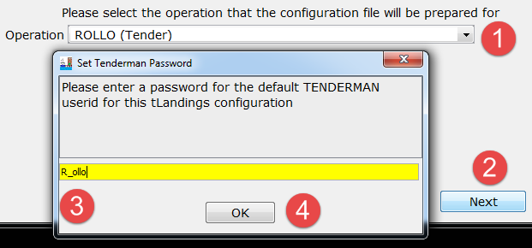

Slide 16
In tLandings, at login
The user enters the following:
User_id = TENDERMAN
Password = <operation password>
i.e – “R_ollo”

Slide 17
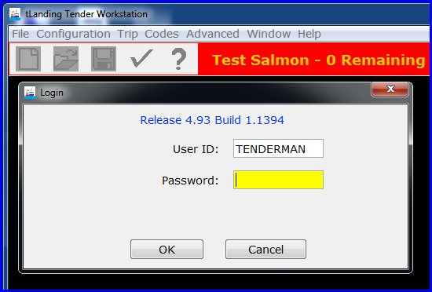

Slide 18
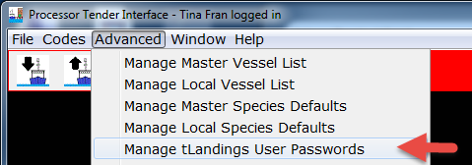
How to view/change passwords
In PTI, click on Advanced>Manage tLandings User Passwords
From here you can view and change operation passwords

Slide 20
Operation passwords are not stored in the elandings database

Slide 21
If you forget an operation password and cannot look it up in PTI, a plant user can log in with their own user_id and password.

Slide 22
If the tender forgets password, generate an encrypted password

Slide 23
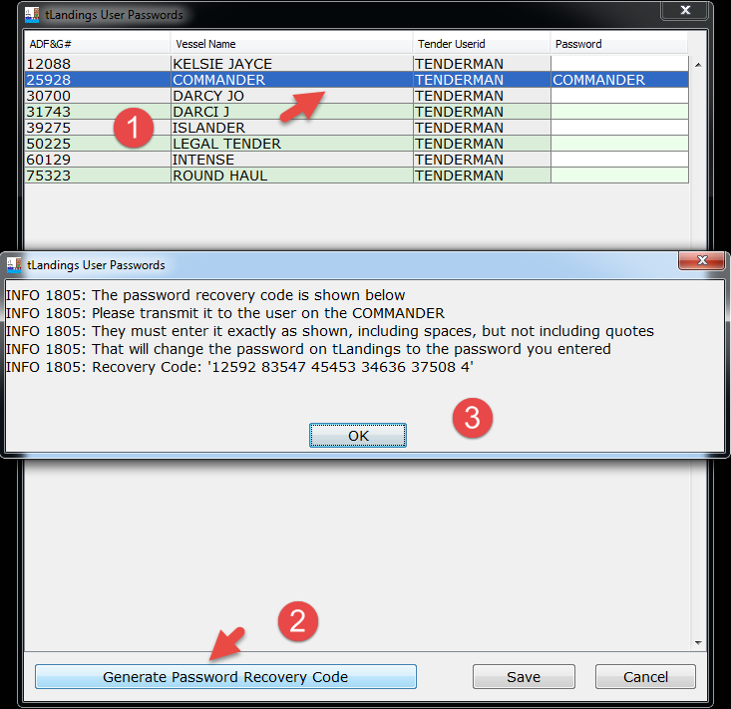

Slide 24
TENDERMAN Passwords simplify your workload

Slide 25
If you do not plan to do custom processing, take a break

Slide 26
Custom Processing for Tenders

Slide 27
Custom Processing Agreement
It may be desirable for one processing plant to purchase fish and have another plant, process those fish.
There is an “Owner” and a “Processor” of the fish.

Slide 28
More complete definitions exists

Slide 29
Custom Processing Owner
Purchaser/owner of the seafood product.
Sets up another processor to receive, expedite, or process seafood on their behalf.
Must establish a custom processing owner operation for each plant that does the actual processing.
Allows owner of the catch to maintain visibility and control of landing reports and to electronically review submitted landing reports created by custom processors.
May remove authorization of processor to access reports if the business relationship be terminated.
Owner must have a valid license with the State, and may have their own receiving permits from NMFS.
These permits are used to establish the custom processing owner operation.

Slide 30
Custom Processor
The operation in possession of seafood product, but not the owner, or a direct agent for the owner.
A processor, business, or entity that provides the service of seafood receiving, expediting, or processing but has not purchased (does not own) the seafood.
Landing reports are usually done by users at the plant doing the custom processing for the custom processing owner.

Slide 31
More resources
https://elandings.atlassian.net/wiki/display/pm/Custom+Processing+Cheat+Sheet
https://elandings.atlassian.net/wiki/display/tr/2015+-+September+29%2C+2015++eLandings+Workshop+in+Dutch+Harbor?preview=%2F74088596%2F75792685%2FCustom_Processing_Setup.pptx

Slide 32
Crazy Example
Owner Plant in Cordova
Honker Cordova
Processing Plant in Sitka
Some Guys Joint Venture
We want to set up:
A Custom Processing Operation
One or more Tender or Buying Station Operations

Slide 33
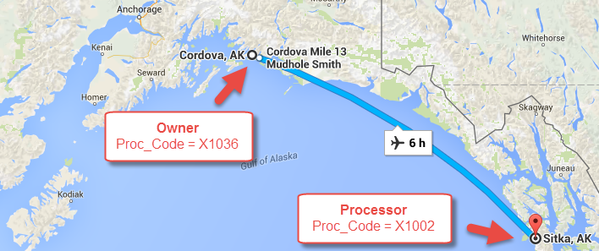

Slide 34
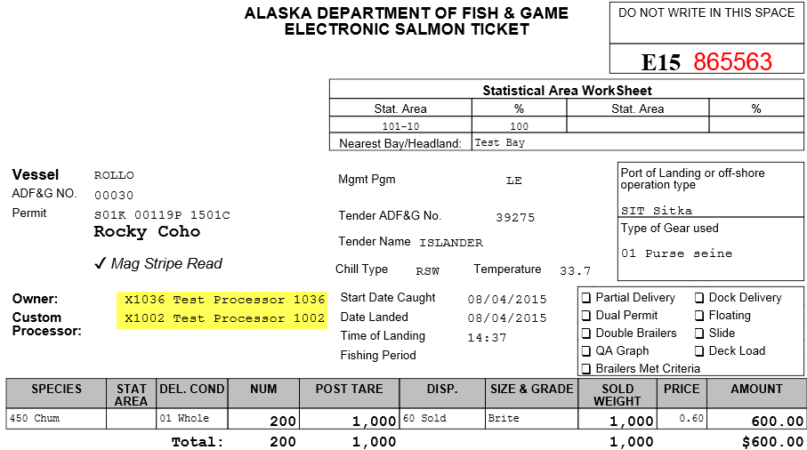
Example Landing Report

Slide 35
Custom Processing Operations Relationship Diagram

Slide 36
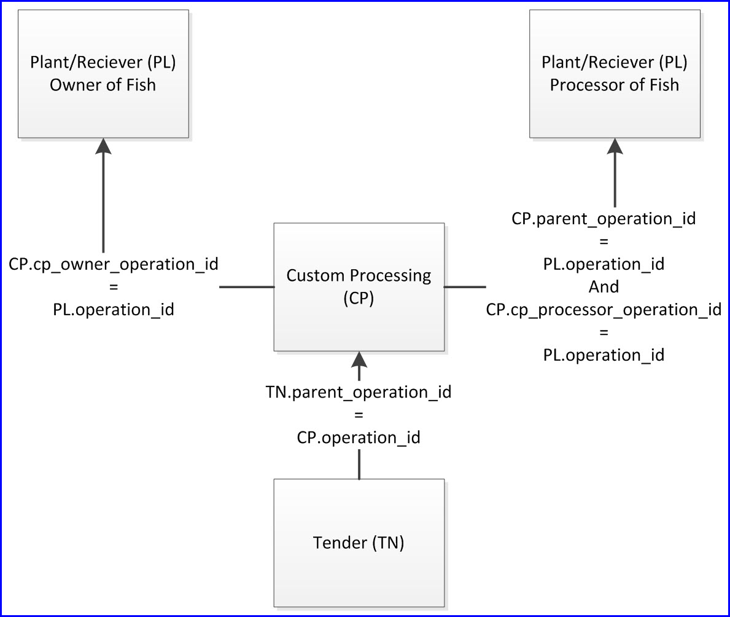

Slide 37
Operations for Custom Processing
 | OWNER | PROCESSOR | CUSTOM_PROCESSOR | TENDER
OPERATION_ID | 997649 | 997644 | 998013 | 1008415
OPERATION_TYPE | PL | PL | CP | TN
NAME | Honker Cordova | Some Guys Joint Venture | Some Guys for Honker Cordova | ISLANDER-SG 4 Honker COR
PROC_CODE | X1036 | X1002 | X1036 | X1036
FED_PROC_CODE | 961431 | 961386 | 961386 | 961386
PORT_CODE | COR | SIT | SIT | SIT
ADFG_NUMBER |  |  |  | 39275
PARENT_OPERATION_ID |  |  | 997649 | 998013
CP_OWNER_OPERATION_ID |  |  | 997649
CP_PROCESSOR_OPERATION_ID |  |  | 997644

Slide 38
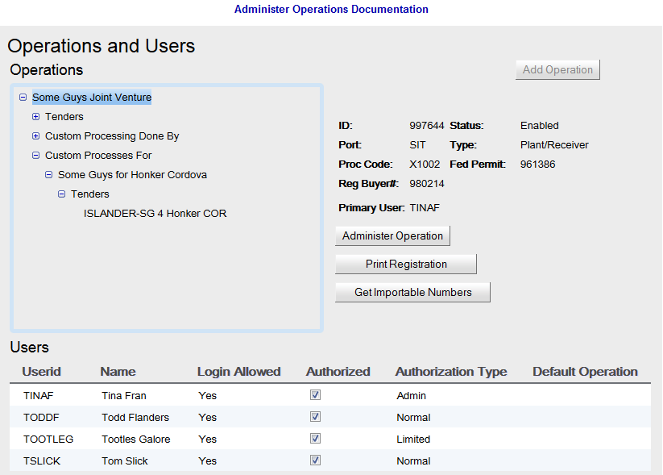
“Processor”
of the Fish

Slide 39
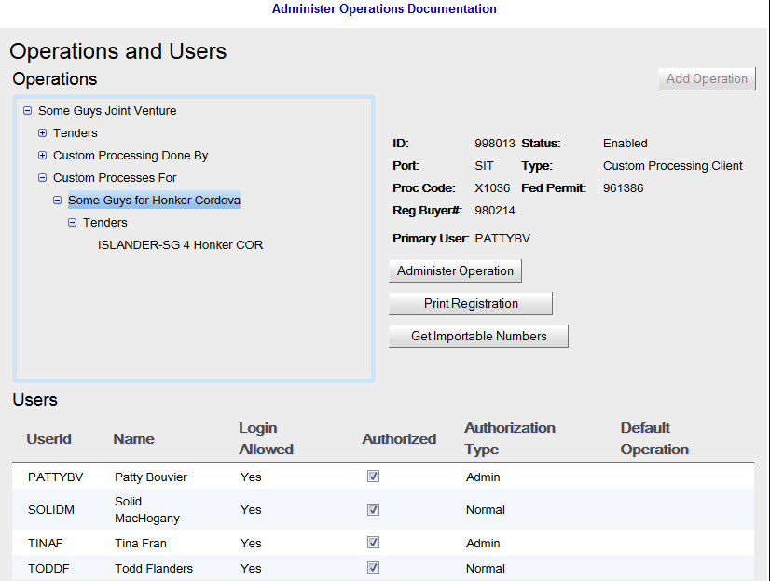
“Processor”
of the Fish

Slide 40
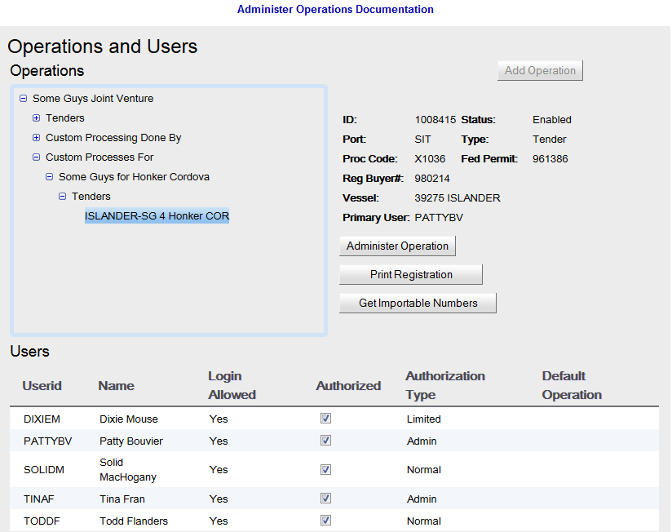
“Processor”
of the Fish

Slide 41
Notice
The Custom Processor user lack rights to the Owner operation.
A tender vessel may have two operations
One for the processing plant
One for the custom processing arrangement

Slide 42
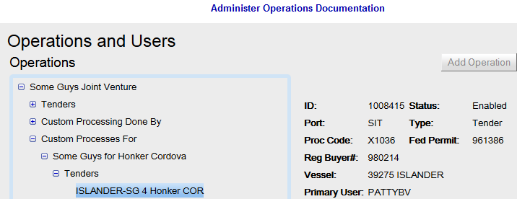
“Processor”
of the Fish

Slide 43
Name the Custom Processing Tender and Buying Station operations so you can tell they are for Custom Processing!

Slide 44
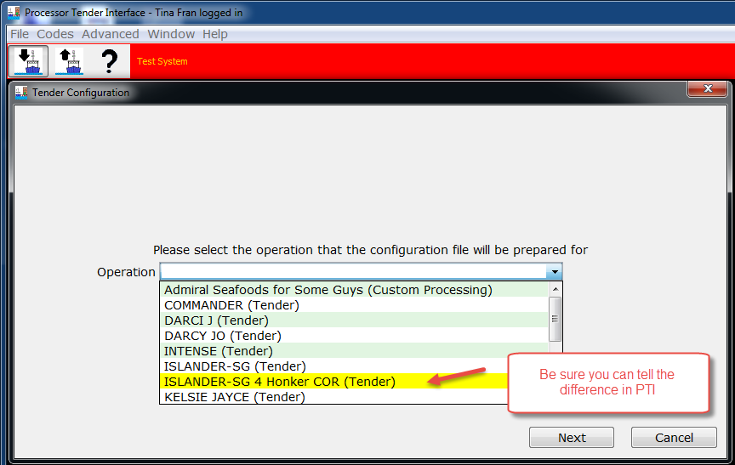

Slide 45
The Owner Processor has to set up the Custom Processor Operation

Slide 46
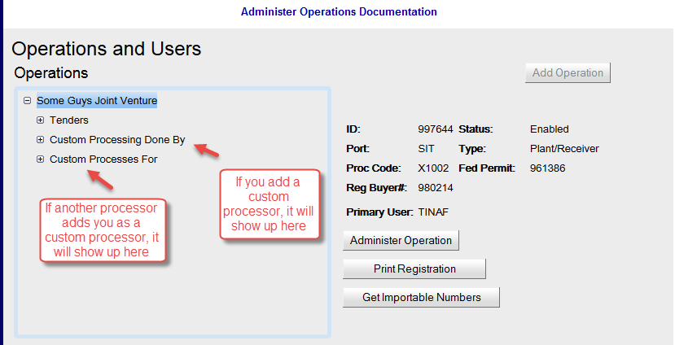
Setting up a Custom Processing Operation

Slide 47
Let’s create a Custom Processing Operation for “Some Guys Joint Venture” as the Owners

Slide 48
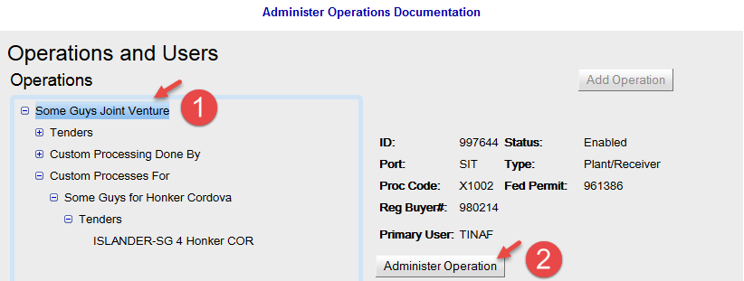
Setting up a Custom Processing Operation

Slide 49
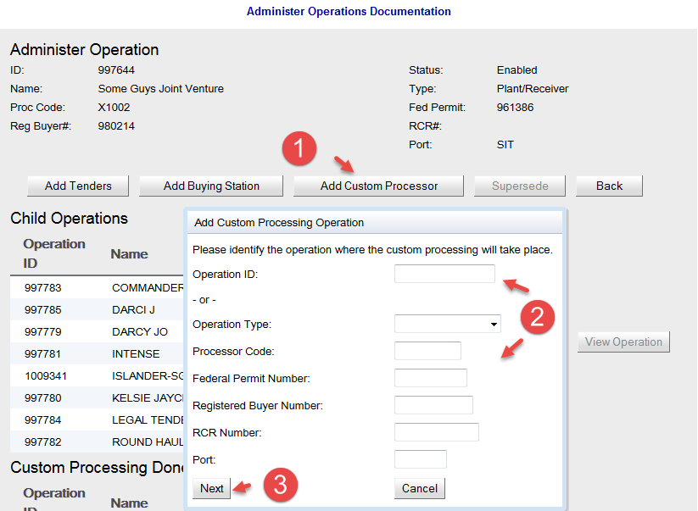

Slide 50
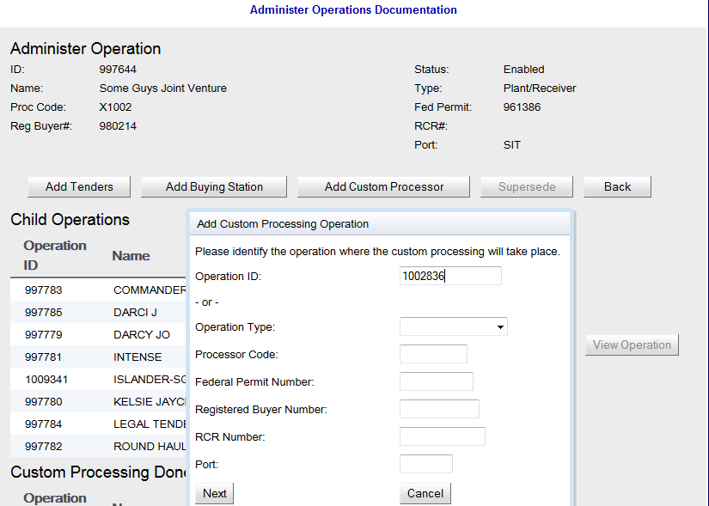

Slide 51
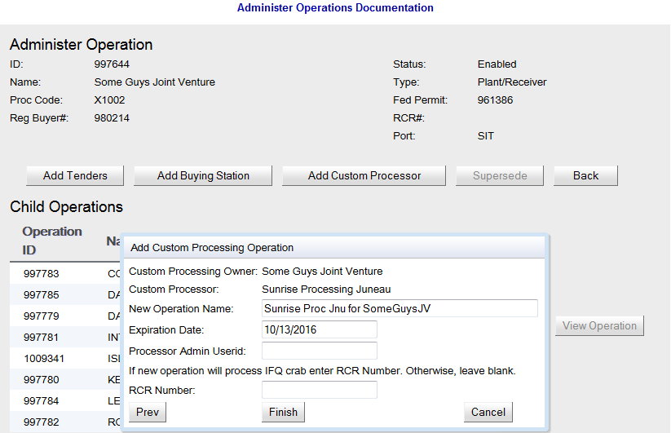

Slide 52
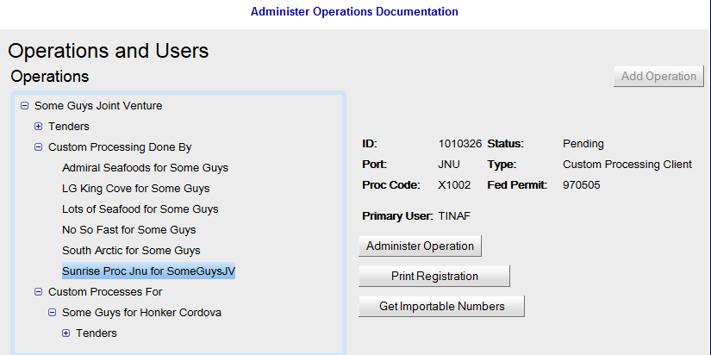
“Owner” Sees

Slide 53
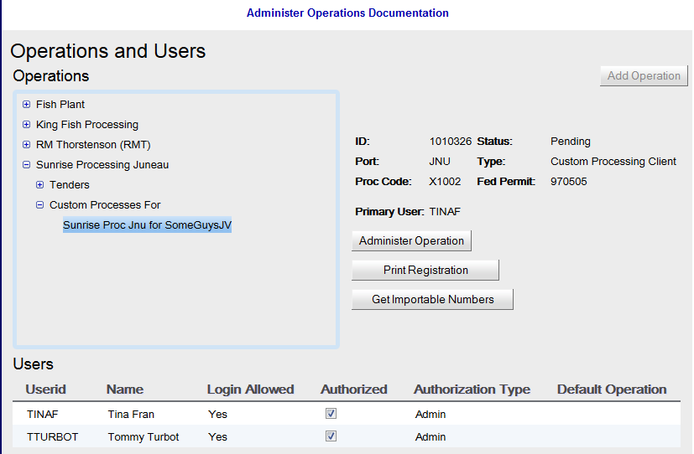
“Processor” Sees

Slide 54
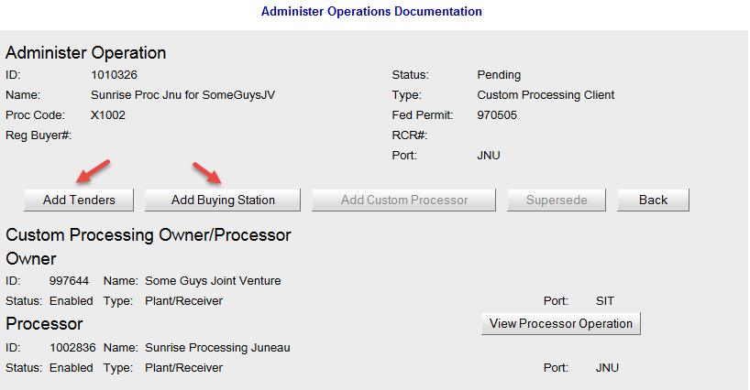
To Custom Process, must create a Tender or Buying Station Op

Slide 55
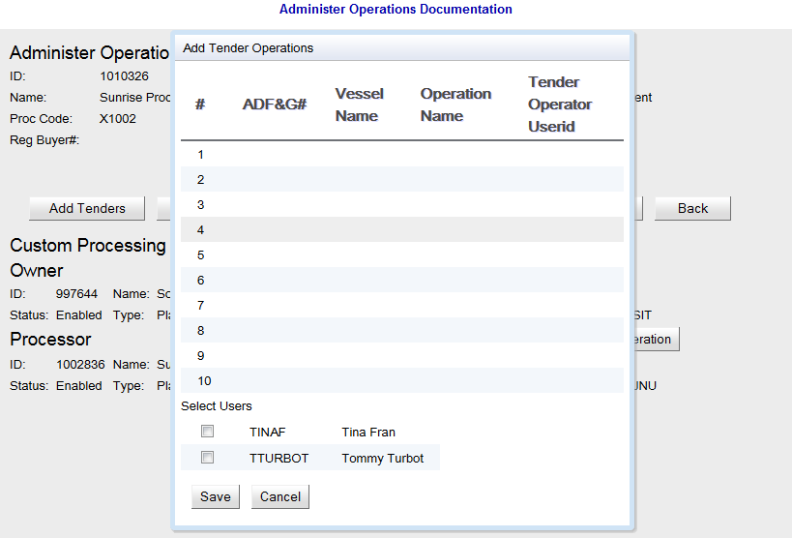

Slide 56
Remember to name CP Tender and Buying Stations distinctly!

Slide 57
eLandings Staff will need to Activate the C/P Operation

Slide 58
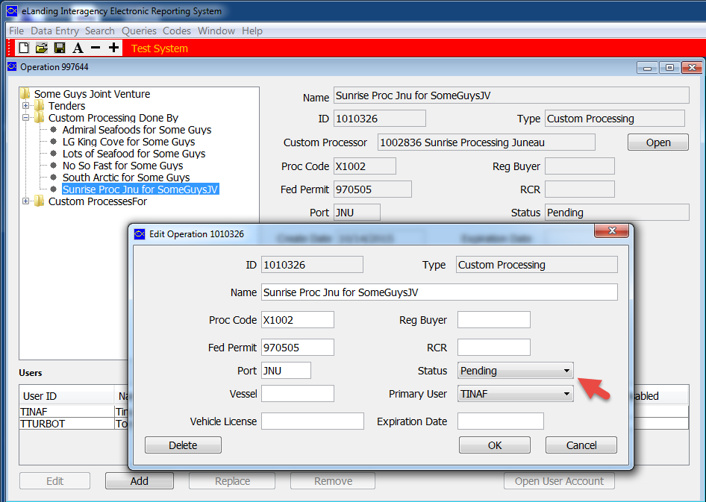

Slide 59
Setting up Custom Processing is Confusing. Please contact eLandings to get help.

Slide 60
Questions?

