Slide 1
PTI Installer – Scanning for old versions

Slide 2
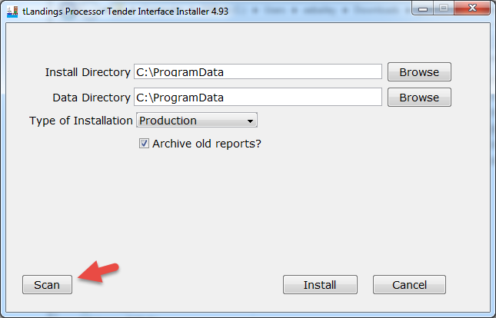

Slide 3
Scan Button
Removes old installs of
Removes old Desktop

Slide 4
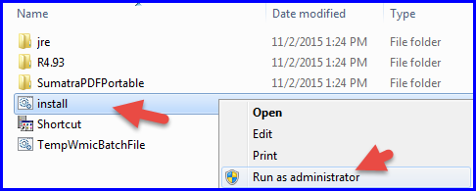
You may need admin rights
Or a system admin to run it for you

Slide 5
Running Scan without Admin Rights

Slide 7
Running Scan with Admin Rights

Slide 8
1. No old version found

Slide 9
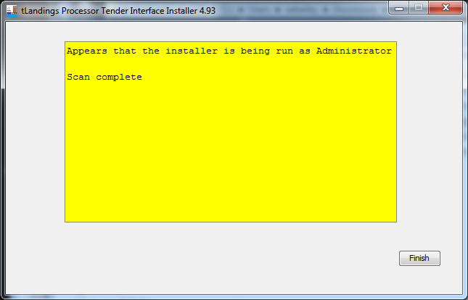

Slide 10
2. Old version found

Slide 11
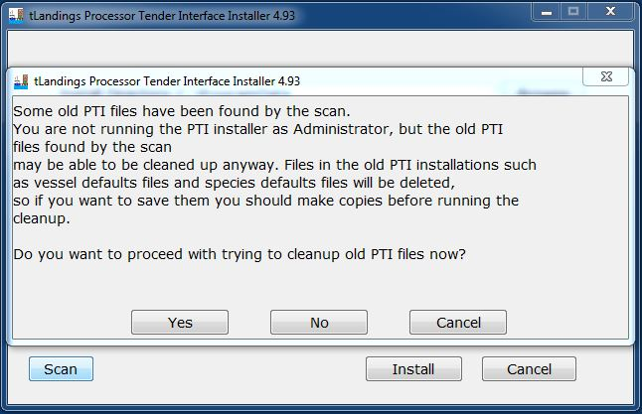

Slide 12
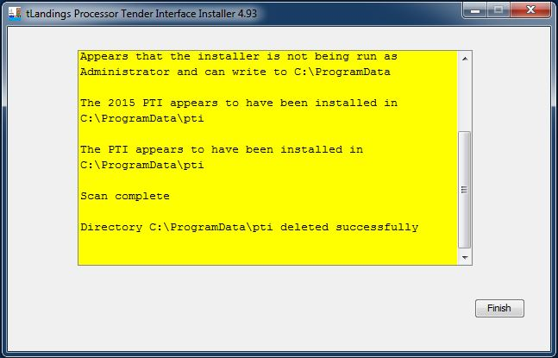

Slide 13
Note: Program will exit after scan. Please run program again to install.

Slide 14
Questions?

