Slide 1
Creating a Salmon Landing in tLandings + Setting Average Weight

Slide 2
New Desktop Icon

Slide 3
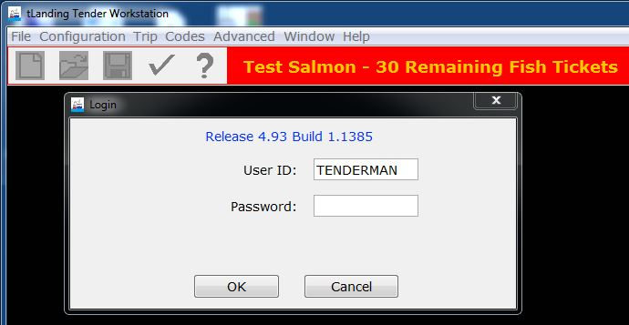

Slide 4
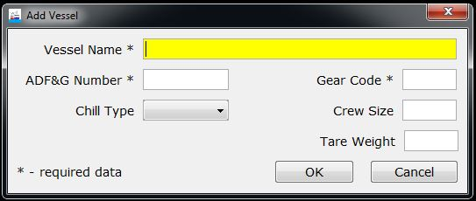

Slide 5
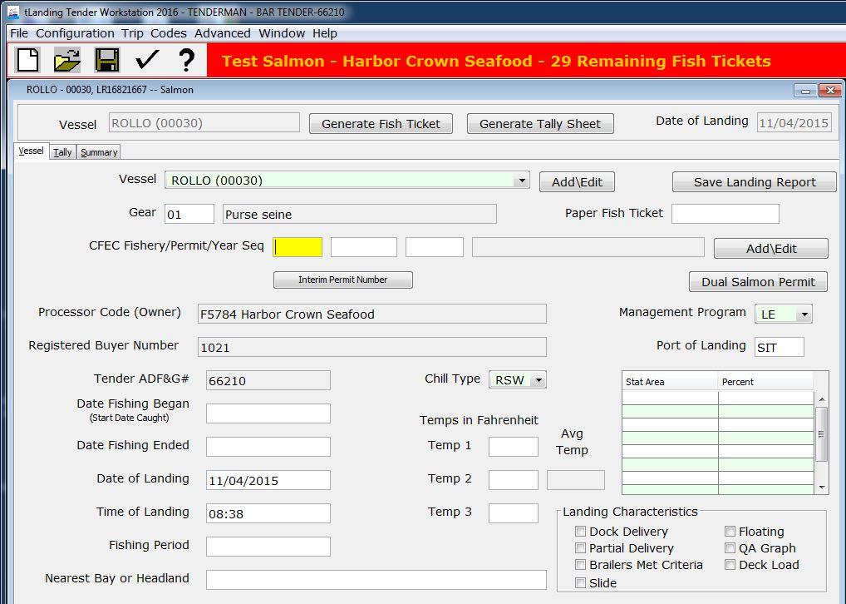

Slide 6
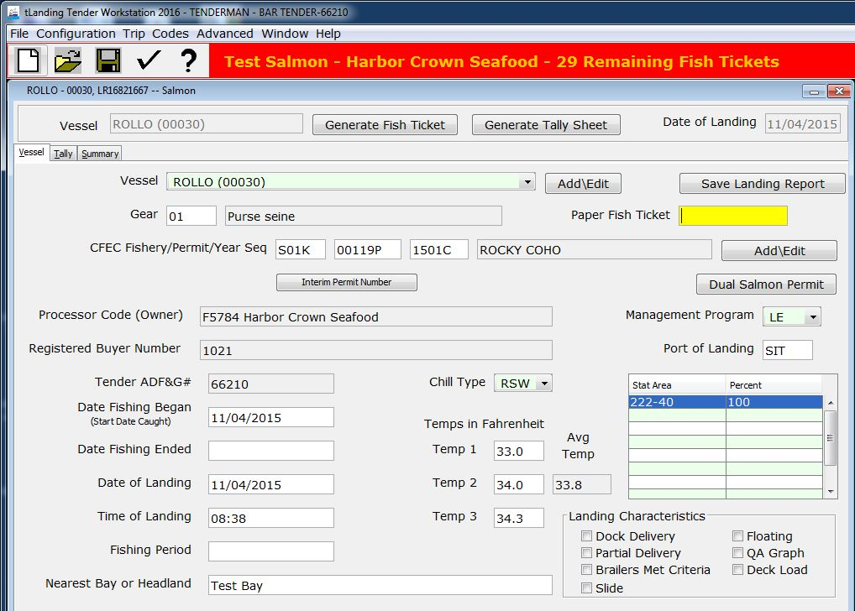

Slide 7
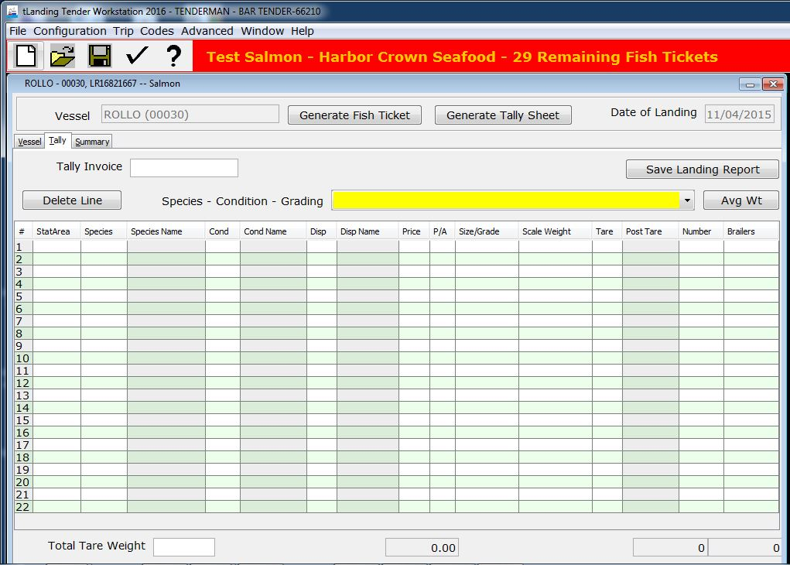

Slide 8
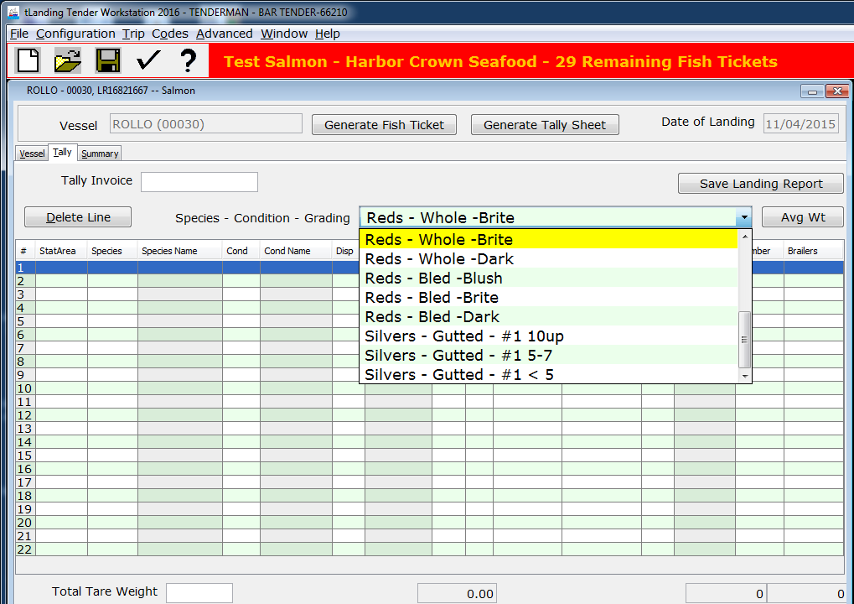

Slide 9
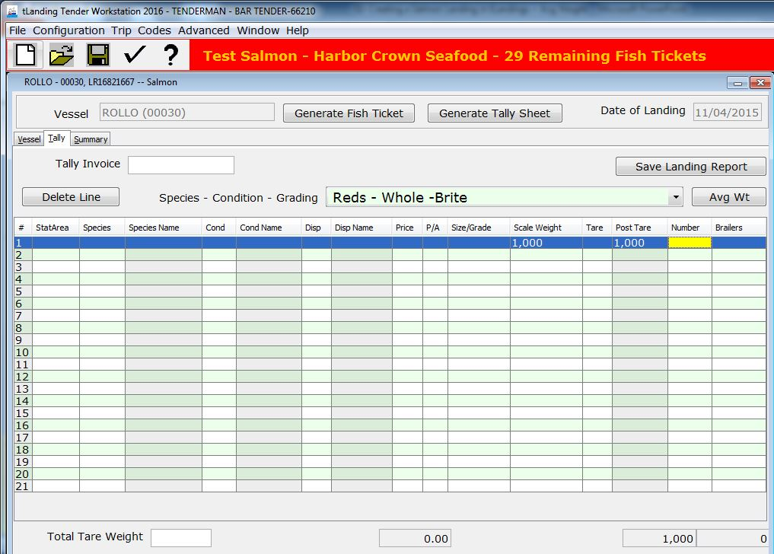

Slide 10
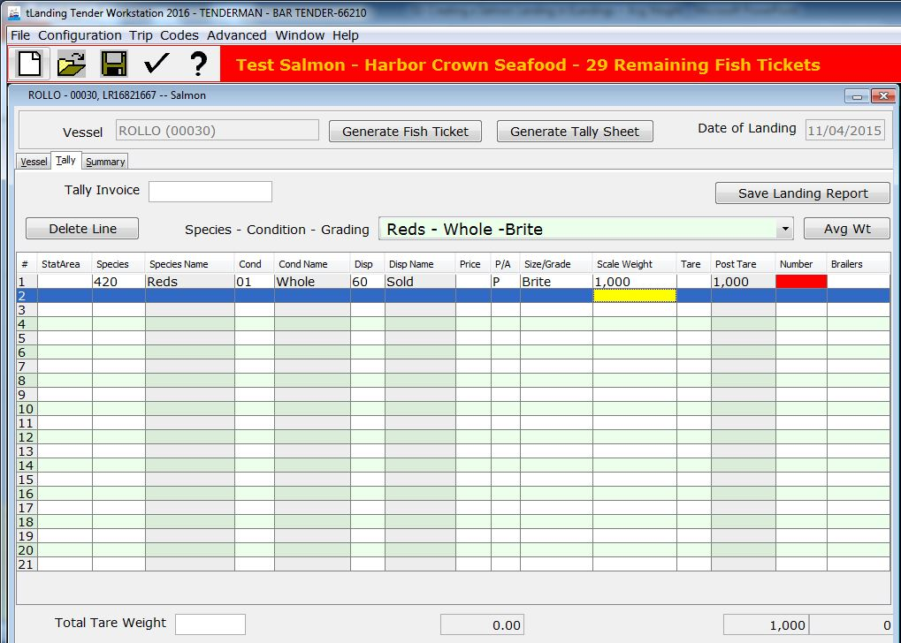

Slide 11
The system could not automatically calculate number of fish because we don’t have an average weight for this species yet

Slide 12
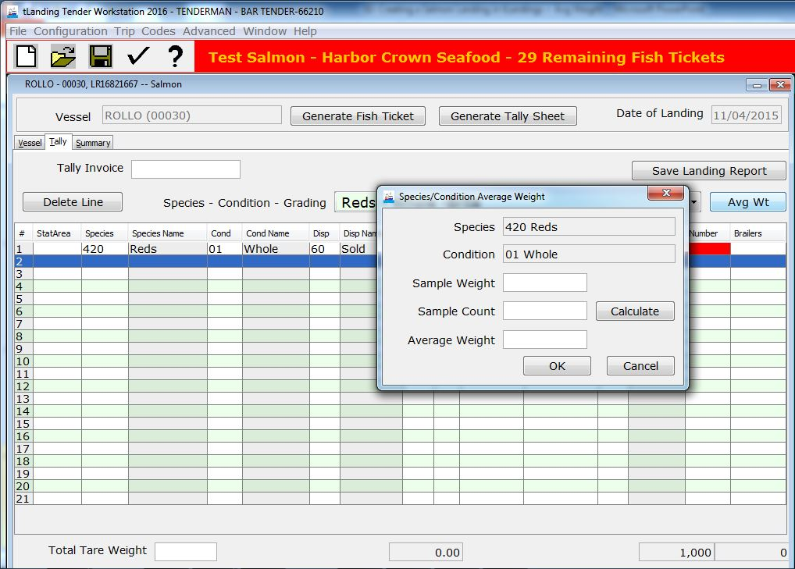

Slide 13
Ideally tenders will take an species average on each delivery

Slide 14
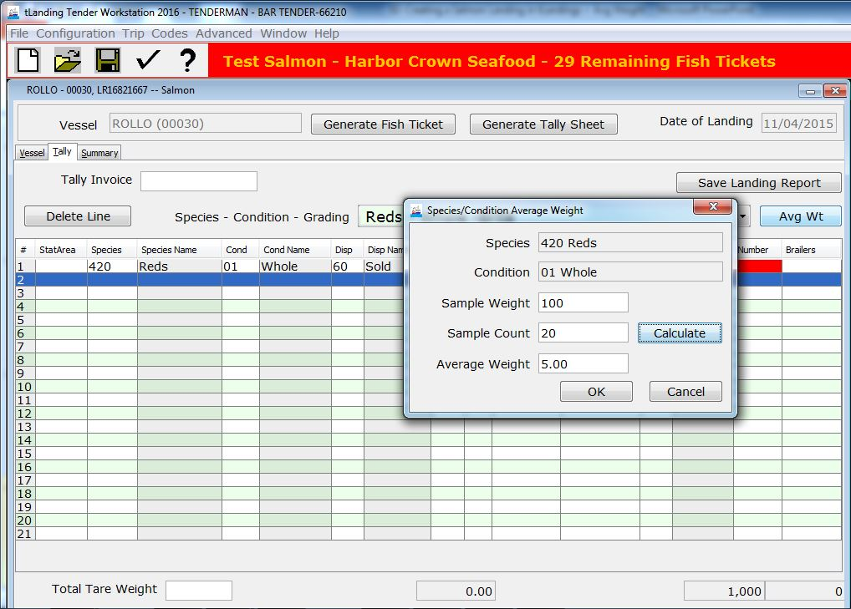

Slide 15
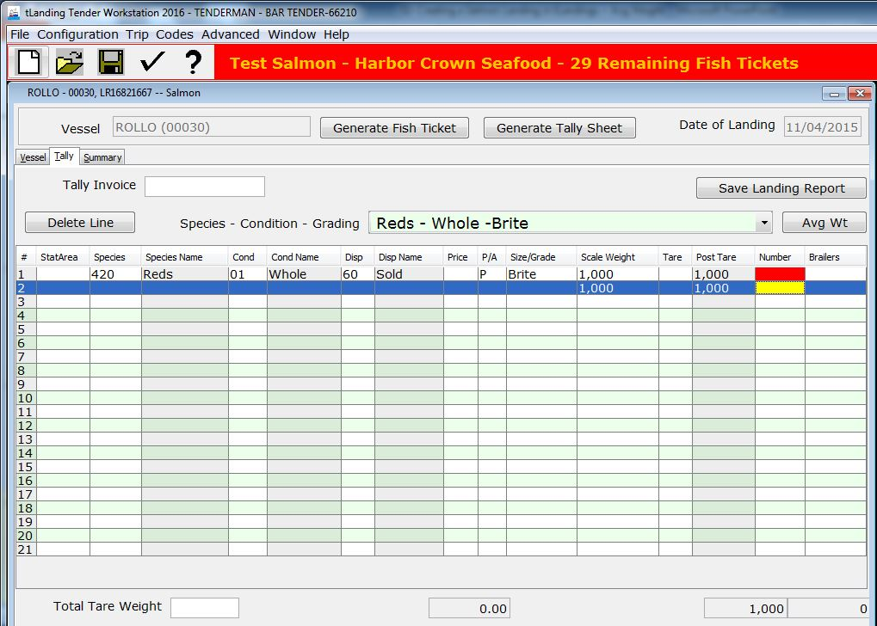

Slide 16
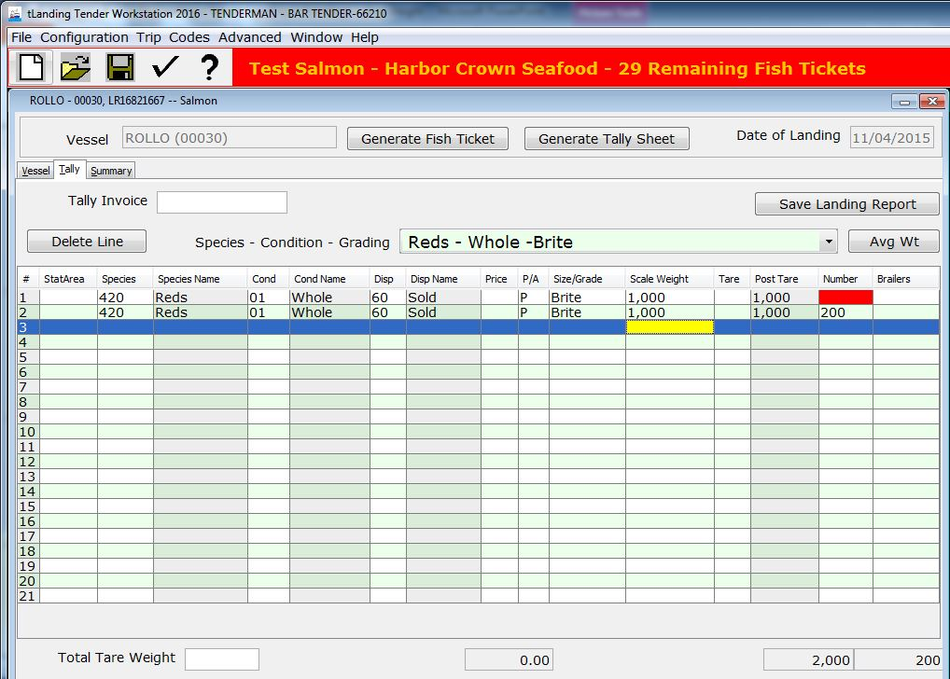

Slide 17
Number of Fish was automatically calculated by tabbing out of number field

Slide 18
Click on first row Number Field and tab out to auto-calculate number of fish on that line

Slide 19
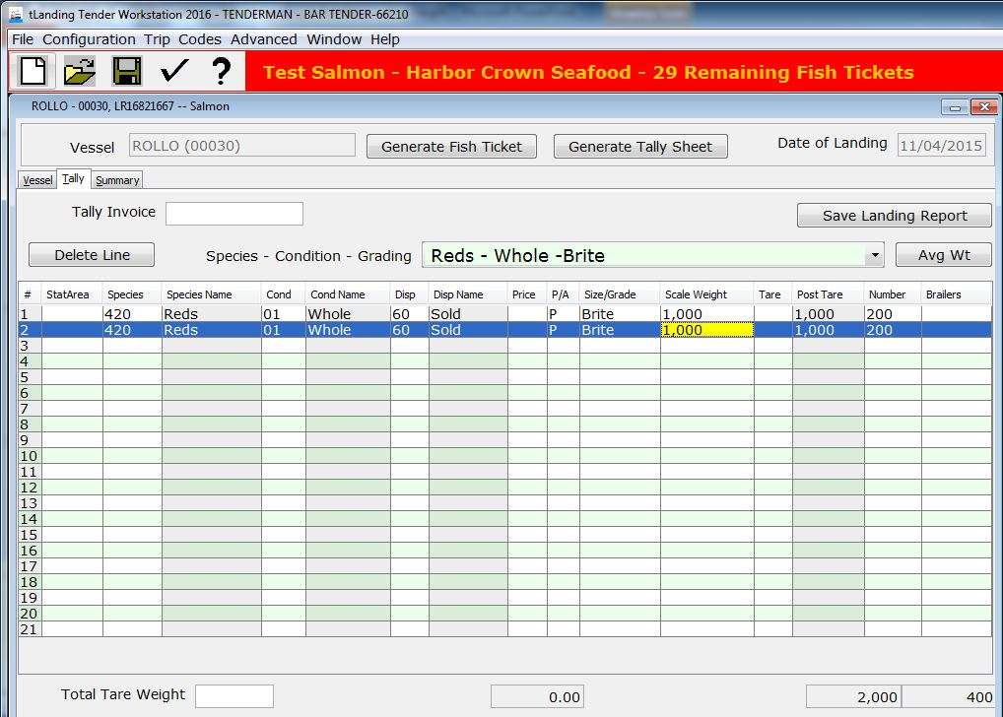

Slide 20
Click the Save button

Slide 21
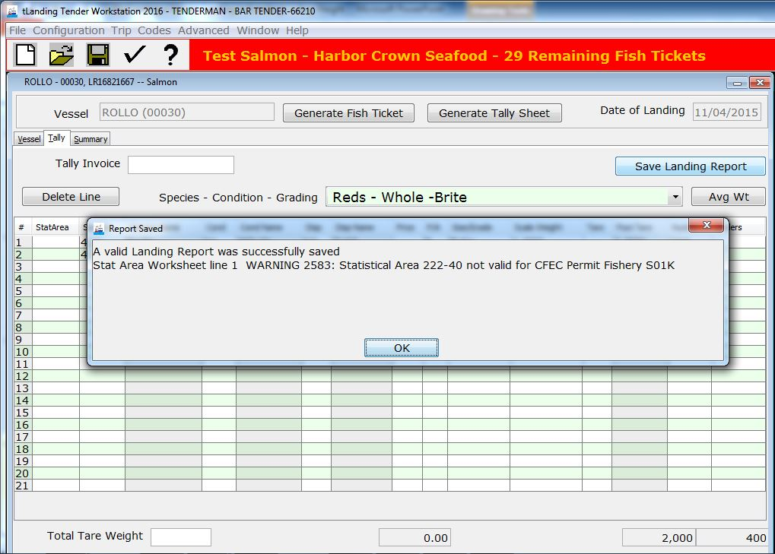

Slide 22
Click Generate Fish Ticket

Slide 23
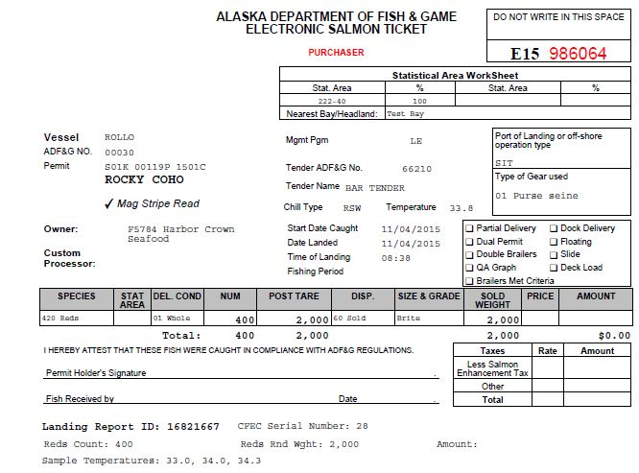

Slide 24
One signed paper copy goes with Fisherman. - One signed copy goes to Processor

Slide 25
Questions?

