Slide 1
Recap of PTI / tLandings 2016 Changes

Slide 2
New to PTI
New Desktop Icon – includes the Year
Set / store TENDERMAN passwords locally
Change the Operation on tickets during or after the ticket upload process

Slide 3
New to PTI
Server allows Two Vessel Defaults
Groundfish
Salmon

Slide 4
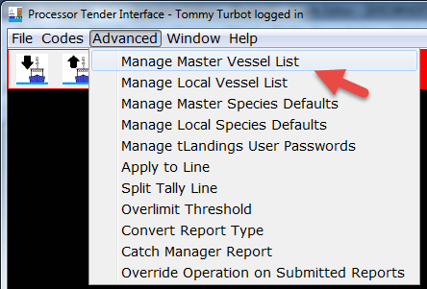

Slide 5
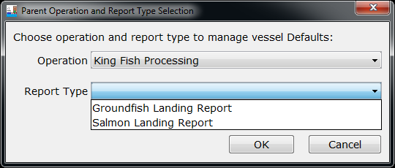

Slide 6
New to tLandings
New Desktop Icon – includes the Year
Use of Generic ‘TENDERMAN’ user_ids
Dual Permits can now be entered on the ticket

Slide 7
New to tLandings (cont.)
Increased stat area reporting capabilities
Line item stat areas
Groundfish stat areas on grounfish species on Salmon Fish Tickets
Minor Bug Fixes
VesselDefaults tabbing

Slide 8
New to eLandings
User Authorization change
If you have rights to a plant, than you have rights to child operations by default

Slide 9
New to eLandings (Cont.)
Running Reports
Handled by a queue now
Send an email response now rather than an immediate download

Slide 10
For a more complete list of changes see:
https://elandings.atlassian.net/wiki/display/doc/Release+Notes

Slide 11
Questions?

