Slide 1
eLandings Data Extract Mechanisms

Slide 2
Data Extract Options:

Slide 3
Report Extract Web Page
Recommended for small operations making few requests

Slide 4
Elandings Public Webservices
Elandings Public Webservices
Recommended for medium to large operations making many requests
Recommended for those seeking greater control
Recommended for 3rd party developers

Slide 5
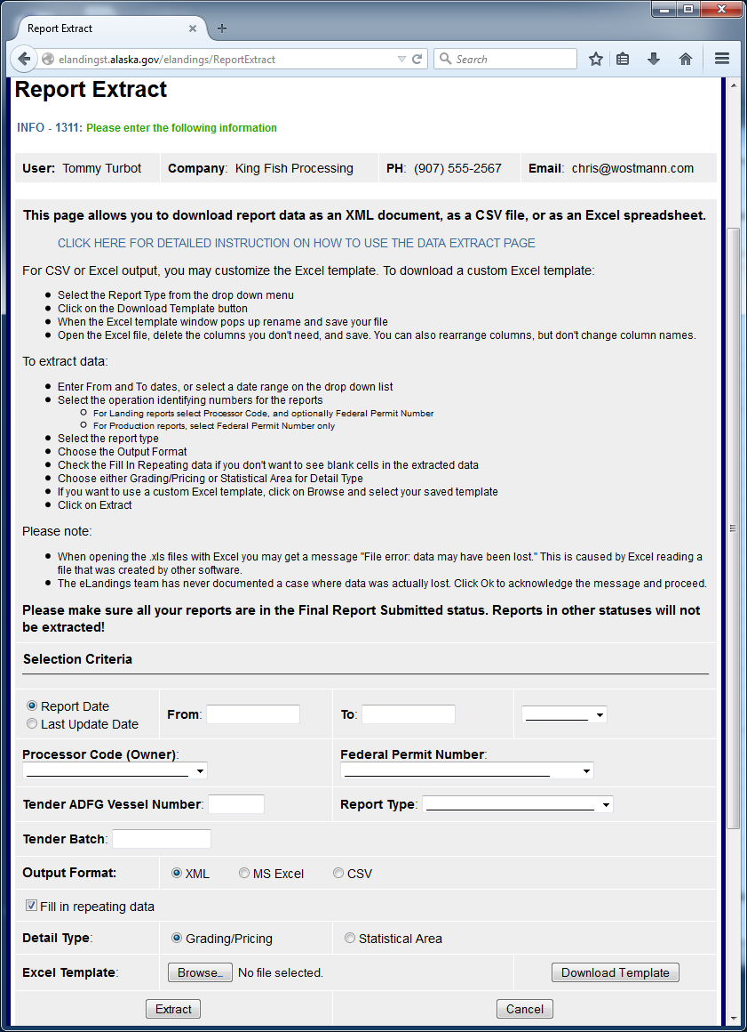

Slide 6
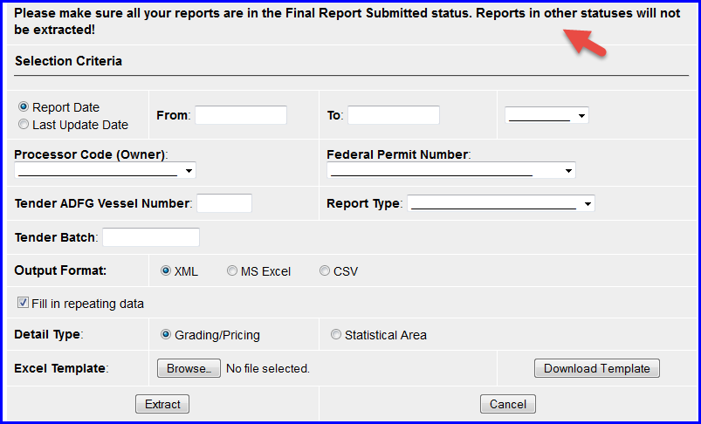

Slide 7
Web Page Change!
Results are now emailed
Requests now get in line and are processed one at a time to protect the system from heavy demand
Please wait for response!

Slide 8
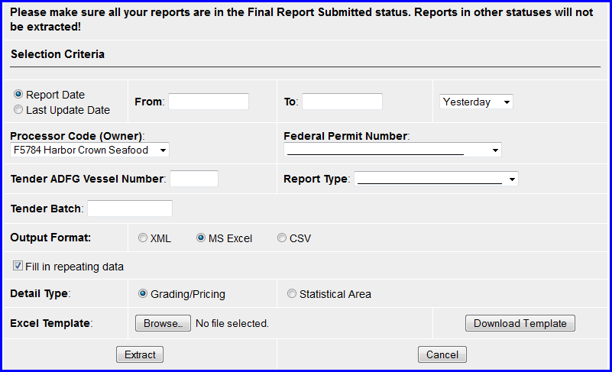

Slide 9
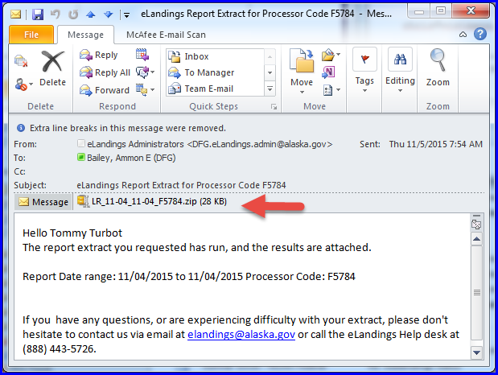

Slide 10
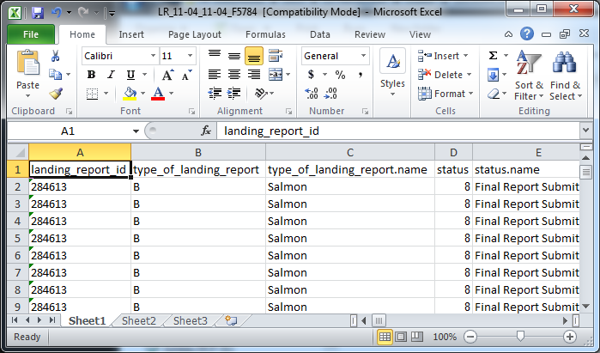

Slide 11
Export Options

Slide 12
“But I only want 3 columns of data!”

Slide 13
Use a Template to define the columns of data you want returned

Slide 14
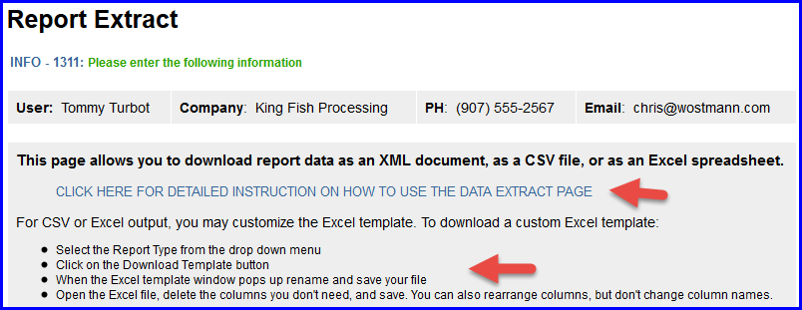
Template Instructions are provided

Slide 15
eLandings Public Webservices
Processing Plant and 3rd Party software developers can write software to talk directly with eLandings
Integrate elandings features into your application

Slide 16
Your system might ask eLandings
Give me the user info for ‘TTURBOT’
Give me all my landing reports that occurred between 7/1/2015 and 7/5/2015 and are Salmon Landings and …
Save these changes to landing report id = 123456
…

Slide 17
Public Webservices provide a lot of power

Slide 18
Public Web Service Documentation
https://elandings.atlassian.net/wiki/display/ifdoc/Public+Web+Service+Documentation

Slide 19
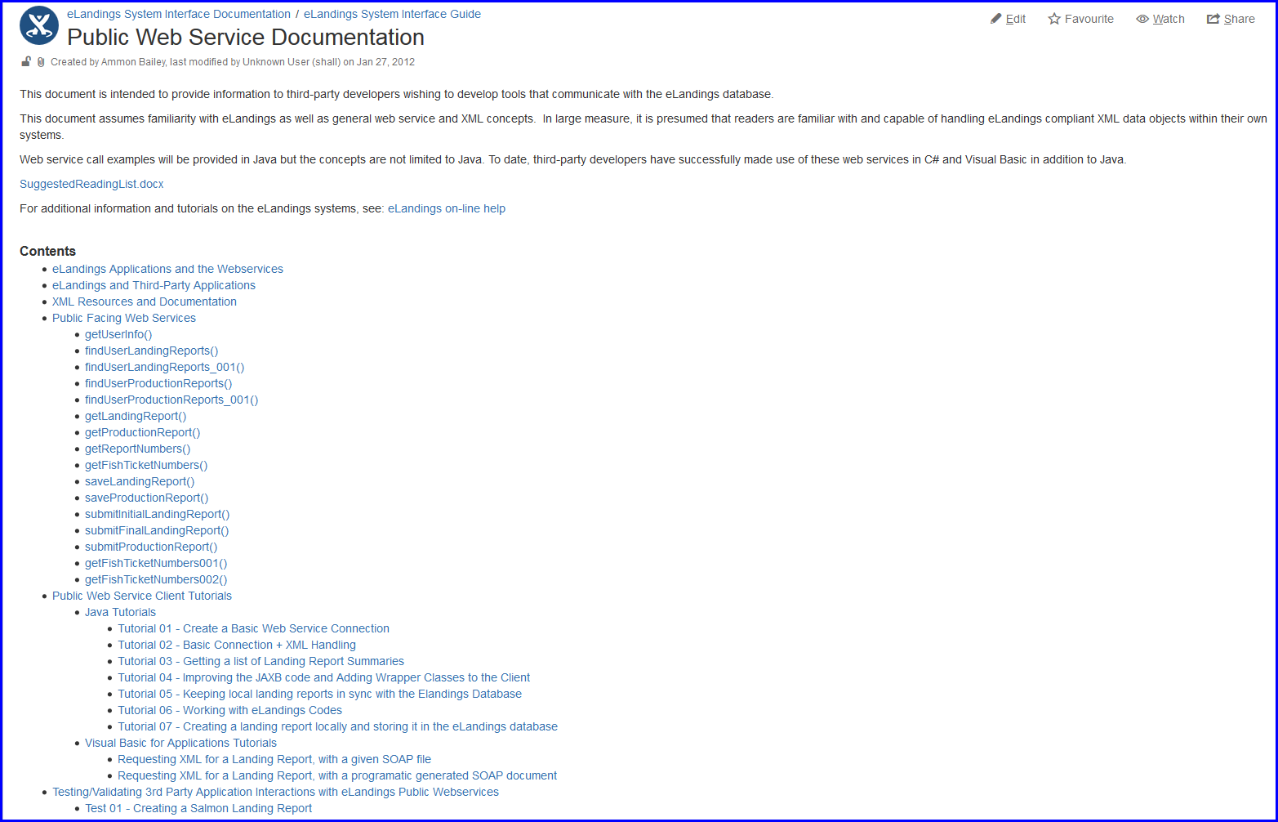

Slide 20
With great power comes great responsibility

Slide 21
We have 1,000’s of Public Webservices connections Daily

Slide 22
Planning to use public webservices? Please talk with us

Slide 23
We’d like your system to take a test
Ensure that you are using the webservices in a way that protects the data

Slide 24
Why Test?
Data was not handled correctly
We have provided information on what is happening and how to correct it

Slide 25
Why Test?(cont.)
Inefficient / excessively redundant requests to the system
We have helped 3rd party developers to filter their requests to get what they want

Slide 26
Webservice Objects change periodically - Download the current XSD files at least yearly

Slide 27
Track Changes At:
https://elandings.atlassian.net/wiki/display/ifdoc/Schema+Version+History
https://elandings.atlassian.net/wiki/display/doc/Release+Notes

Slide 28
Questions?

