Slide 1
Bristol Bay Weekly Report + Mixed Salmon Update

Slide 2
If you do not work with Bristol Bay data, feel free to take a break now

Slide 3
Bristol Bay Weekly Report
ADFG has requested Processors to report weekly harvest by stat area.
By running this report:
Processors can identify problems sooner

Slide 4
Bristol Bay Weekly Report
By sending the report to ADFG, you are signaling that you have reviewed the reports for that week

Slide 5
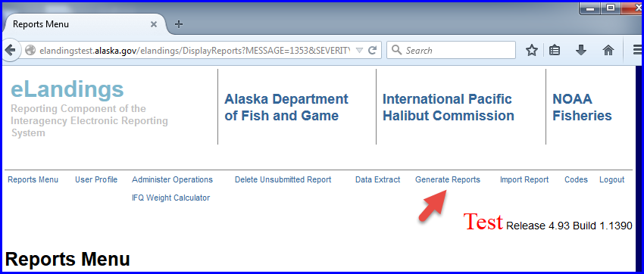

Slide 6
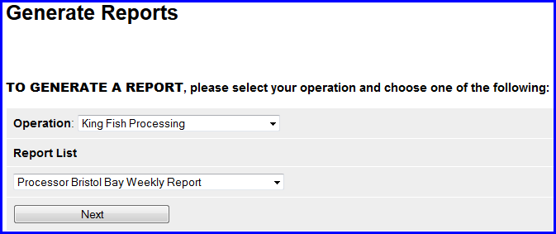

Slide 7
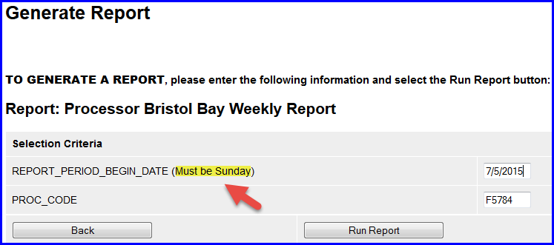

Slide 8
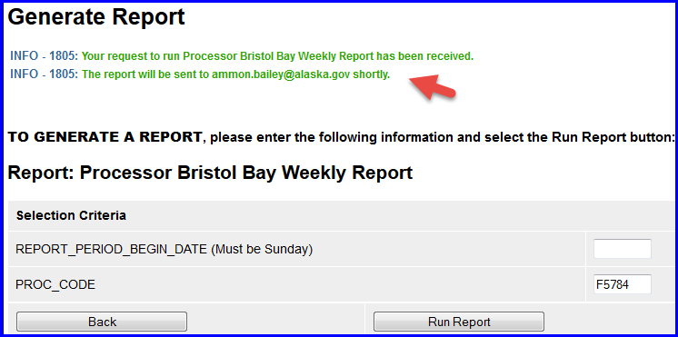
Report Results are emailed

Slide 9
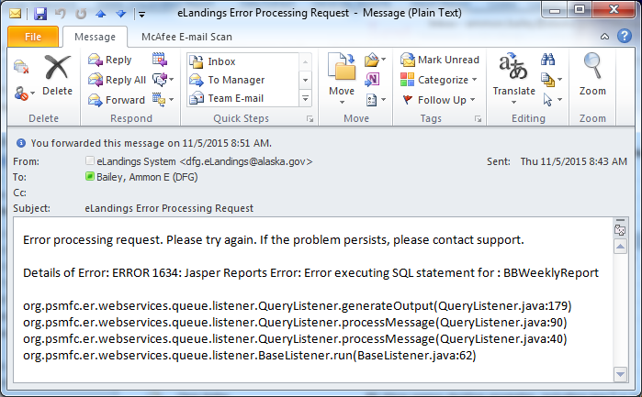
Email on Failure

Slide 10
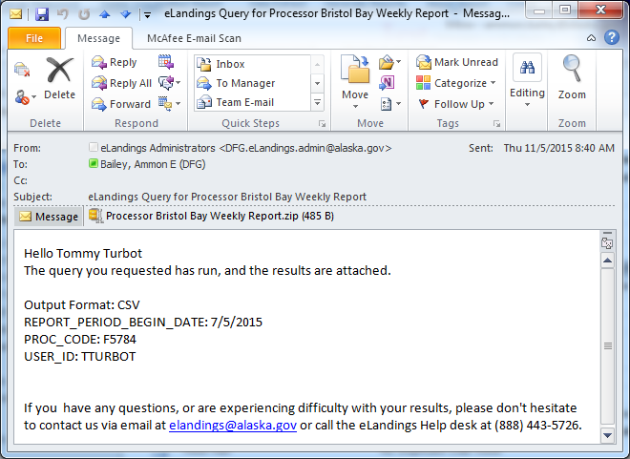
Email on Success

Slide 11
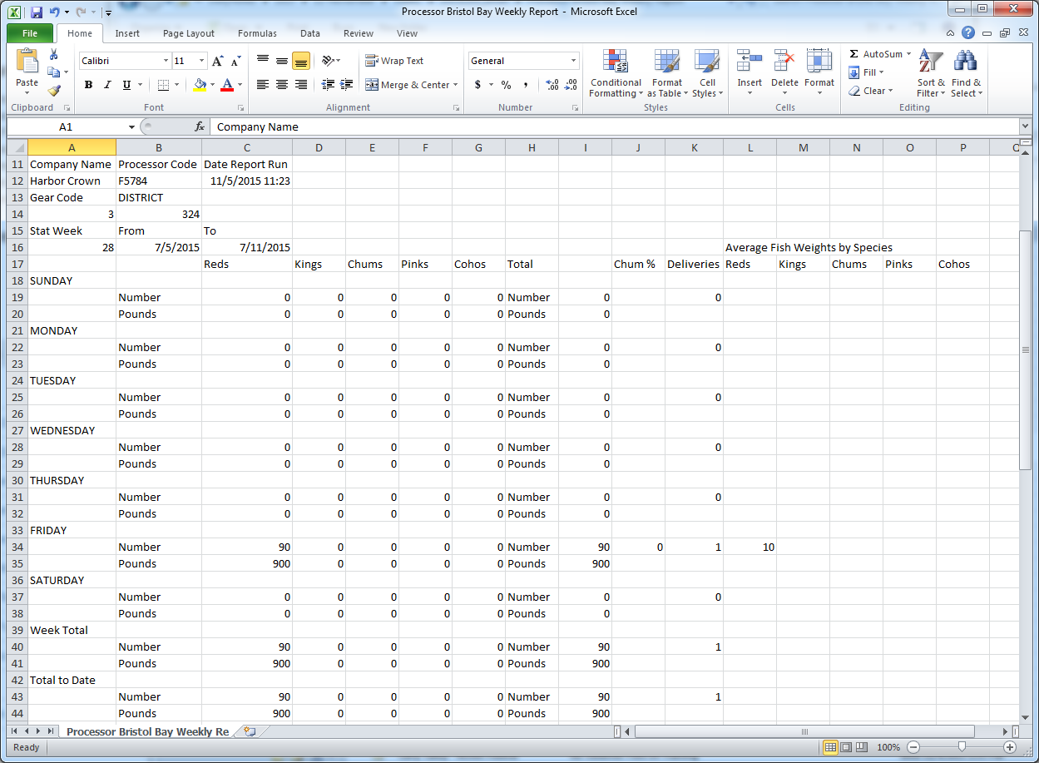

Slide 12
Why email?
Allows eLandings to process big requests one at a time.
Protects eLandings from trying to do too much at once

Slide 13
Why email? (Cont.)
Protects other users who are doing less costly activities on the server from Connection Timeouts

Slide 14
Mixed Salmon Update
The Bristol Bay Area Management allows fisherman to create Landings Reports with species 460 – Mixed Salmon.

Slide 15
Mixed Salmon Update (Cont.)
ADFG requires processors to figure out percentages of Chum, Pink, Red, and Coho
Requires the processors to replace species 460 with the true species and weights before final submit

Slide 16
In PTI import, set a tender batch

Slide 17
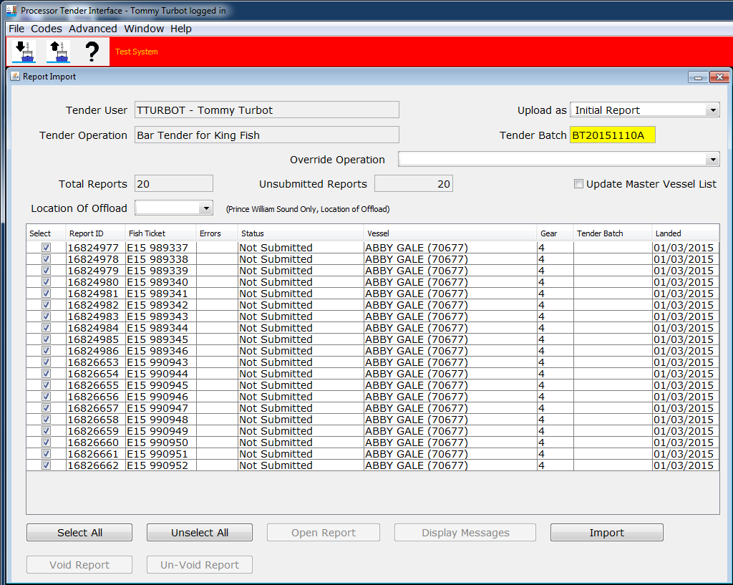

Slide 18
In the eLandings Web Pages

Slide 19
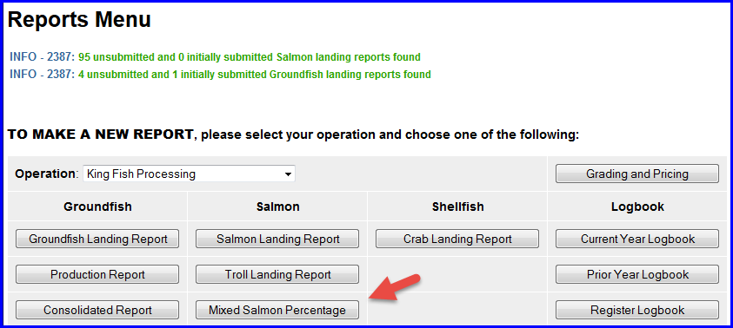

Slide 20
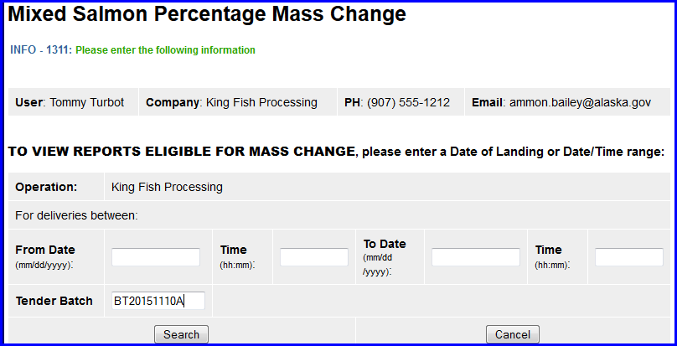

Slide 23
After Applying Chum Percentage
The tickets are automatically “Final Submitted” when you apply chum percent

Slide 24
Printing “Final” Tickets
You need to print out the “Final” version of the ticket and staple it to the front of the original signed ticket and send to ADFG

Slide 25
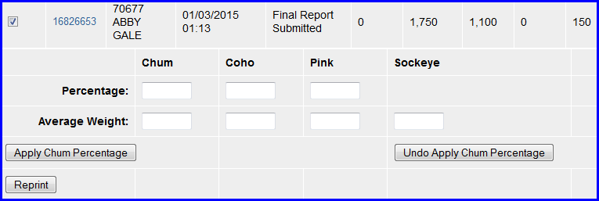

Slide 26
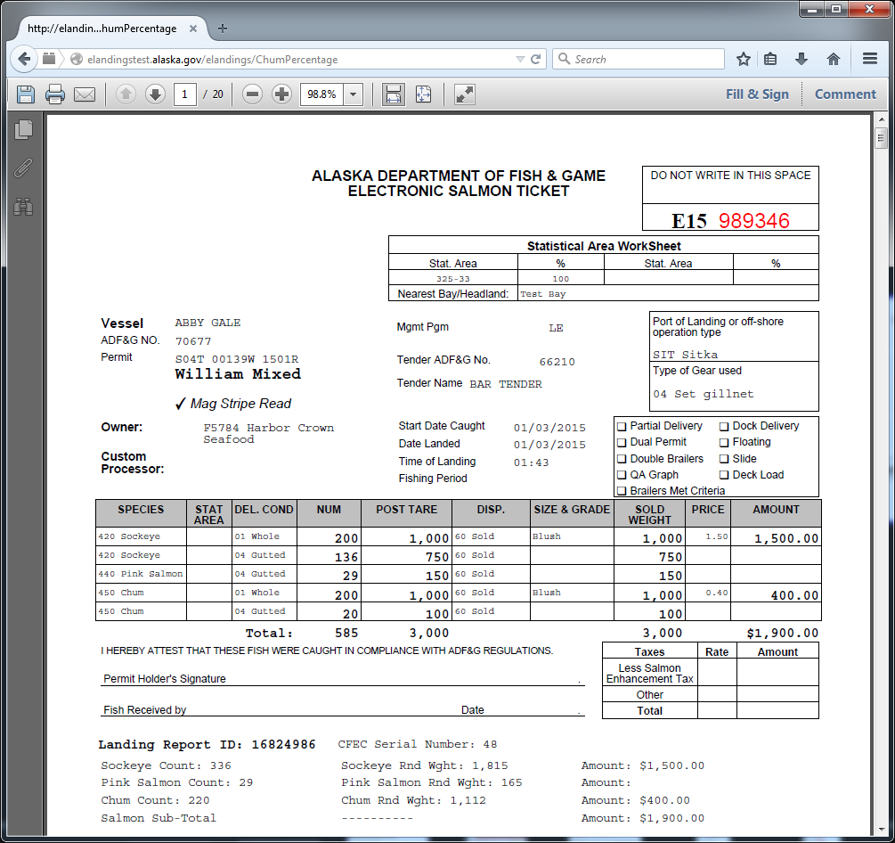

Slide 27
Undo Chum Percent
You can undo a Chum percentage as long as the ticket has not been edited in any other way.

Slide 29
Future Enhancement: Apply Chum Percentage as Queued Job and email Results?

Slide 30
Questions?

