Slide 1

eLandings for Salmon
2016
Gail Smith, ADF&G
Ammon Bailey, ADF&G
Jennifer Shriver, ADF&G
Suja Hall, NMFS

Slide 2

Welcome
Housekeeping
Breaks and snacks
Agenda review
Questions – ask if you do not understand!
Handouts

Slide 3

eLandings
eLandings =
Interagency Electronic Reporting System (IERS)

Slide 4



eLandings for Salmon Components
Processor-Tender Interface
Web-based application to configure thumb drives and upload landing reports
eLandings
Web-based reporting of landings
tLandings
Reporting from tender vessels via USB drive
eLandings Repository Database

Slide 5
eLandings System
eLandings Database stores:
    Your Operation licenses and permits
    Your User Accounts
    Species and pricing
    Catcher vessel list
    Your landing reports (fish ticket records)

Slide 6
eLandings System
tLandings Thumb drive stores:
    The tLandings application
    Your Operation licenses
    The Tender Vessel informtion
    Your user accounts to access the thumb drive
    Your species and catcher vessel list
    Unique landing report and fish ticket numbers
    and landing reports

Slide 7

eLandings System
Processor – Tender Interface (PTI)
  Web-based application
    Loads data on thumb drive – license/permits, user accounts, vessel and species information and unique numbers
    Allows you to view & correct reports
    Allows you to assign a tender batch ID
    After the tender trip – uploads report

Slide 8
eLandings System
tLandings application
    Loaded on the thumb drive
    Used by tenders, buying stations and even office locations to report salmon and groundfish landings
    Each configured thumb drive is unique to tender
    Generates tender reports:
        Species summary
        Species/statarea summary
        Tender trip log report
    Does not require the internet

Slide 9
eLandings System
Establish Operation and user accounts
Download PTI and establish vessel and species list
Configure thumb drives and distribute to tenders

Slide 10
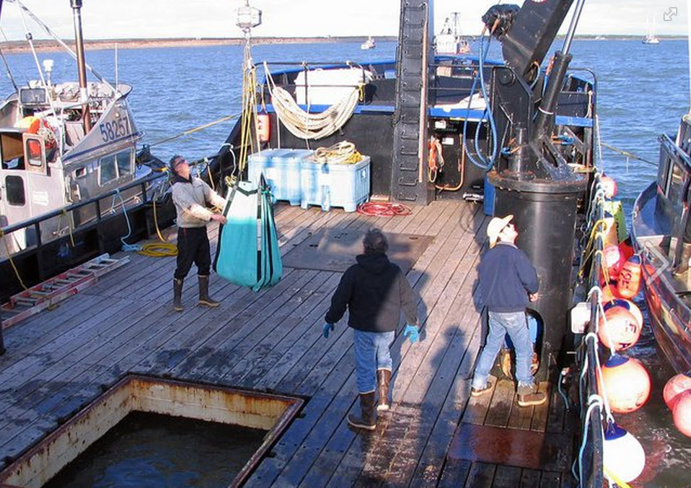
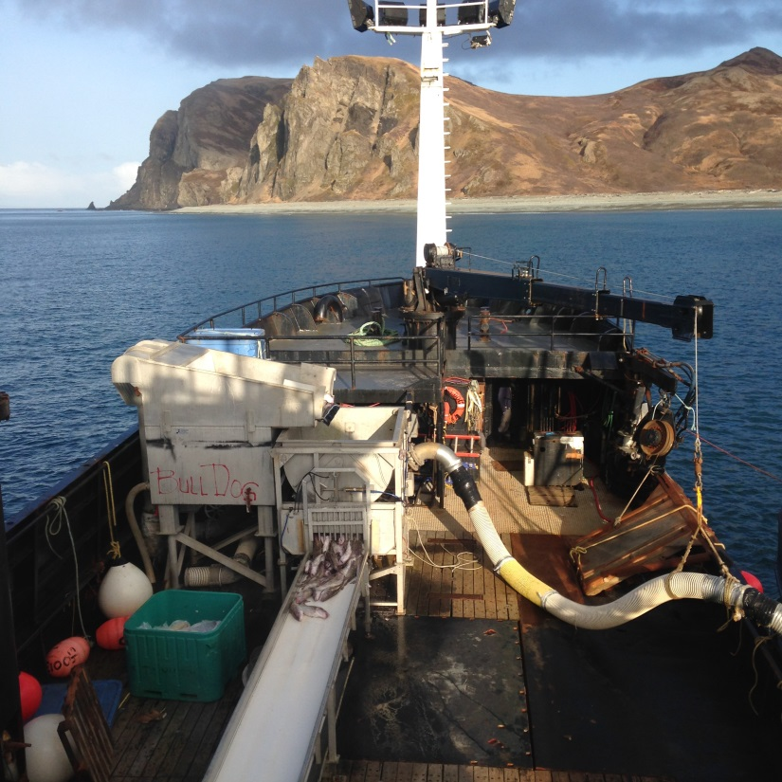
eLandings System
Record landings – salmon or groundfish

Slide 11
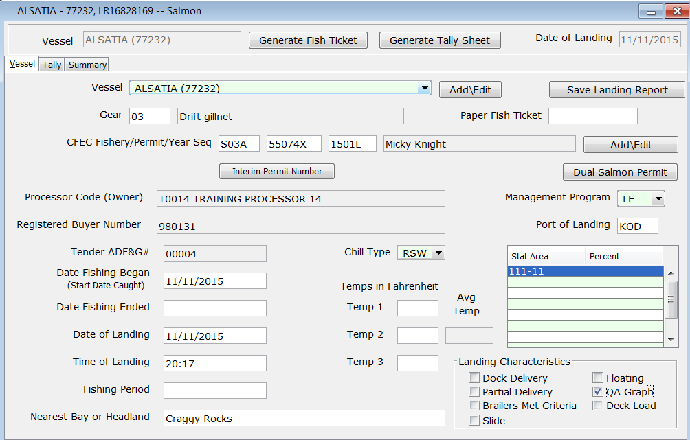

Slide 12
eLandings System
Tender Operator generates Tender Trip Log Report
Returns signed copies of fish tickets and thumb drive to seafood office
Office staff review landings in PTI and upload data to eLandings Database

Slide 13
eLandings System
Re-configure thumb drives
Distribute to tenders
Create landing reports in tLandings
Provide fish ticket copies and thumb drive to office
Upload landing reports into eLandings database

Slide 14
eLandings System
Equipment
Office
        Workstation to install PTI
        Thumb drives (Provided by ADF&G)
Tender
        Inexpensive laptop computer
        Inexpensive B/W laser printer
        Magnetic card swipe

Slide 15

Operations and User Accounts
It all starts here…..

