Slide 1
How To Get Help
Specific seaLandings issues – elandings@alaska.gov
General seaLandings questions, not time sensitive - elandings@alaska.gov
After normal business hours IFQ issues –
(800) 304-4846 Option #1
Complex IFQ Questions – elandings@Alaska.gov
Salmon Questions – Carole.Triem@alaska.gov

Slide 2
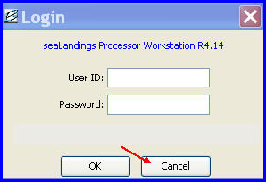
How to change your password
Notify eLandings support of your intent to change your password. We have to change it in the Agency Web as well
Open seaLandings on your workstation
Do not login, click on Cancel instead
On your toolbar go to Configuration…Users

Slide 3
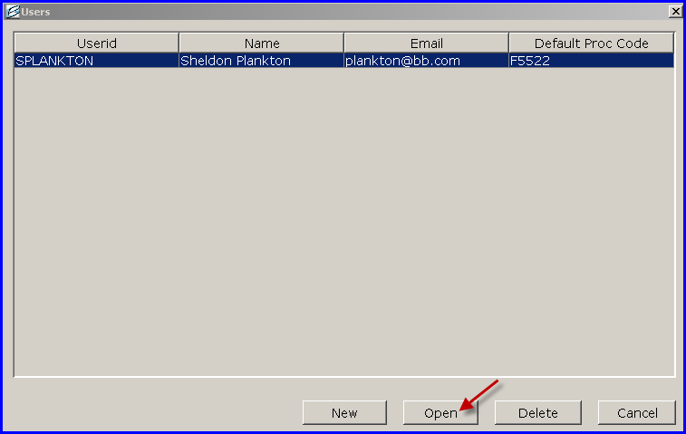
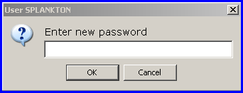
Highlight the user whose password you want to change & click Open
Click Reset Password
You will be prompted to enter your new password twice
Click OK
shellfish

Slide 4
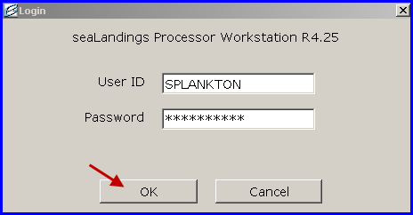
Make sure all dialog boxes are closed
Go t0 File… Login
Enter your User ID and old Password
Click OK
Now you will need to transmit your user file for the change to take effect

Slide 5
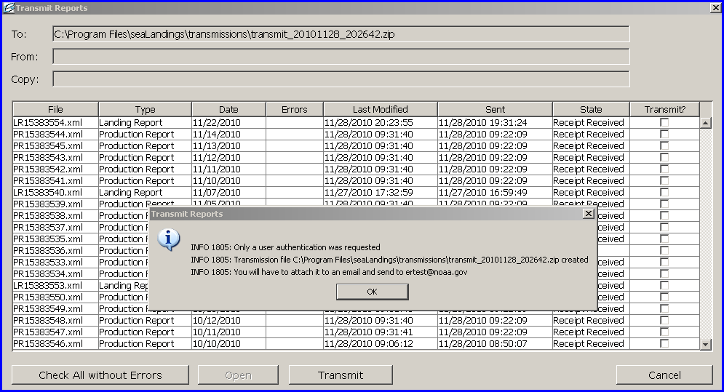
Go to Reporting… Transmit Reports
Make sure no boxes are checked and click on Transmit
Attach the transmission file to an email addressed to elecrep@noaa.gov
Process the return receipt
Go to File… Login and try out your new password

Slide 6
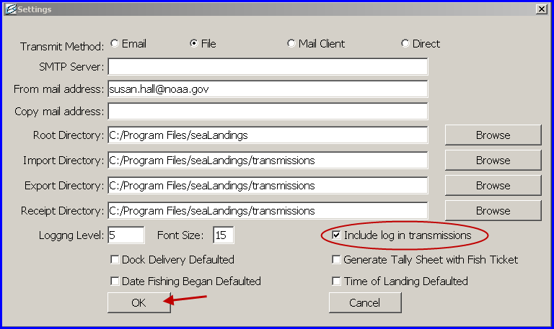
How to Send your Log File
On your toolbar go to Configuration…Settings
Check the box next the Include log in transmissions box.
Next time you transmit a report, the log file will accompany it.

